Slide 1
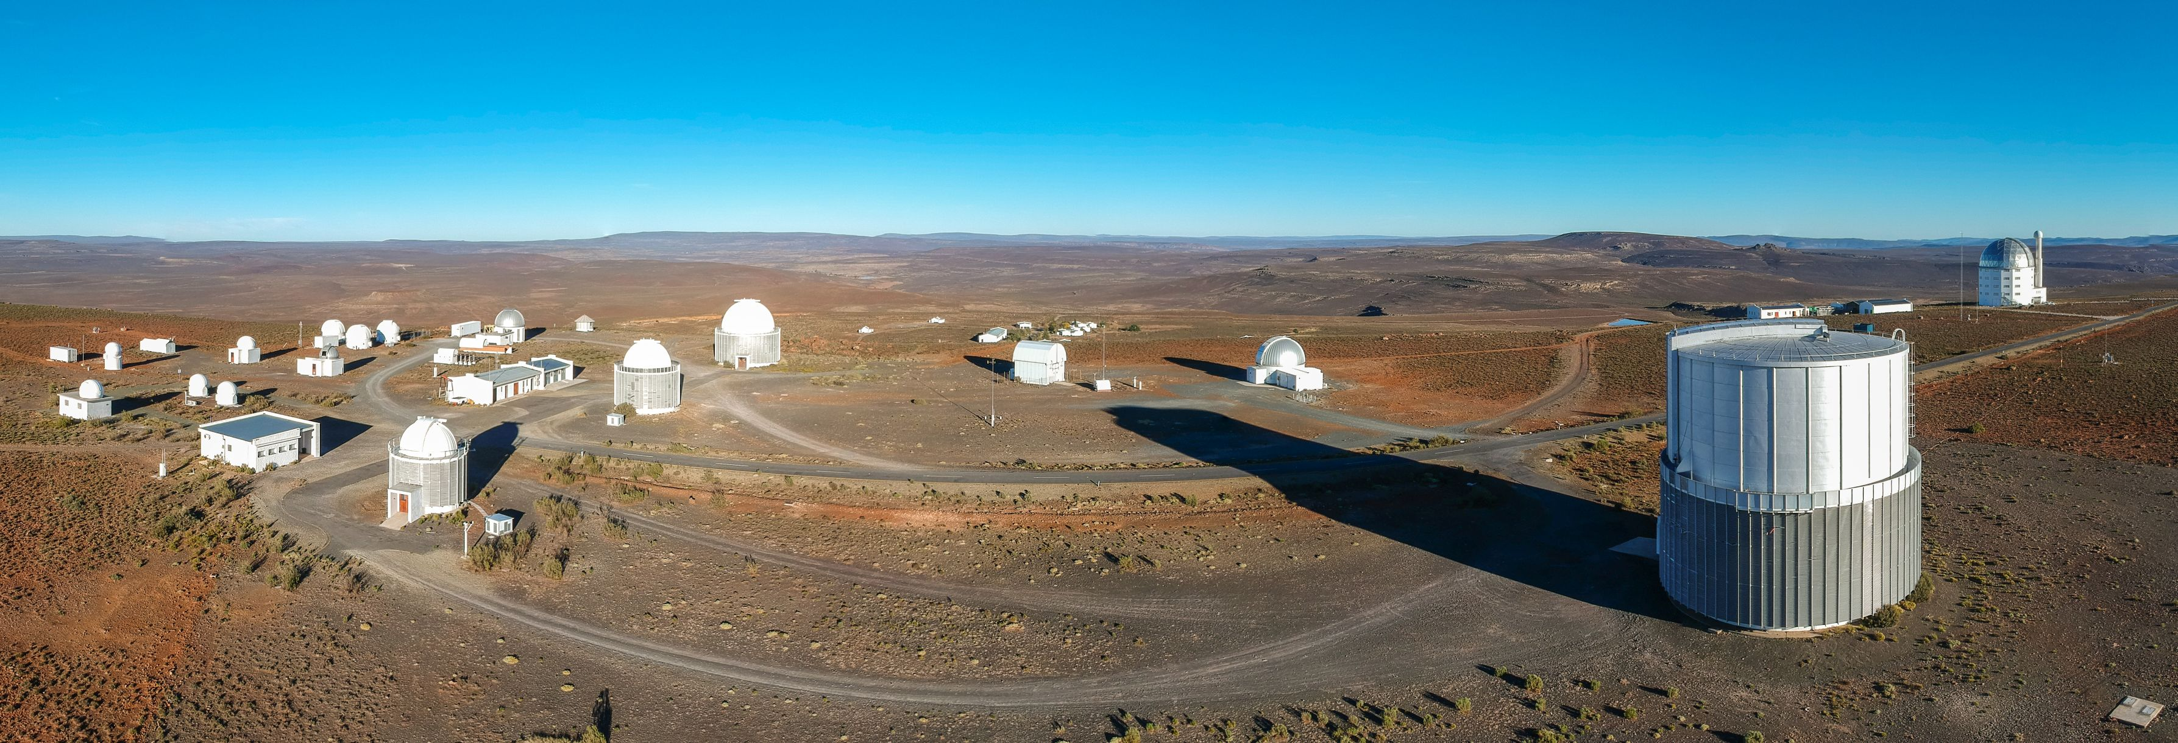
The Intelligent Observatory
SAAO, SARAO (NRF)
Stephen Potter
SAAO, UJ

Slide 2
The Intelligent Observatory
What is multi-messenger Astronomy
SAAO’s story during the GW170817 Event
IO Vision Why, What, How
Telescopes
Data
IO Vision: current status

Slide 3
GW170817: South African follow-up

Slide 4
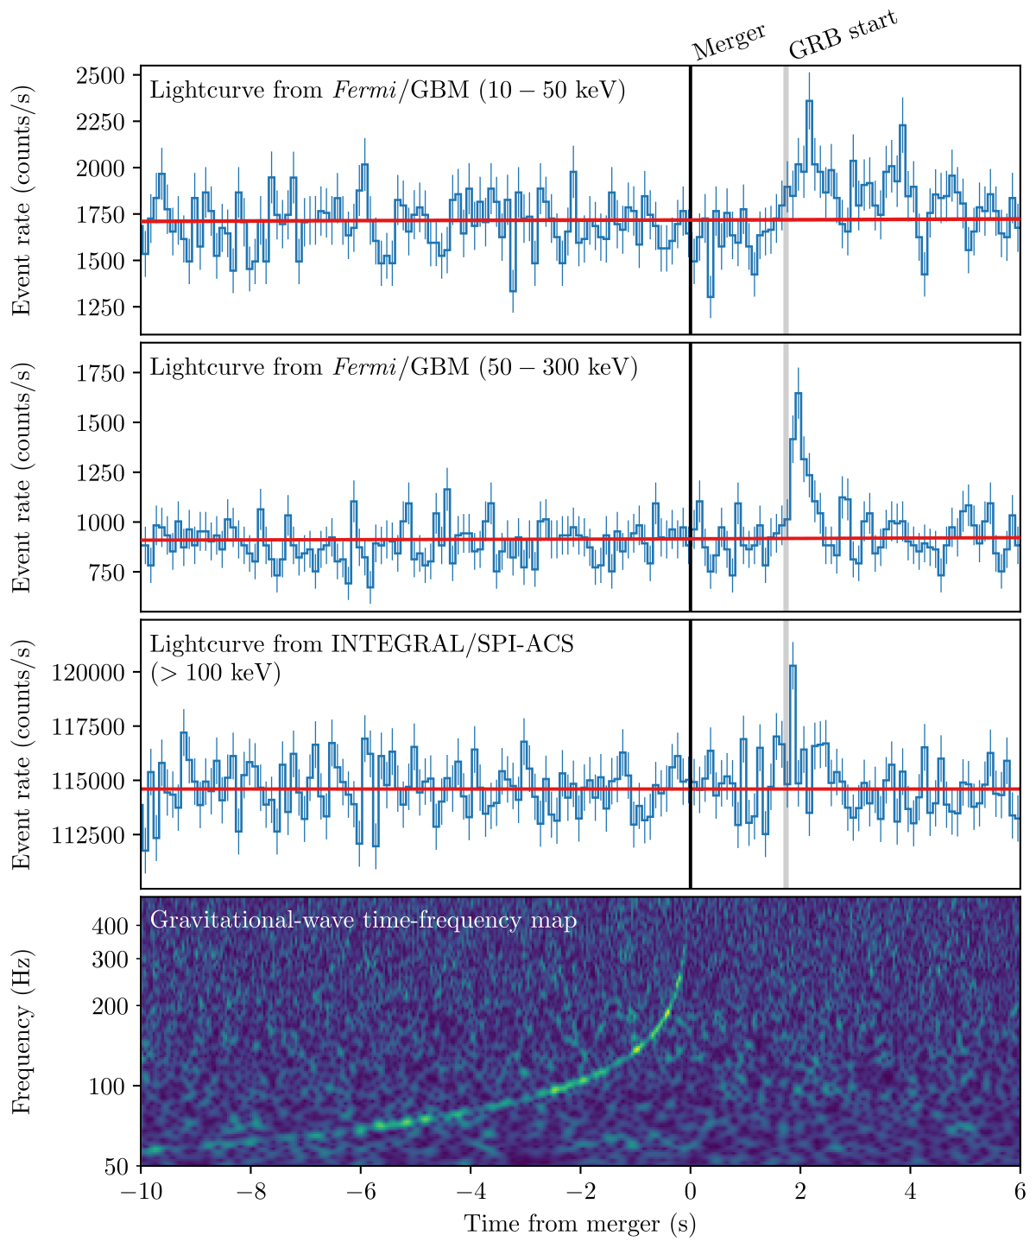
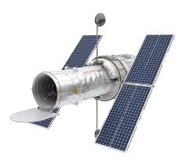
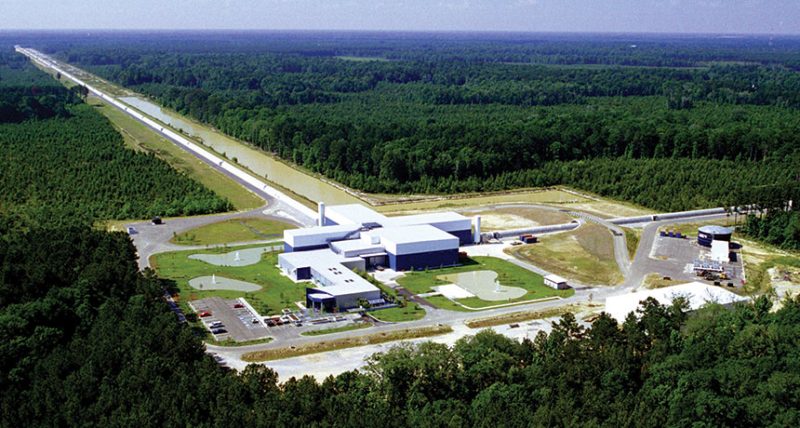

Slide 5
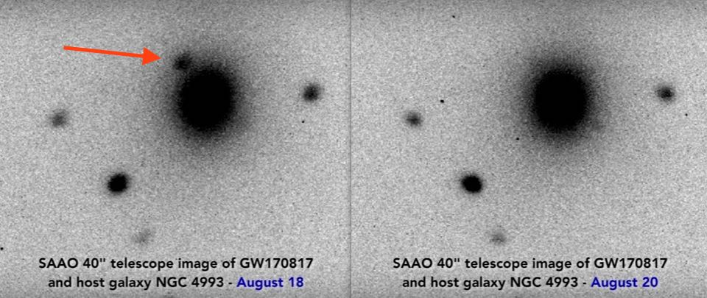

Slide 6
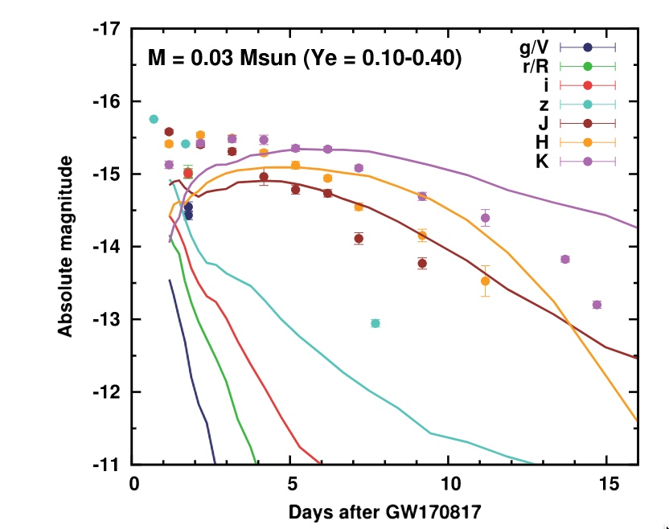
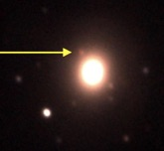
SAAO IRSF (JHK)

Slide 7
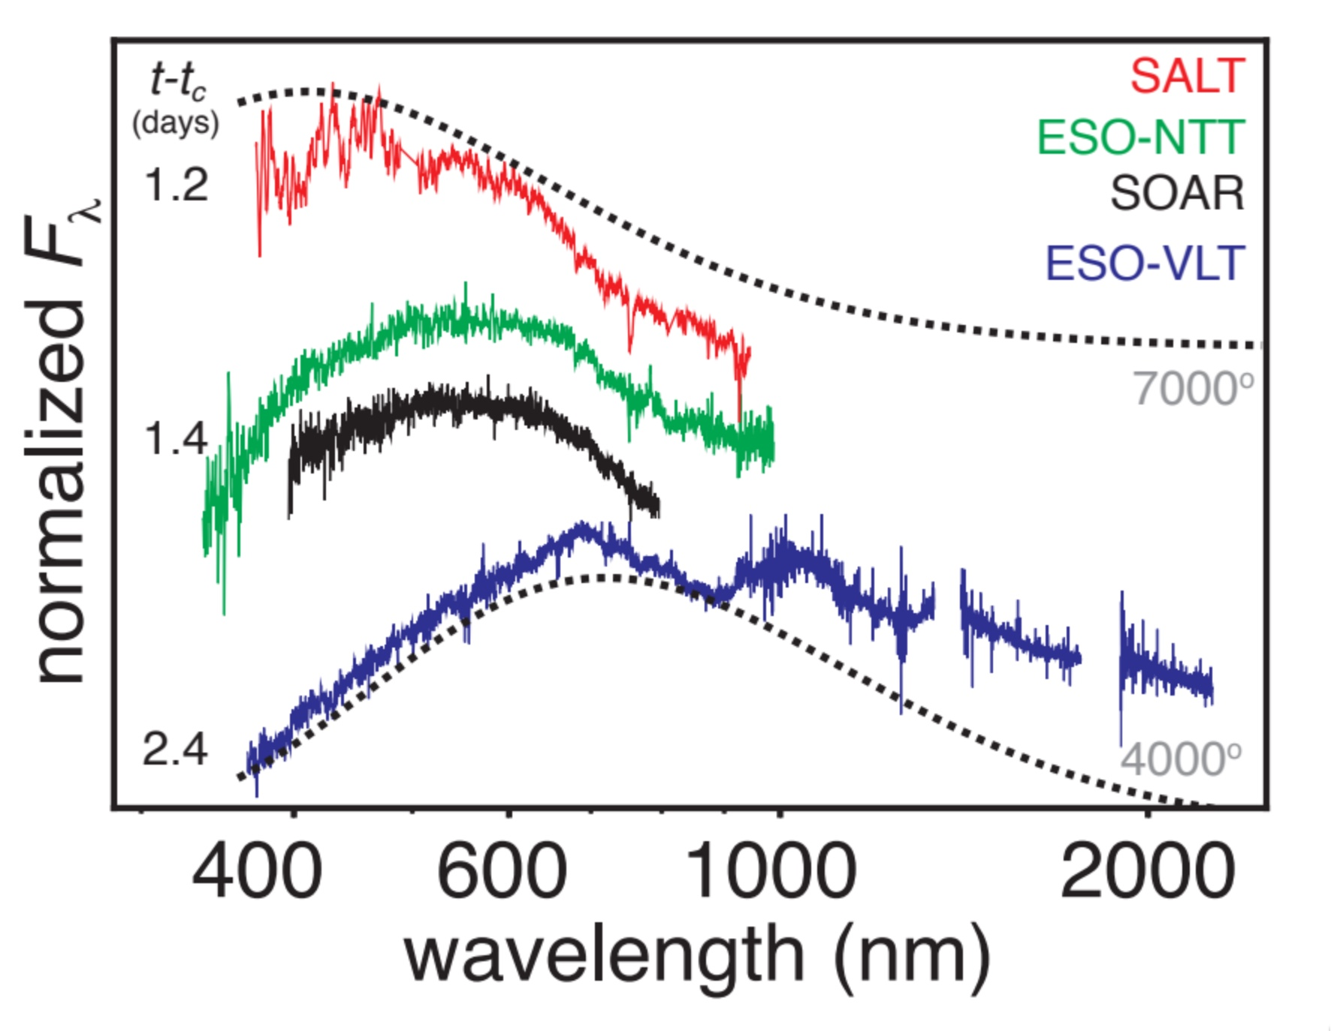

Slide 8
Multi-messenger Observations of a Binary Neutron Star Merger,
2017ApJ…848L..12A, 3677 Authors

Slide 9
Intelligent Observatory (IO) Vision
To better serve the community/users: (Why)
All telescopes integrated into an the IO (What)
Coordinated science across telescopes in the era of multi-messenger astronomy
Respond to alerts, computer generated requests, automation, robotisation
Advance SAAO into the 4IR

Slide 10
How

Slide 11
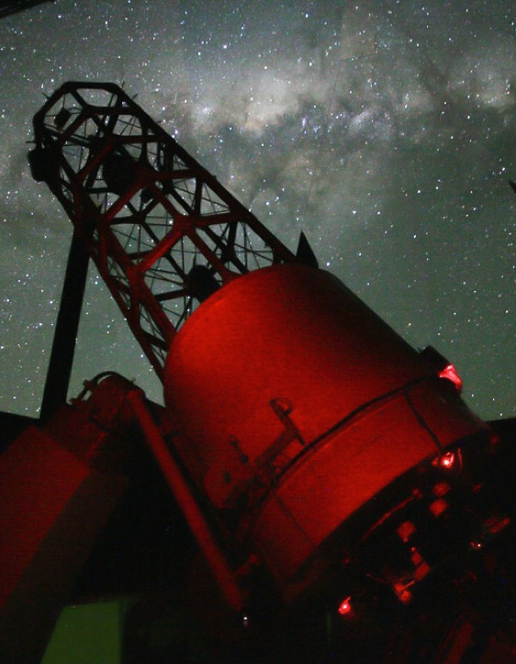
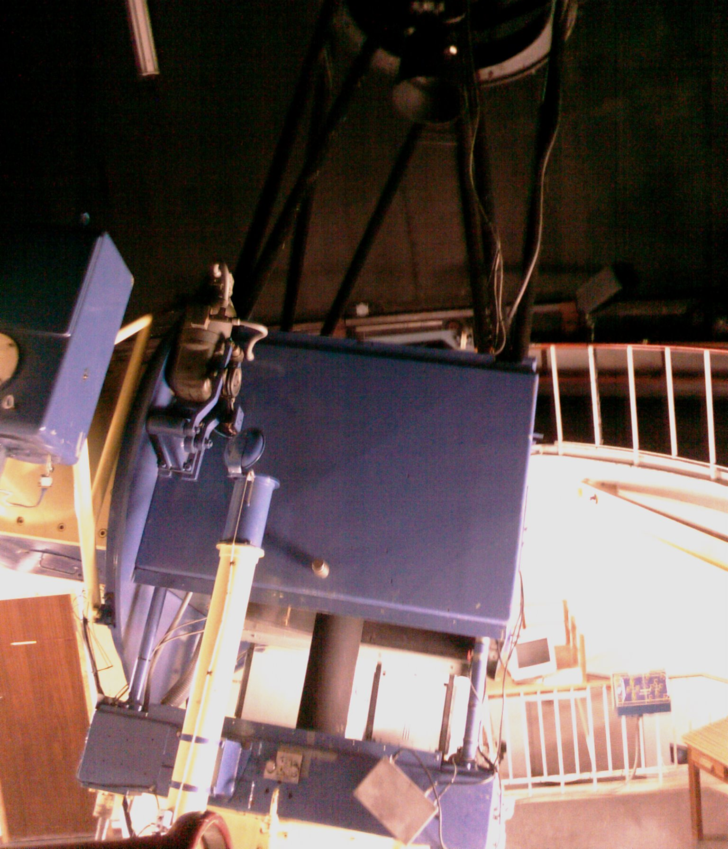
Telescopes 1.9m and 1.0m
In-house control electronics AND software
PLC, C, python, C++
Instruments (imagers, spectrogragh, polarimeter)
In-house control electronics AND software
C, python, C++

Slide 12
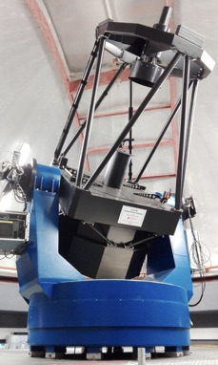
Telescope 1.0m
3rd party control software
Instruments (imagers, spectrogragh)
In-house
Software in partnership with collaborators

Slide 13
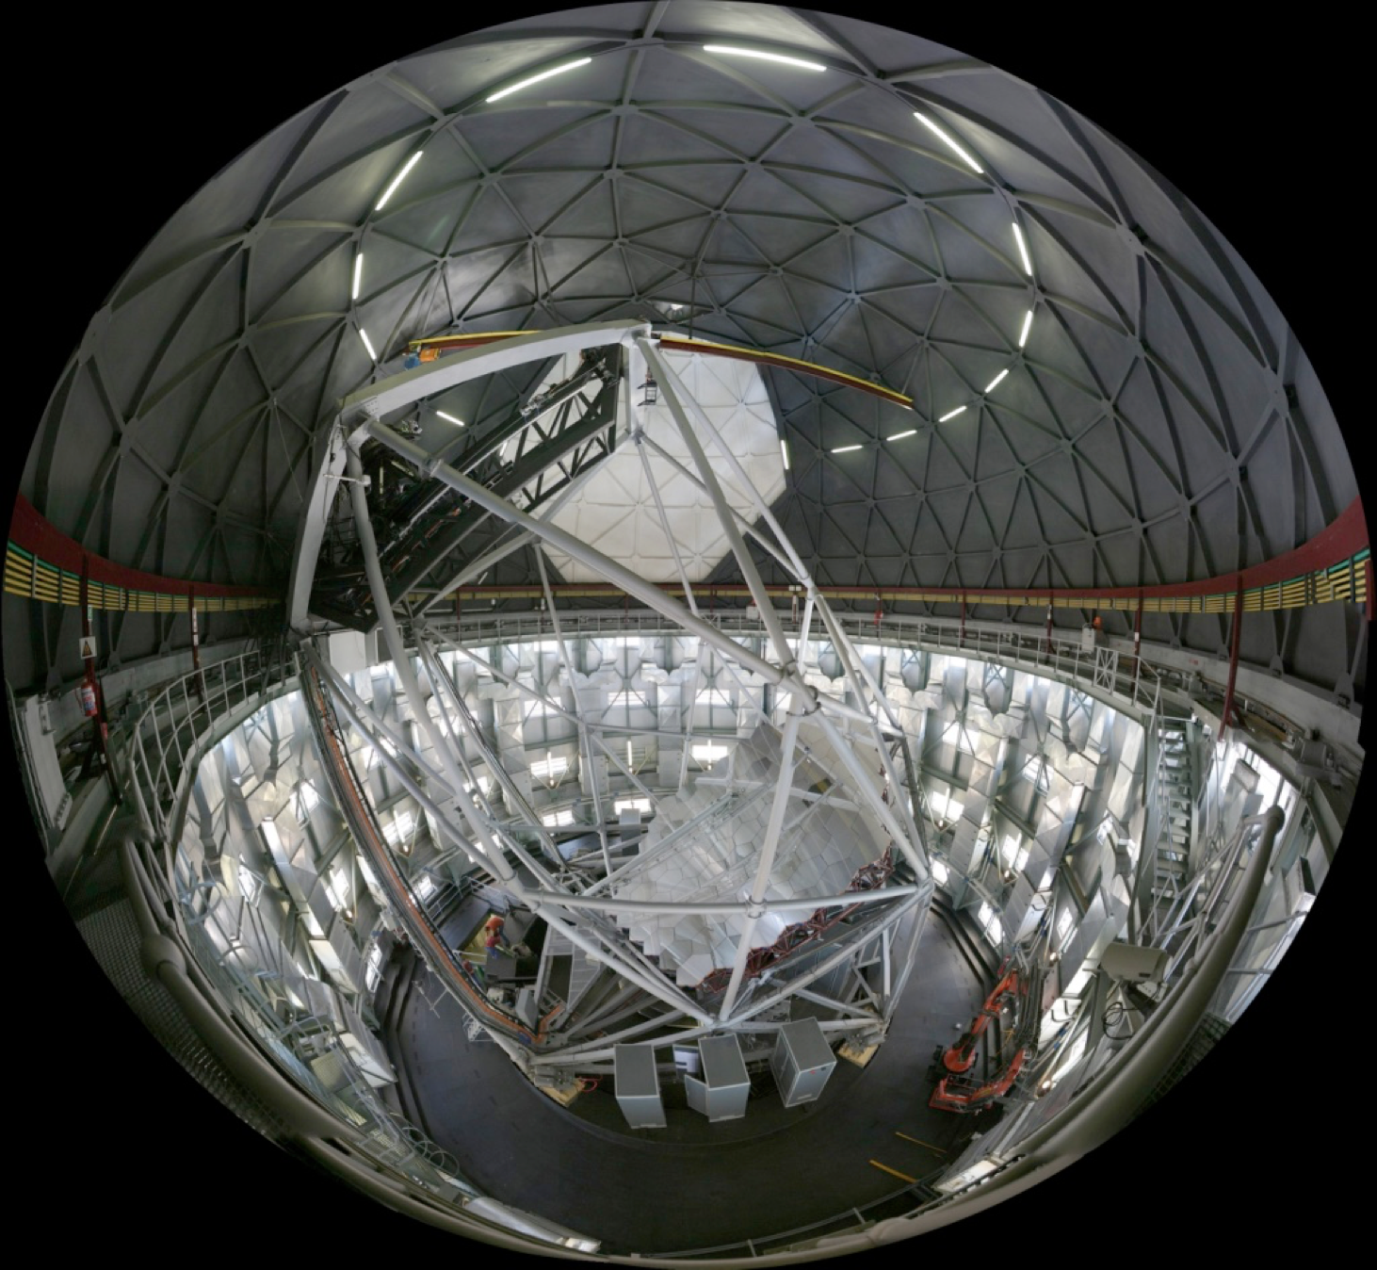
Telescope; Southern Africa Large Telescoe
In-house contracted software engineers (labview)
Instruments (imagers, spectrogragh, polarimeter)
In-house and partners
Service observing
Data bases (data - proposals)
Planning tools
Submission tools
Instrument pipelines and reduction tools
Data analysis

Slide 14
Telescope
In-house contracted software engineers (labview)
Instruments (imagers, spectrogragh, polarimeter)
In-house and partners
Service observing
Data bases (data - proposals)
Planning tools
Submission tools
Instrument pipelines and reduction tools
Data analysis

Slide 15
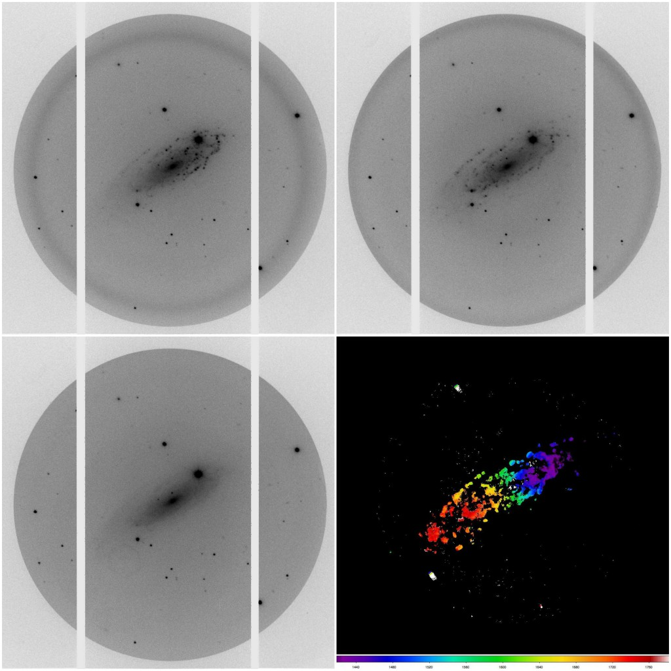

Slide 16
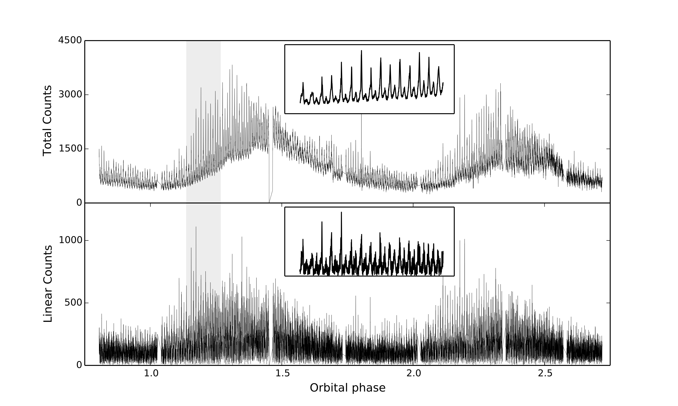

Slide 17
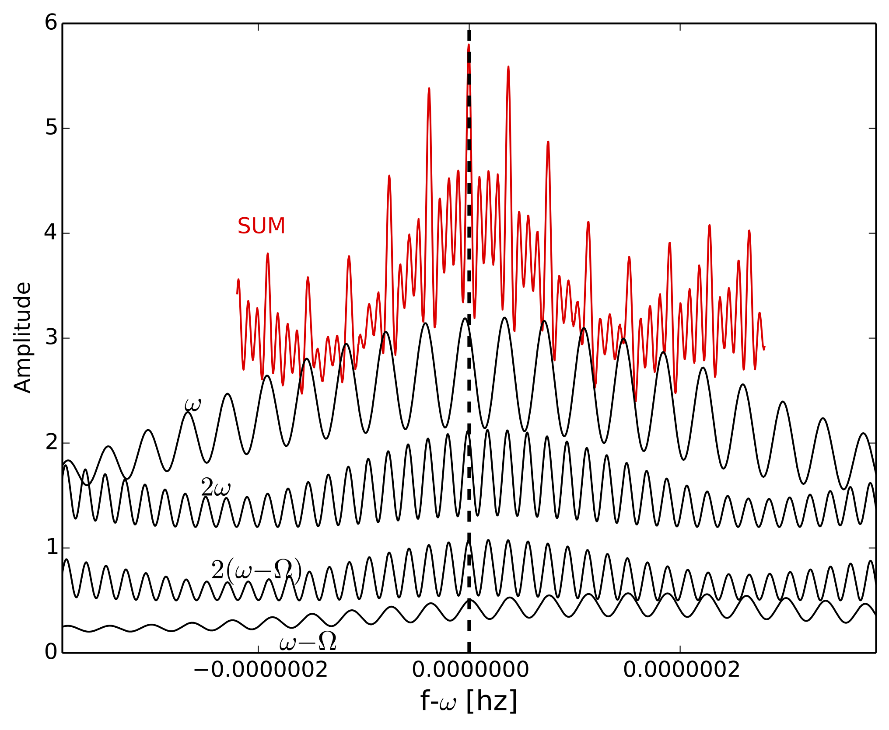
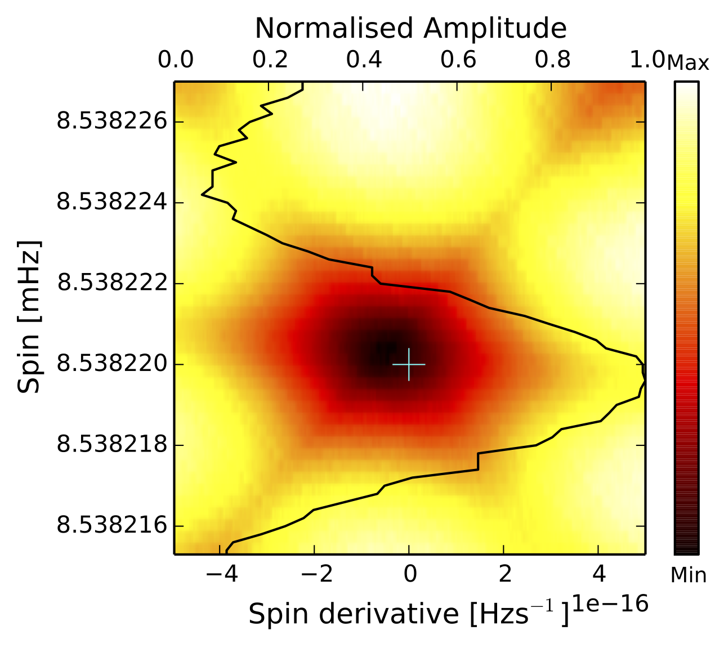

Slide 18
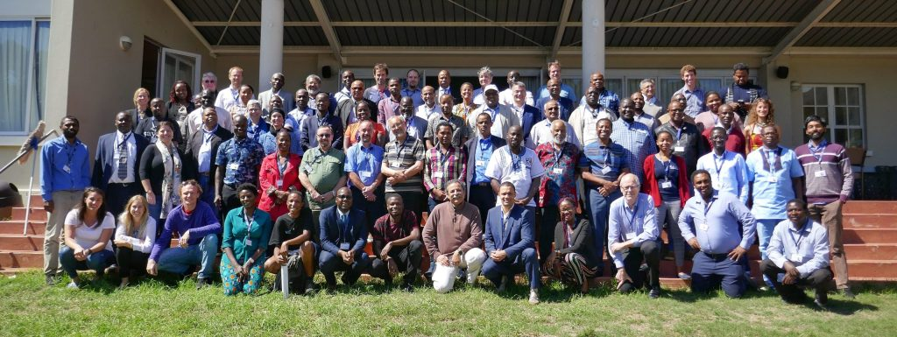
Intelligent Observatory (IO) Vision

Slide 19
IO Vision
Remote
Observing

Slide 20
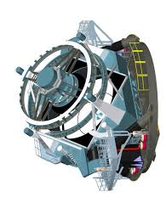
IO Vision

Slide 21
IO Vision
Central Control System IO

Slide 22
Central Control System IO
Astronomy operations
Software algorithms (AI)
Queue schedulers
Alert systems
Real time data analysis
Proposal management
Data management

Slide 23
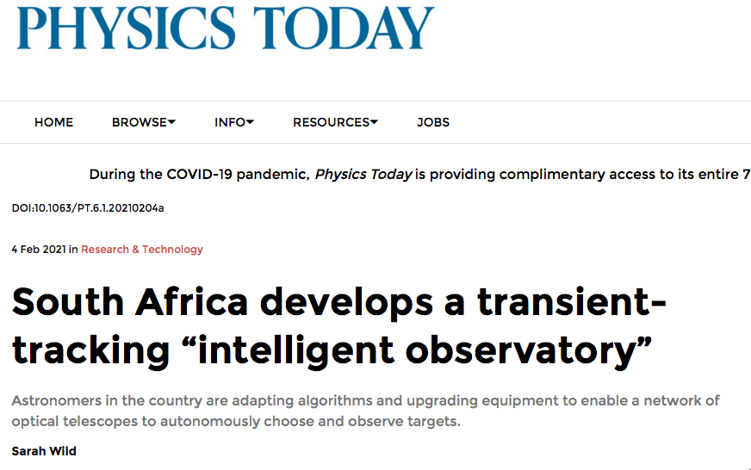
https://io.saao.ac.za/

Slide 24
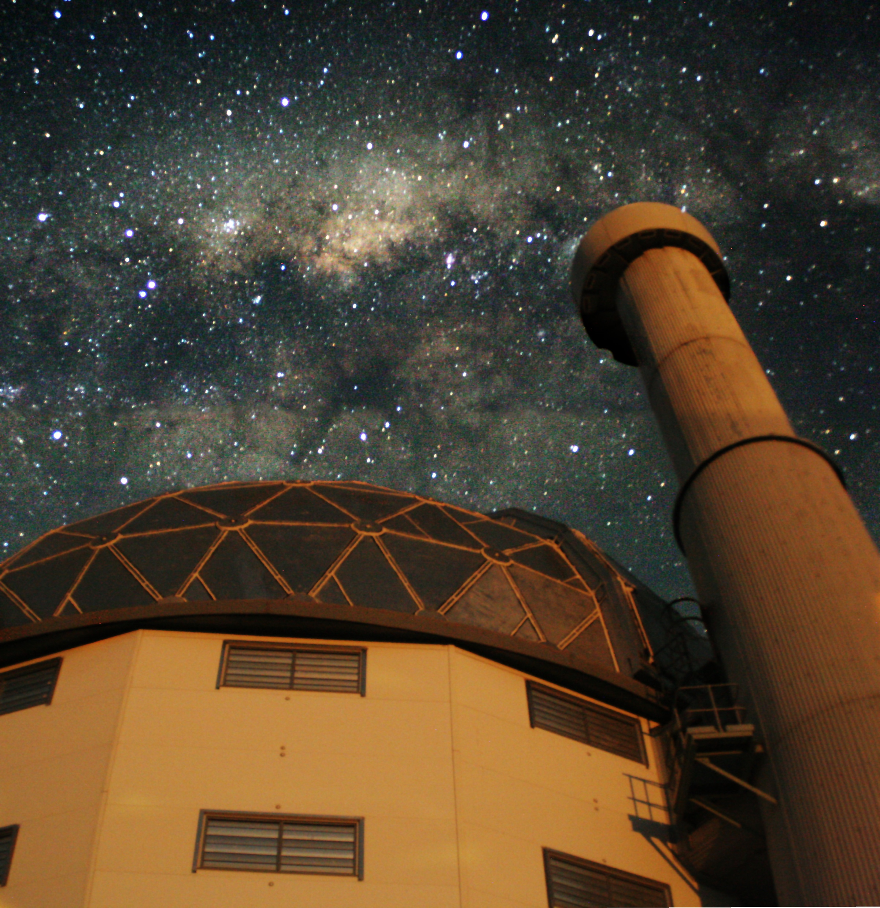
Thankyou
https://io.saao.ac.za/
sbp@saao.ac.za
sbp@nrf.saao.ac.za

