Slide 1
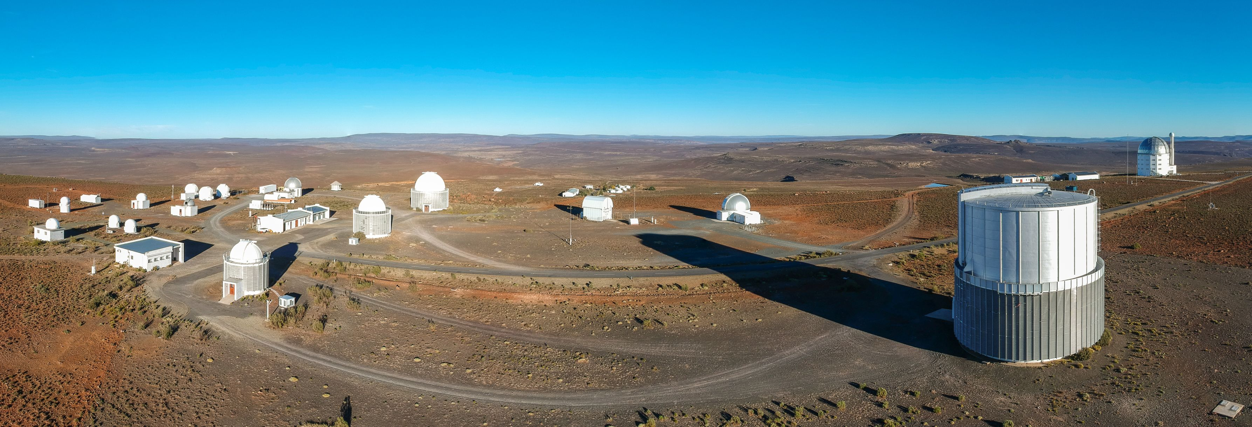
South African Astronomical Observatory
The Intelligent Observatory
SAAO, SARAO (NRF)
Stephen Potter (SAAO, UJ)

Slide 2
IO Vision
To better serve the community/users:
Submit proposals/observation requests at any time
Science on any time scale (not restricted to 1 week blocks)
Observe from Sutherland, Cape Town or anywhere
Observe manually, queue or service
Respond to alerts, computer generated requests
Enhance our national and international partnerships
All telescopes integrated into an the IO
Coordinated science across telescopes in the era of multi-messenger astronomy
Advance SAAO into the 4IR
Building upon communication technologies, automation, intelligent algorithms

Slide 3
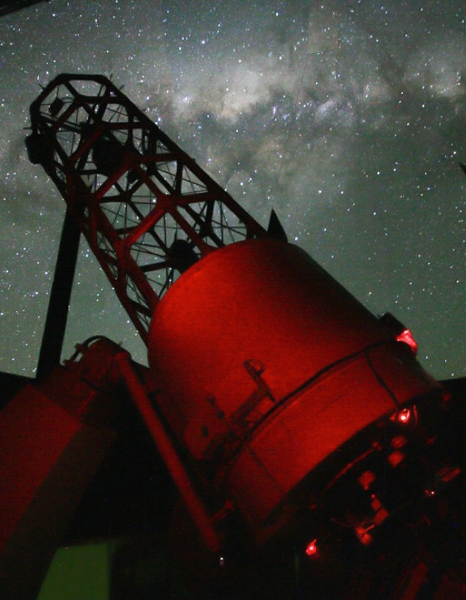
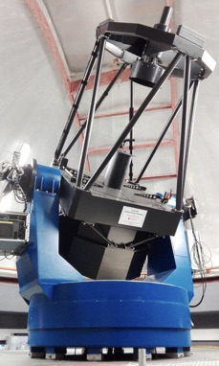
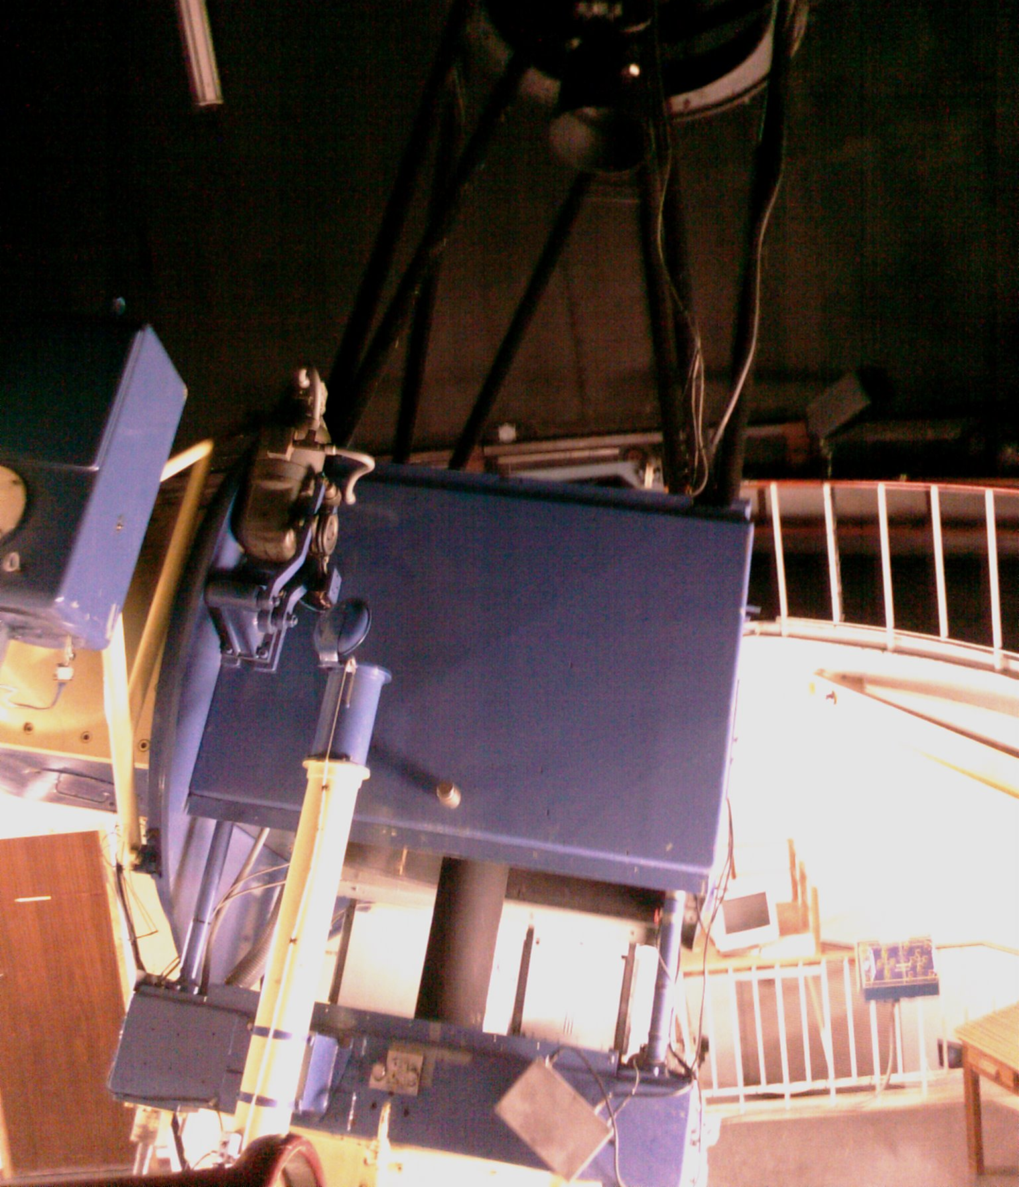
Telescopes 1.9m and 2 x 1.0m
Spectrographs
Polarimeters
Imagers
High-speed imagers

Slide 4
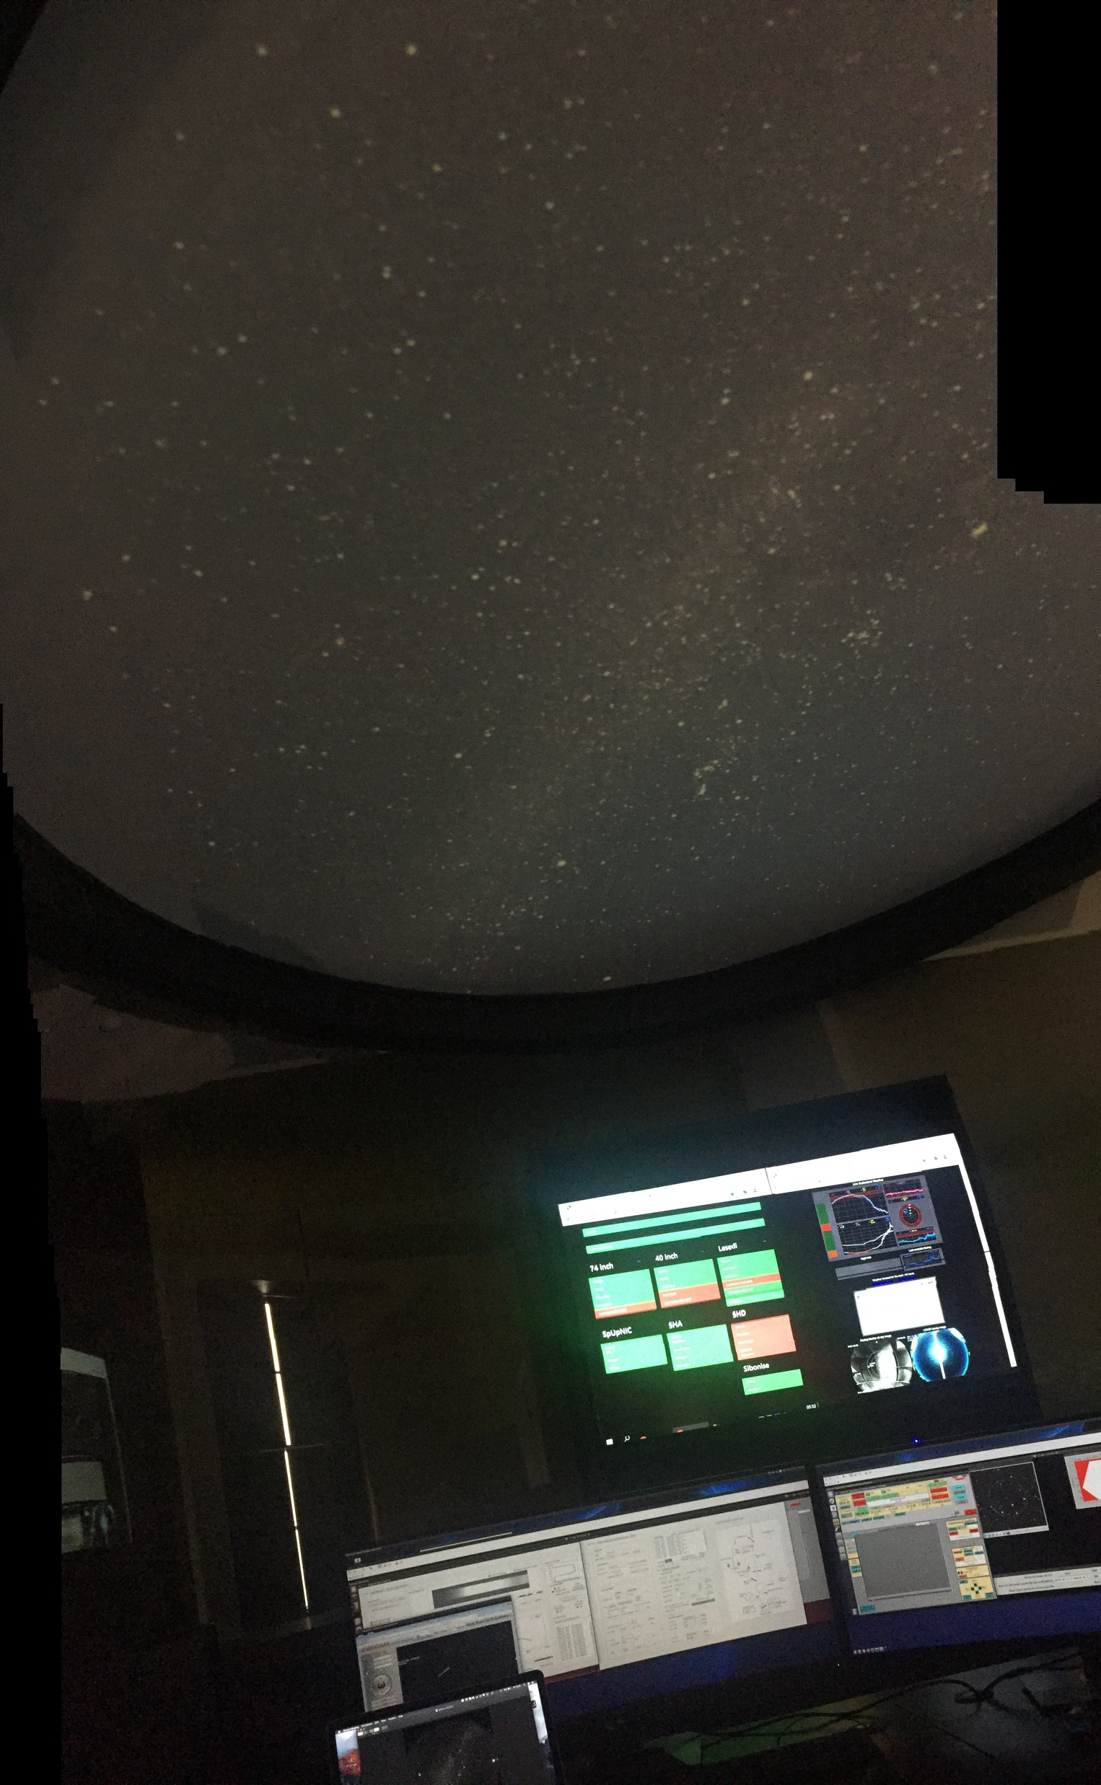
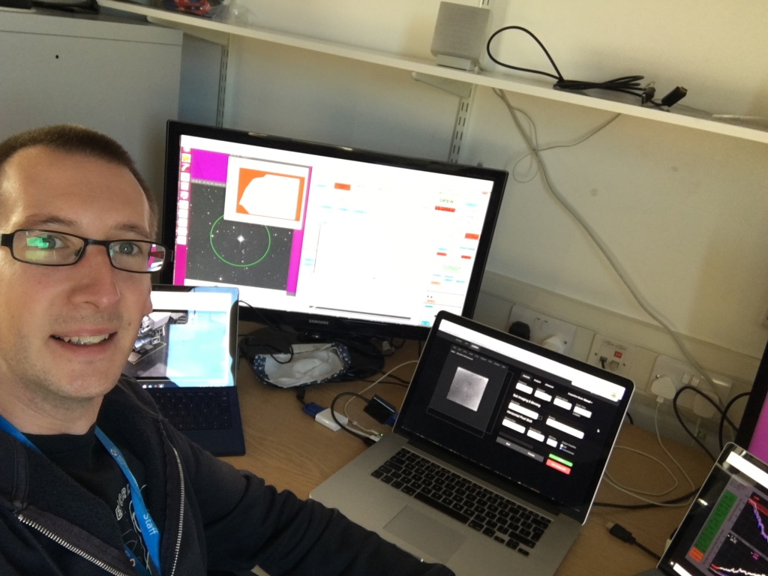
Remote Observing

Slide 5
Telescopes 1.9m and 2 x 1.0m
Spectrographs
Polarimeters
Imagers
High-speed imagers

Slide 6
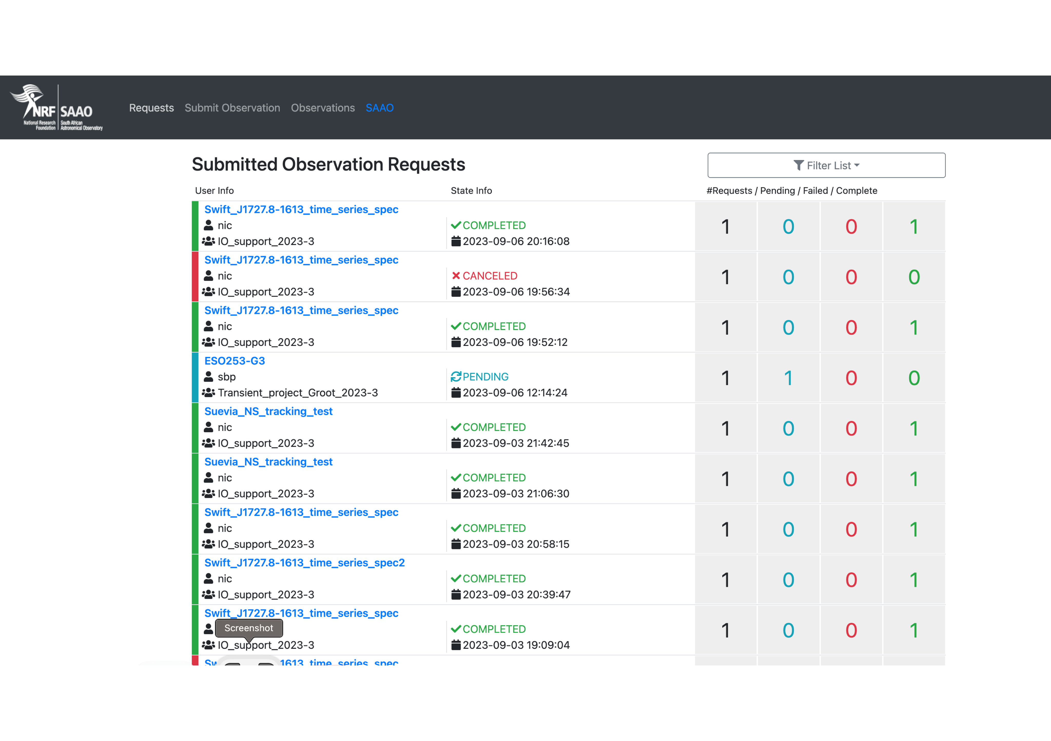
Observatory Control System (OCS)

Slide 7
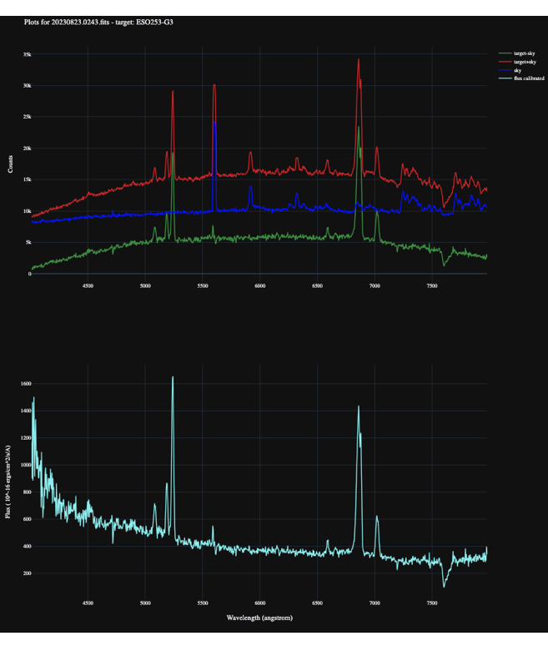

Slide 8
ATLAS -> LESEDI PROGRAMATICALLY
We have triggered on 145 new discoveries since early January of which 88 were successfully robotically observed with Lesedi. Of those 88 we submitted astrometry in time for 71 to be part of the official MPEC (IAU).

Slide 9
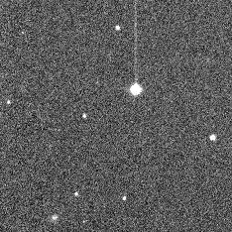
Double Asteroid Redirection Test (DART) was a NASA space mission aimed at testing a method of planetary defense against near-Earth objects (NEOs). It was designed to assess how much a spacecraft impact deflects an asteroid through its transfer of momentum when hitting the asteroid head-on.
On Sept. 26, 2022, DART impacted the asteroid moonlet Dimorphos, a small body just 530 feet (160 meters) in diameter. It orbits a larger, 2,560-foot (780-meter) asteroid called Didymos.

Slide 10
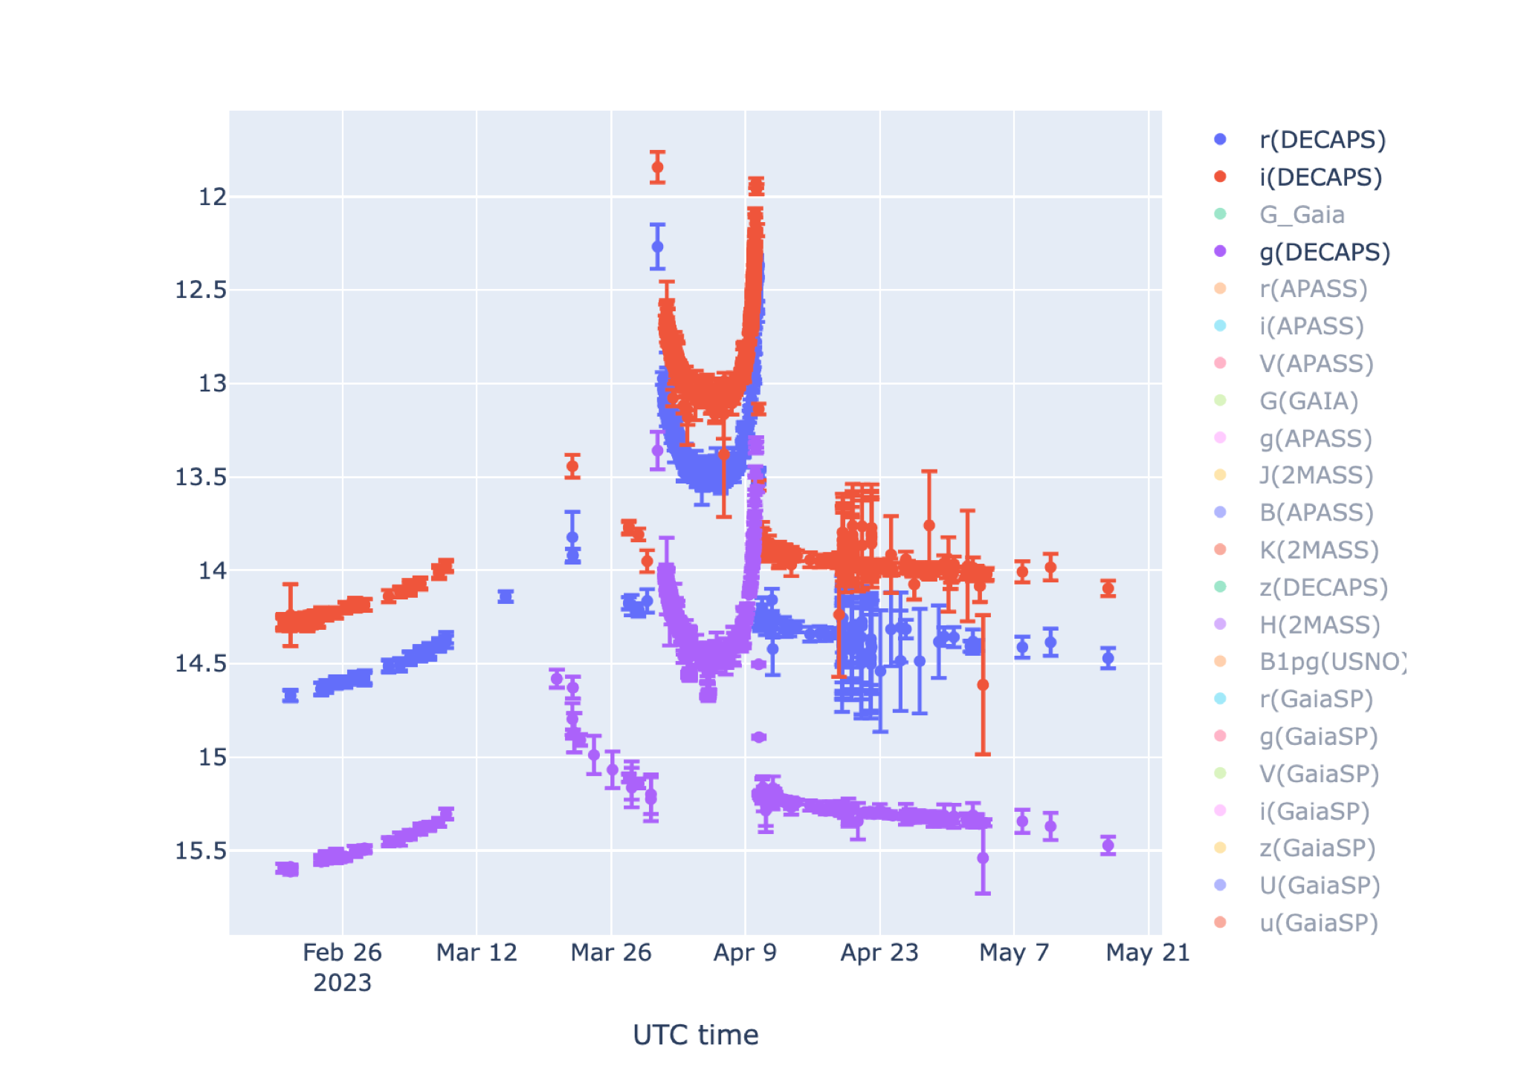

Slide 11
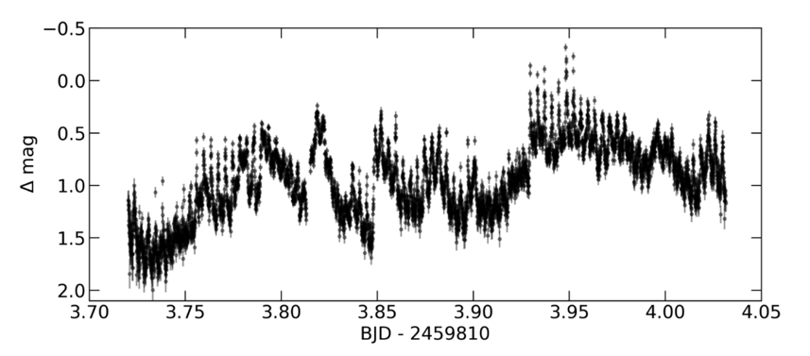

Slide 12
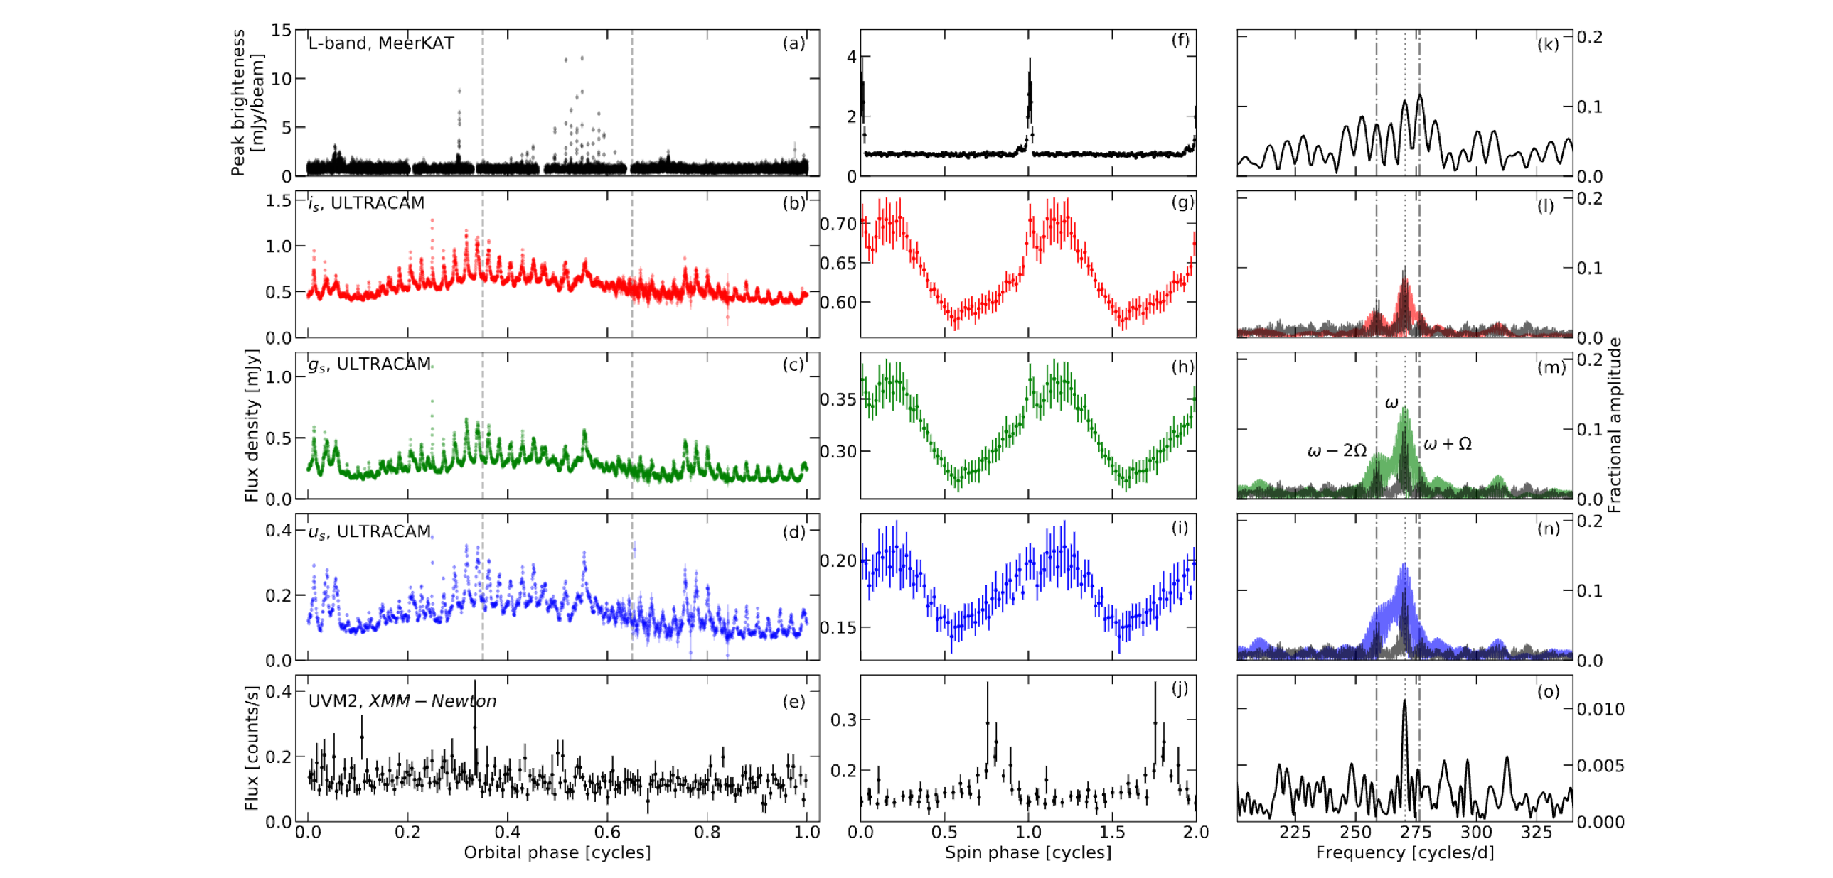
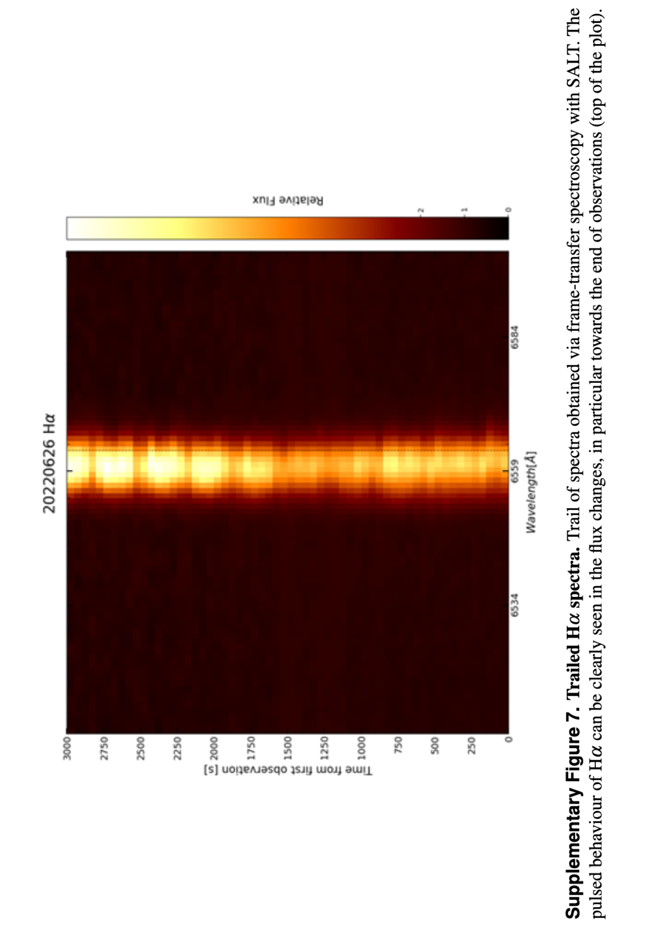
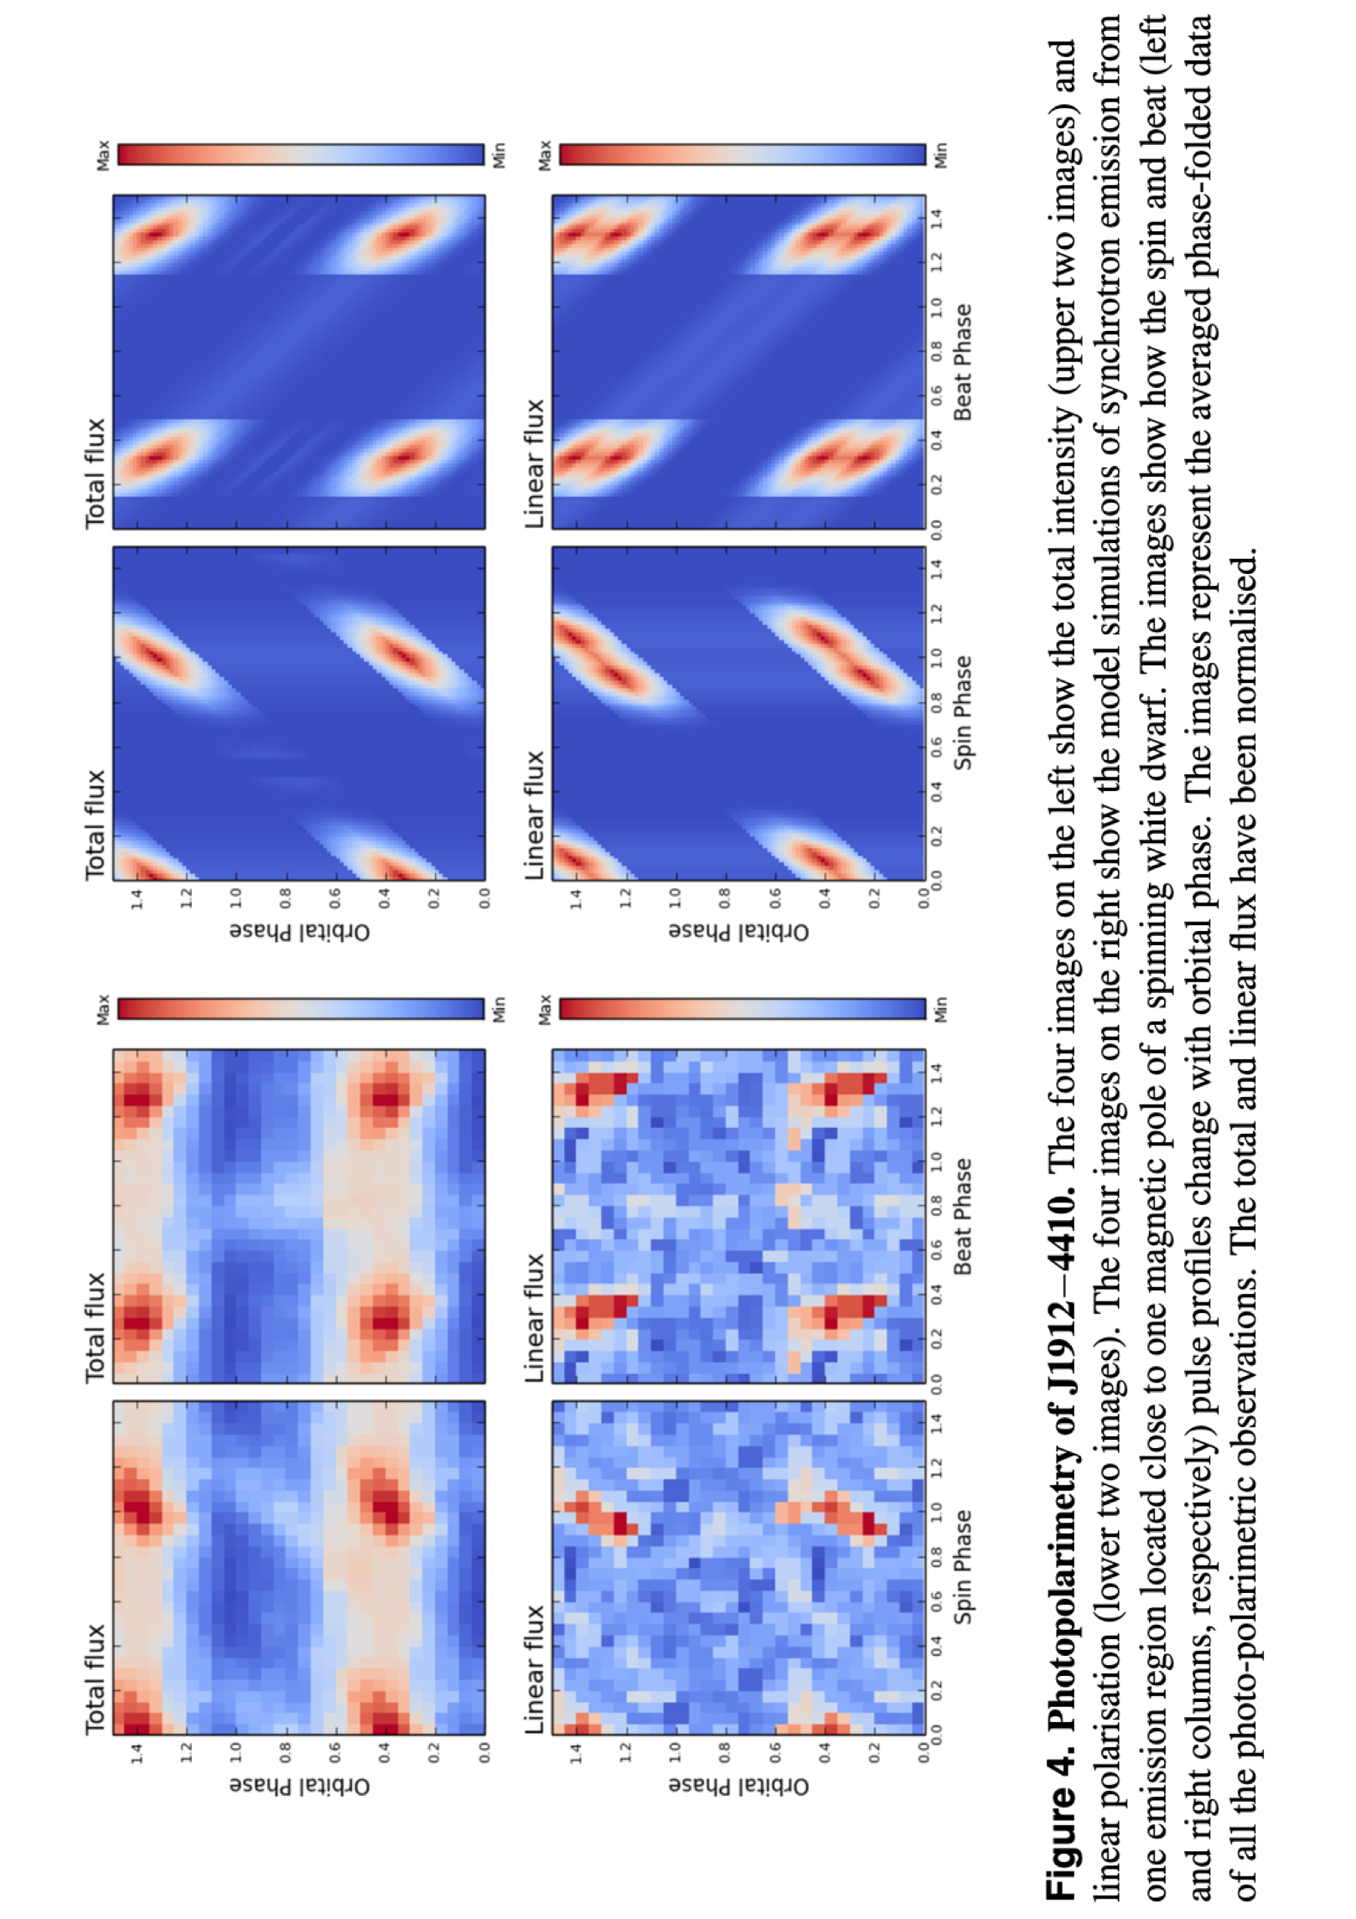
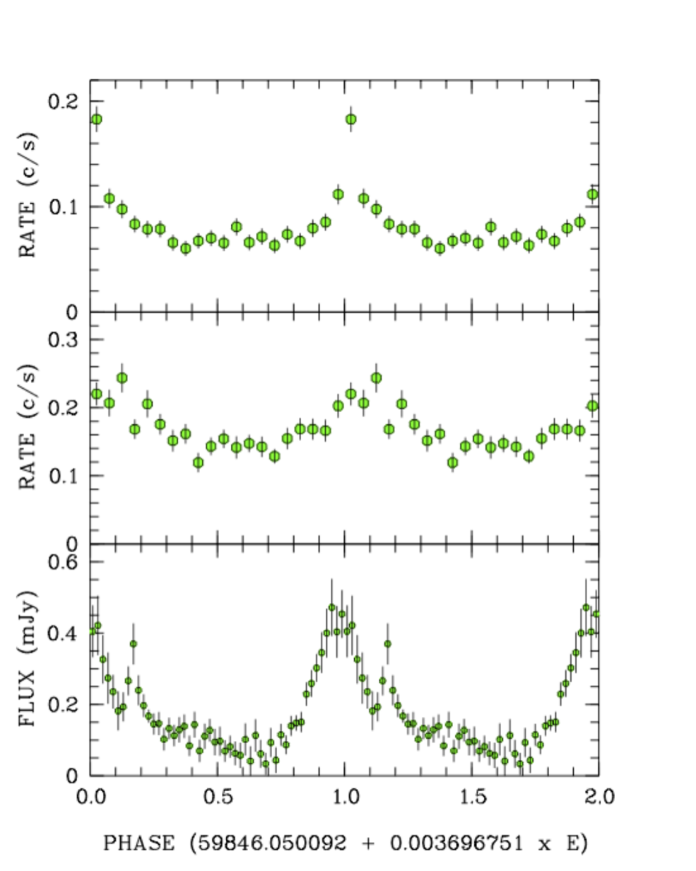
Schwope, A. et al.
2023A&A...674L...9S
Pelisoli, I. et al.
2023NatAs...7..931P

Slide 13
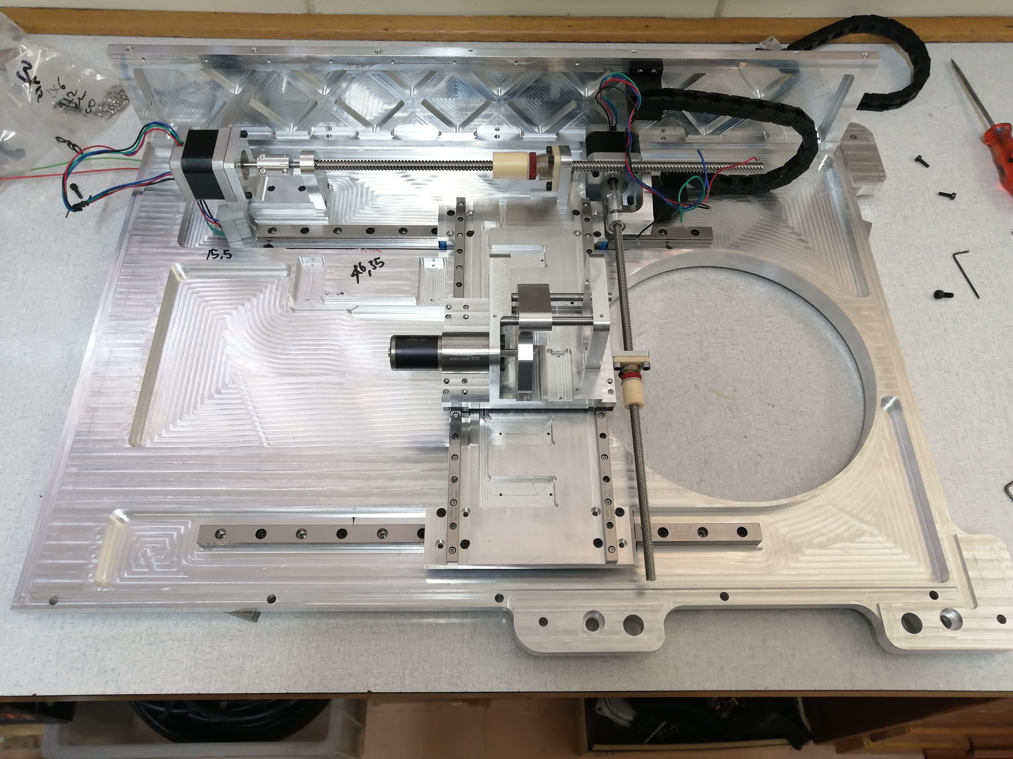
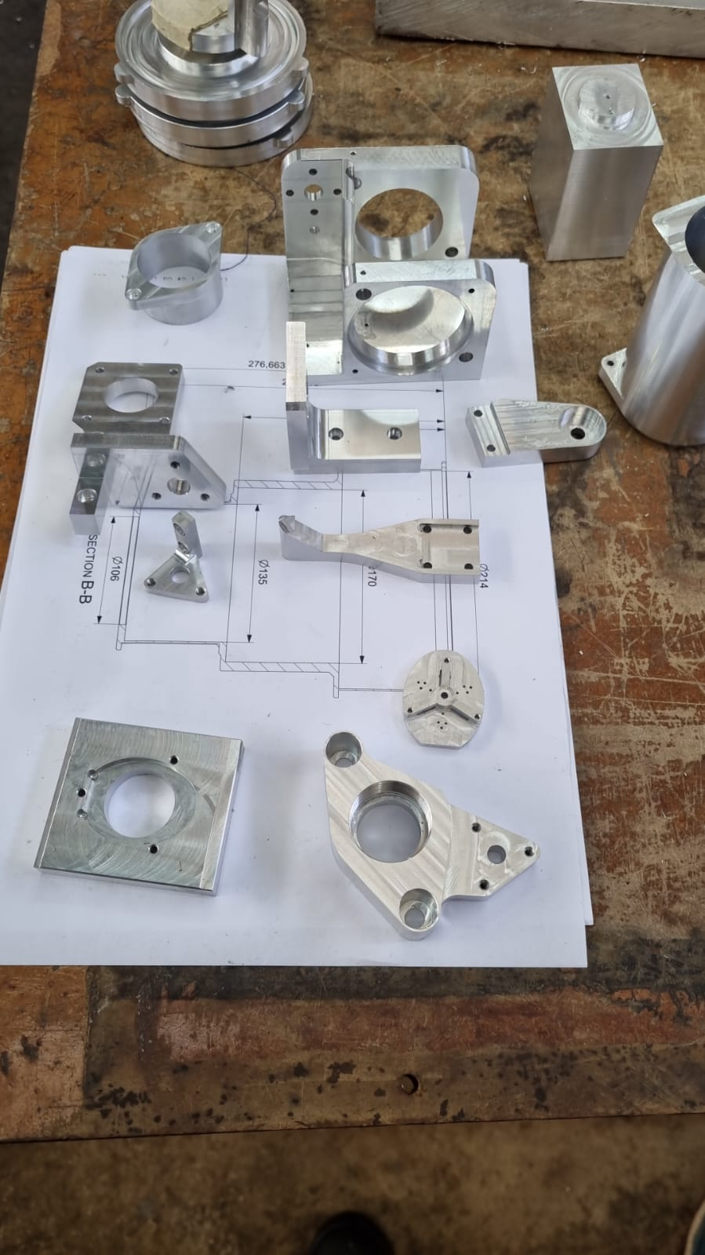
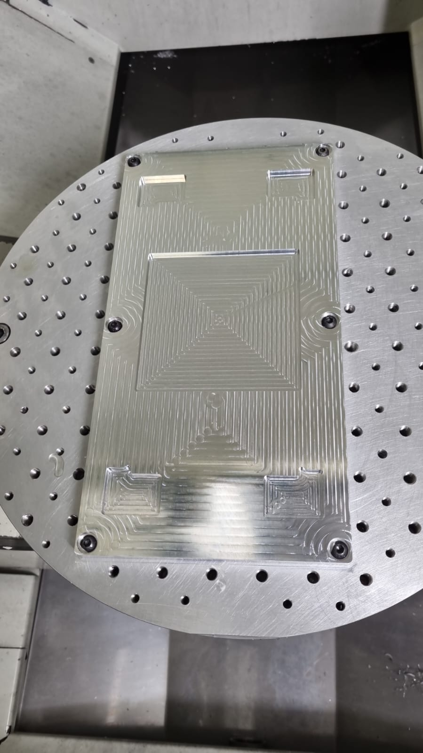
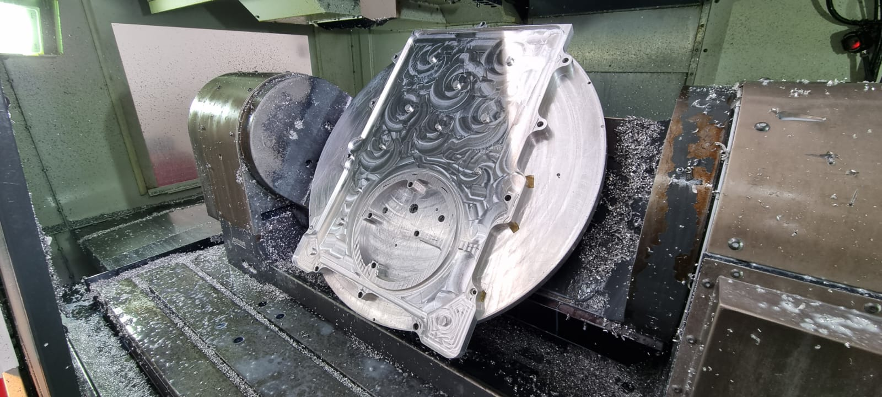

Slide 15
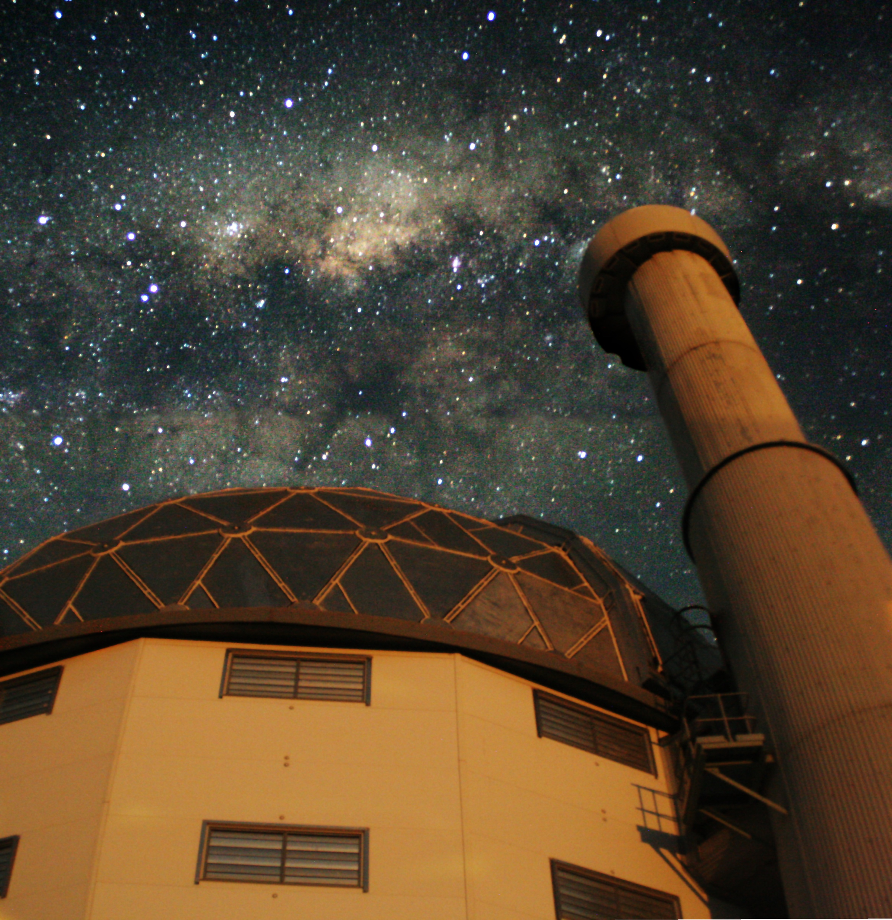
Thankyou
https://io.saao.ac.za/
sbp@saao.ac.za
sb.potter@saao.nrf.ac.za

