Slide 1
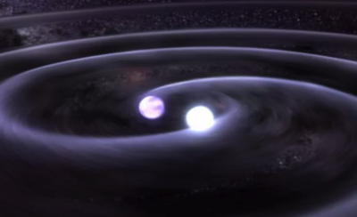
Double Degenerates
WD + WD, WD + NS, NS + NS, BH + … etc

Slide 2
Double Degenerates
WD + WD, WD + NS, NS + NS, BH + … etc
White dwarfs – best known and most observed, SN
Composition
Equation of state
Mass-Radius relation

Slide 3
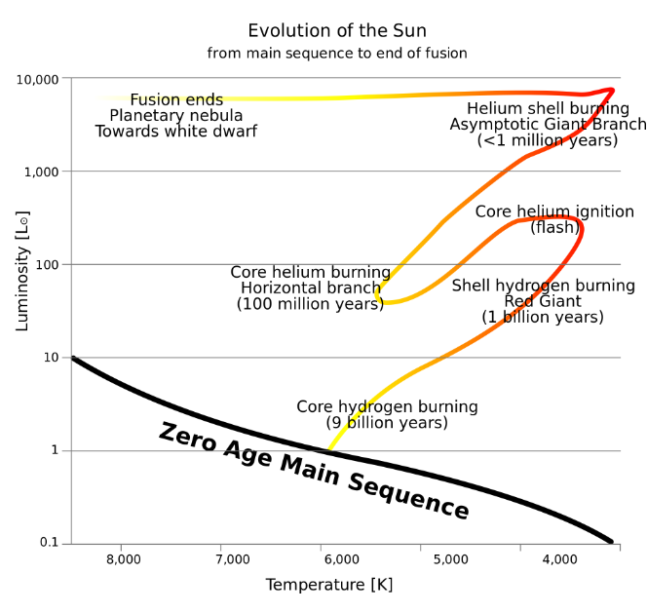

Slide 4
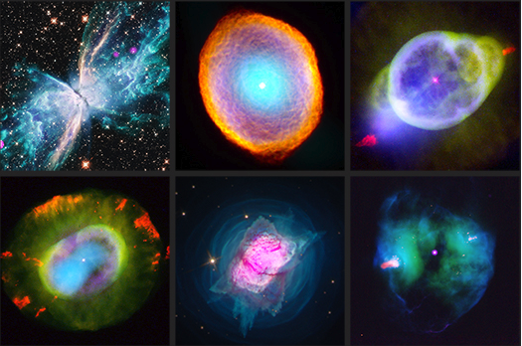

Slide 5
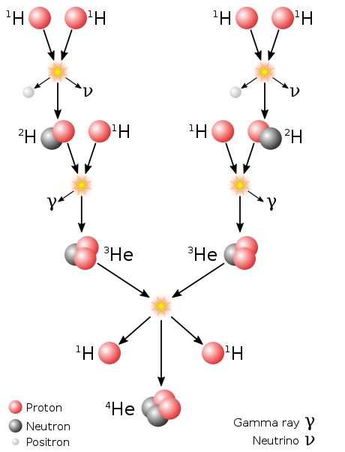
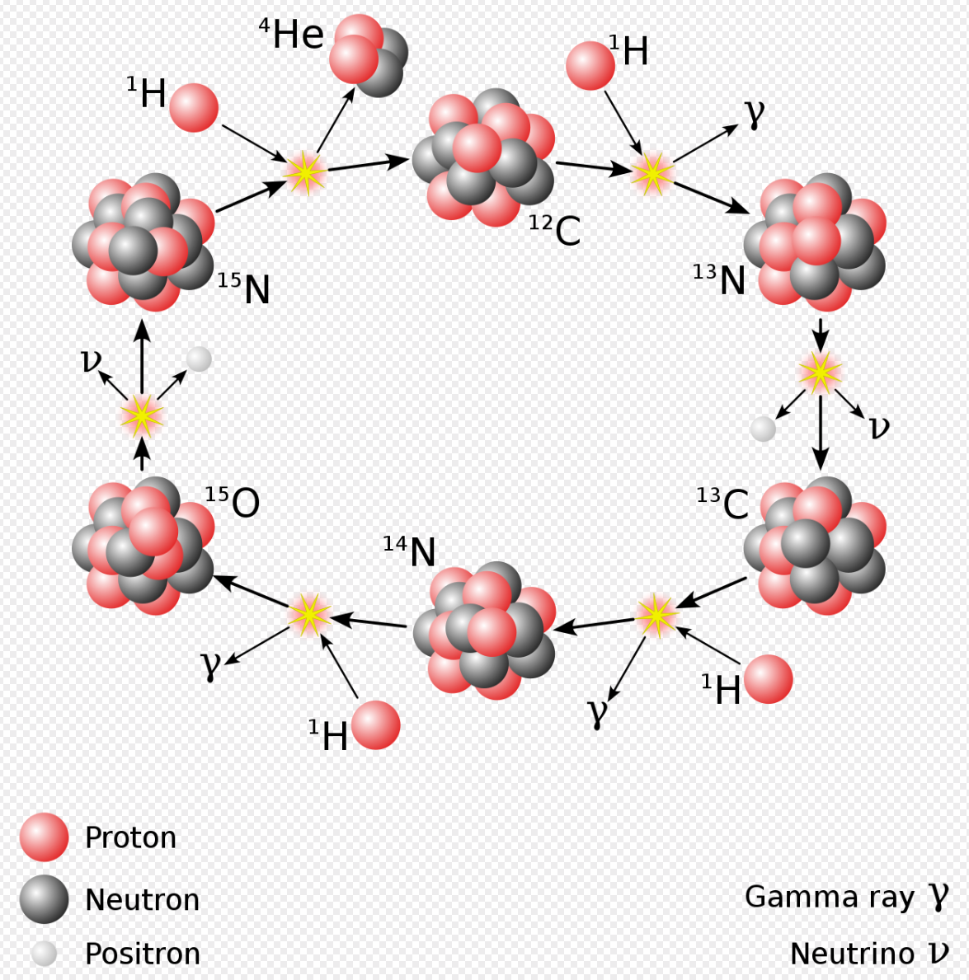
< 1.5 solar mass -> pp-fusion chain T^4
> 1.5 solar mass -> CNO-fusion chain T^16

Slide 6
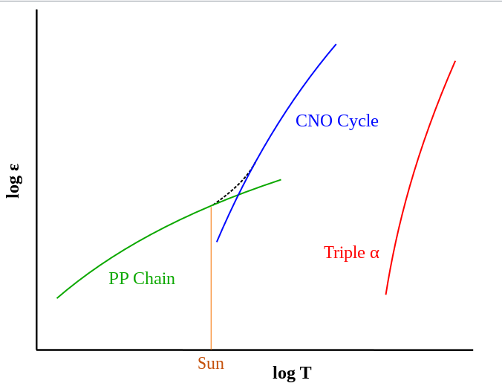
T¹⁶
Fusion
efficiency
He burning
Horizontal
branch
T⁴
M<0.85Msun
ZAMS > Universe age
Small Mass
Large Mass

Slide 7
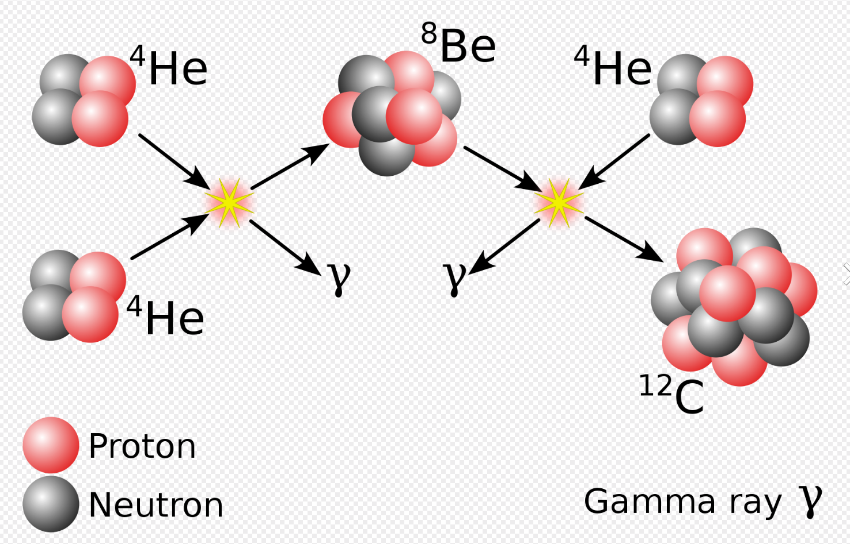
Triple alpha
He burning around core during Horizontal branch
C/O/Ne/Mg/Si -> Fe

Slide 8
Normal Stellar cores are ideal gases -> equation of state:
Stable temperature
Balance between gravity and gas pressure

Slide 9
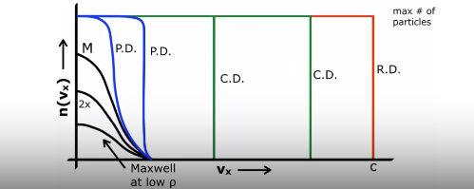
Post AGB
C/O core
Fusion stops (low mass stars)
Temperature drops (cools)
Pressure decreases
Core contracts
BUT density increases (> 1000kg/cm^3)
> 8 solar masses -> carbon burning
Leads to Degeneracy where ideal gas law no longer applies
Momentum distribution

Slide 10
Degeneracy Pressure
Quantum mechanics:
Pauli exclusion principle (no 2 identical fermions in same phase space)
Heisenberg uncertainty principle (increase momenta as density increases)
No longer depends on temperature
Electron pressure for complete degeneracy:
Electrons: brown dwarfs, white dwarfs
Neutrons: Neutron stars
P.D. = Partial Degeneracy
C.D. = Complete Degeneracy
R.D. = Relativistic Degeneracy

Slide 11
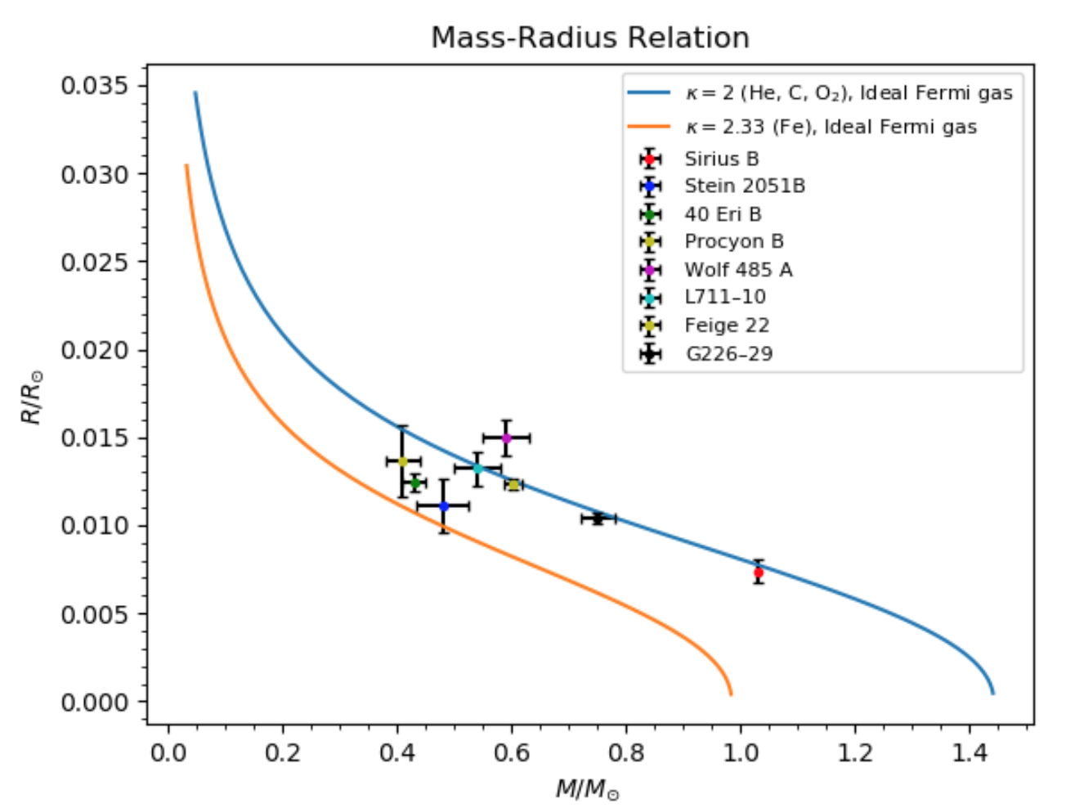
Accretion systems:
-WD gains mass > 1.44 Solar
-Collapse to NS
-SN Ia – ignition of Carbon
Else WD cools over billions
of years – crystallizes
Chandrasekhar Limit

Slide 12
Double degenerates
SN type Ia
LISA sources
Survivors of stellar evolution
Helium white dwarfs
Detached or interacting (AM CVn)

Slide 13
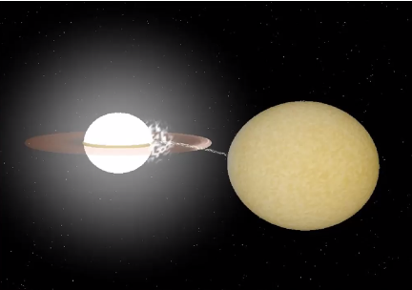
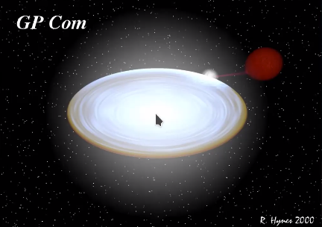
Direct Impact
Accretion disc
Masses (WD radius)
Orbital periods

Slide 14
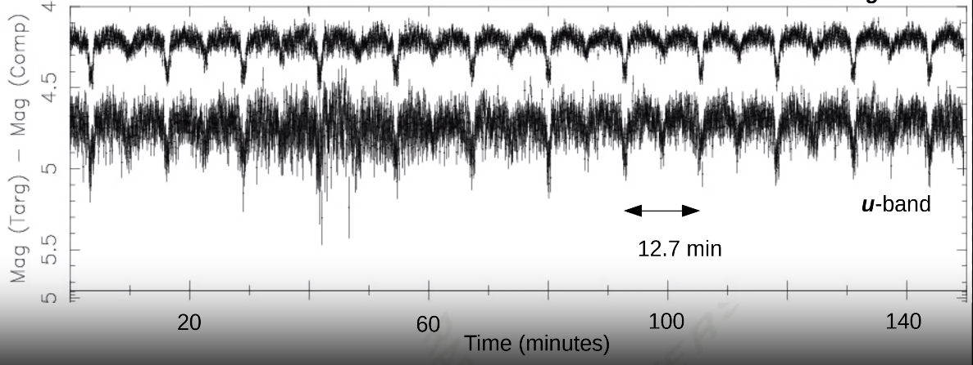
SDSS J0651 detached binary

Slide 15
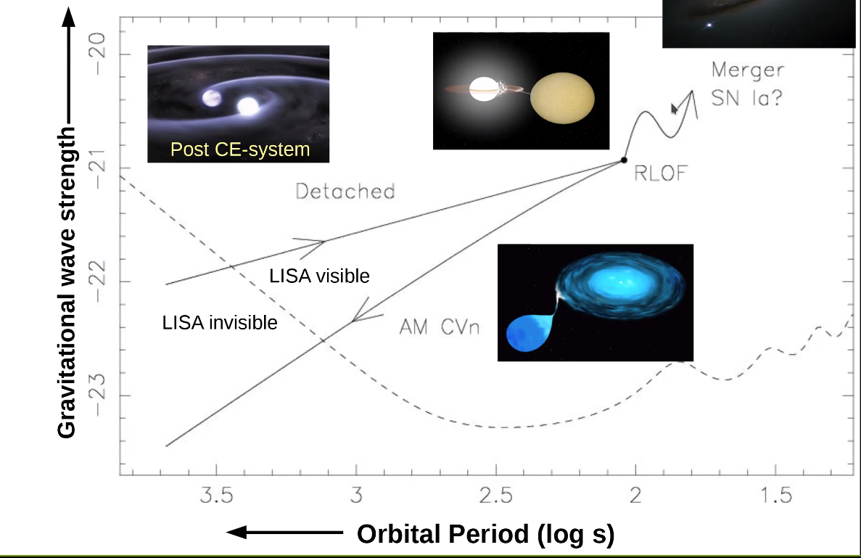

Slide 16
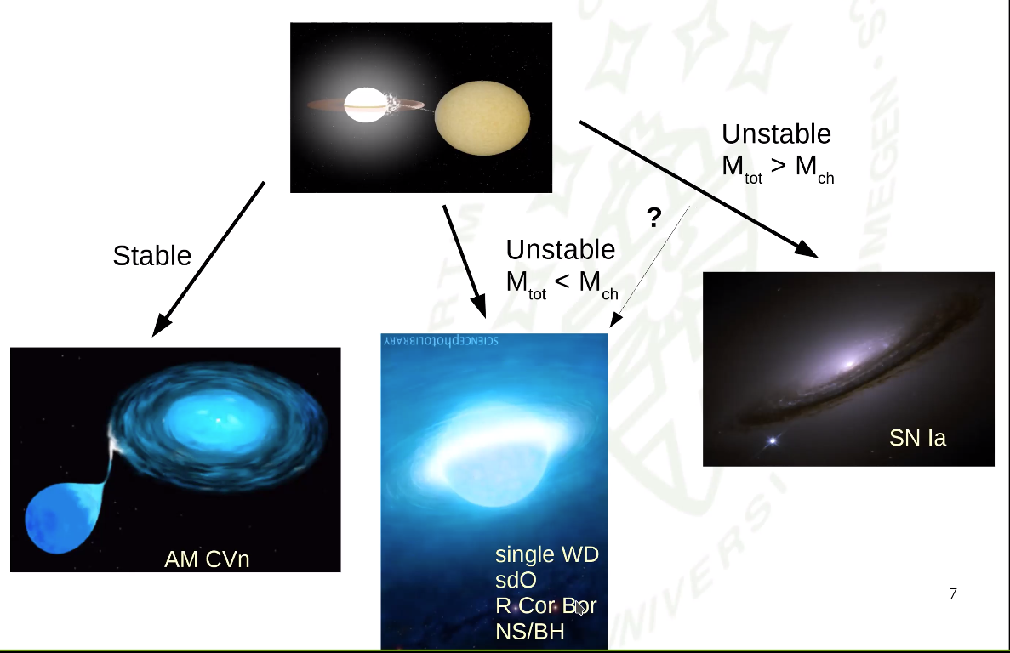

Slide 18
