Slide 1
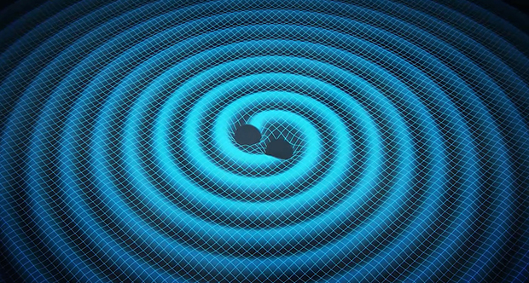
Gravitational Radiation: BH, NS-BH binaries
Gravitational Radiation/Waves
Detection of gravitational waves
LIGO observatories
LIGO’s first detection GW150914 BH-BH merger
GW170817 NS-NS merger

Slide 2
Gravitational Radiation - Ripples in Space-time
Occurs when massive objects in space accelerate or change direction
Produce ripples or waves in the fabric of space-time
Very Small amplitudes -> Very large masses + high accelerations
Compact binaries in compact orbits
Detected by measuring changes in path length using lasers

Slide 3
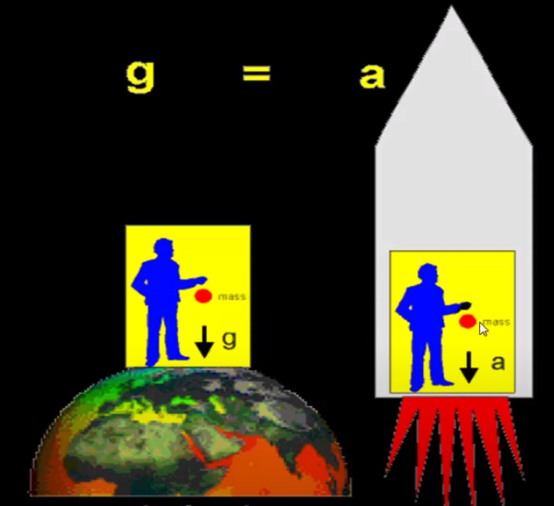
Einstein's Theory of General Relativity
general relativity describes how gravity works
Equivalence principle – Gravitational mass and Inertial mass
Einstein: same thing, different causes – same effect
Can’t tell the difference

Slide 4
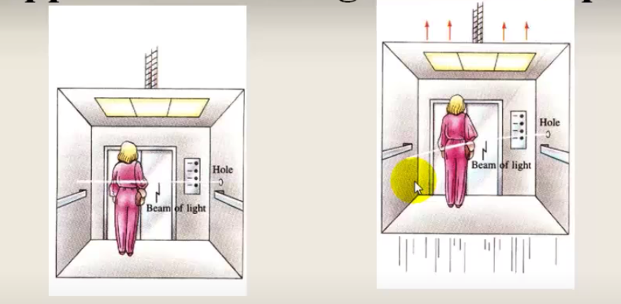
Einstein's Theory of General Relativity

Slide 5
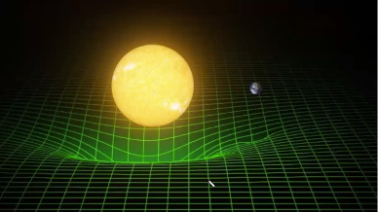
Einstein's Theory of General Relativity
Gravity –curvature of space time
Amount of curvature = magnitude of gravity
Moves with time
Speed of light = speed of gravity

Slide 6
Gravitational waves

Slide 7
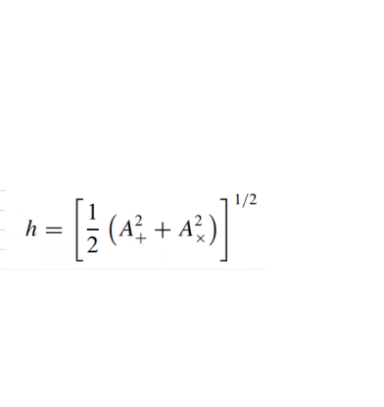
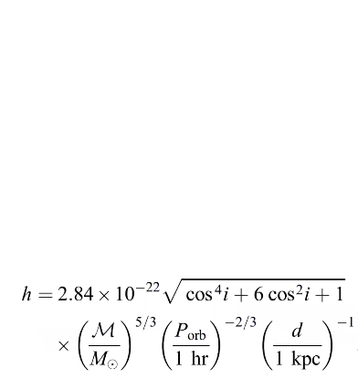
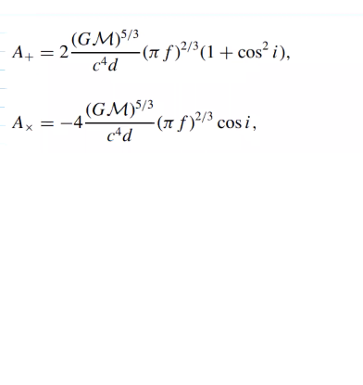
Detection of gravitational waves
H = strain amplitude
Amount of deformation dL/L

Slide 8
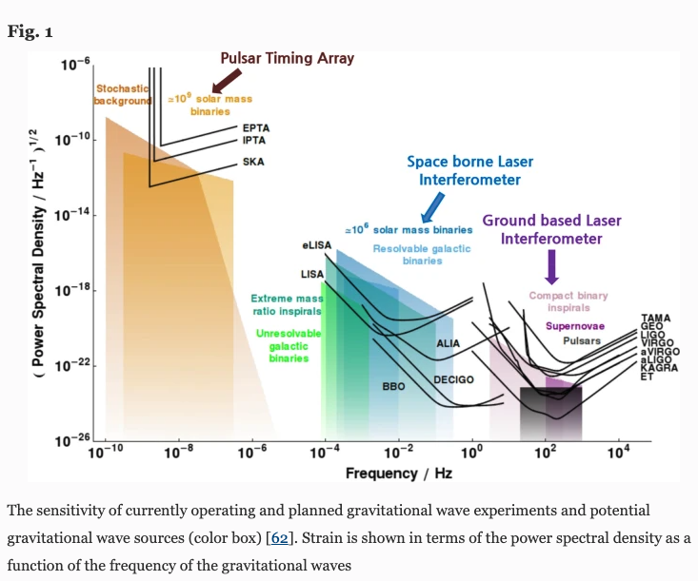
Detection of gravitational waves
GW wavelength
-> binary separation
-> antenna length
Km – solar radii - AU

Slide 9
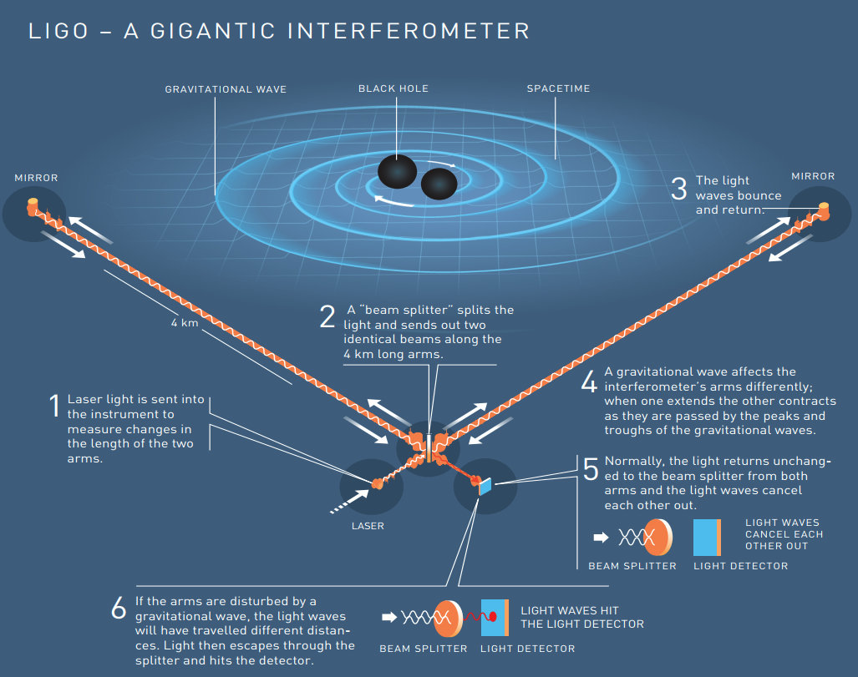

Slide 10
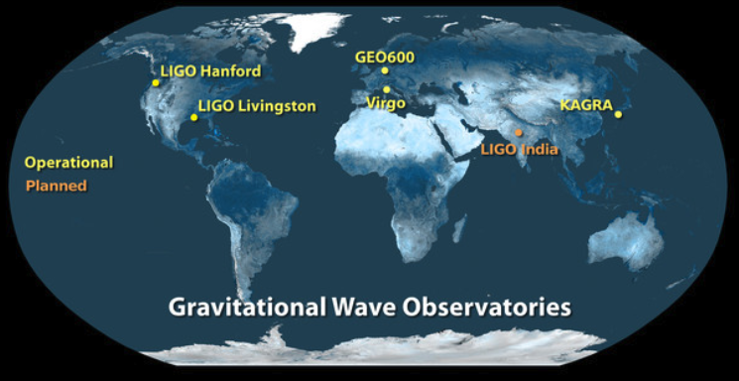
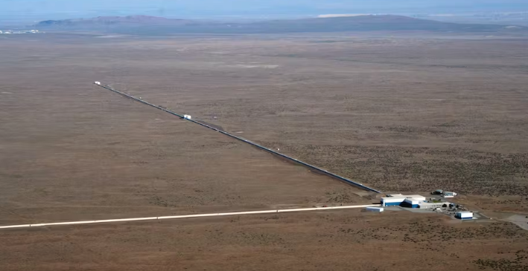

Slide 11
LIGO’s first detection GW150914 BH-BH merger
first observation of a binary black hole merger

Slide 12
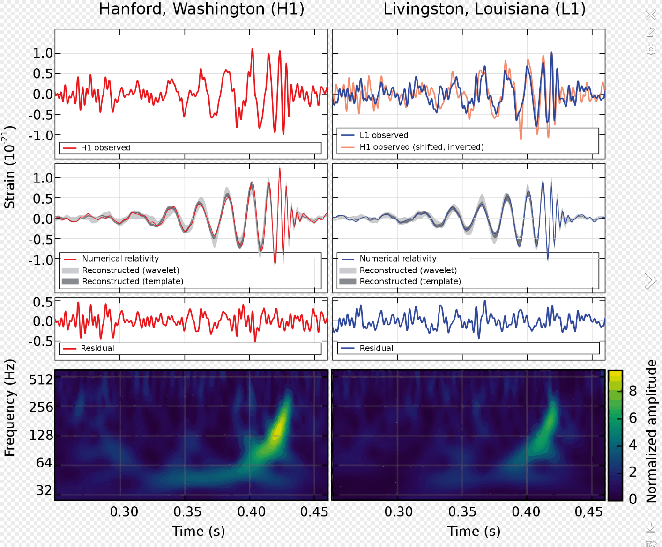
LIGO’s first detection GW150914 BH-BH merger
first observation of a binary black hole merger

Slide 13
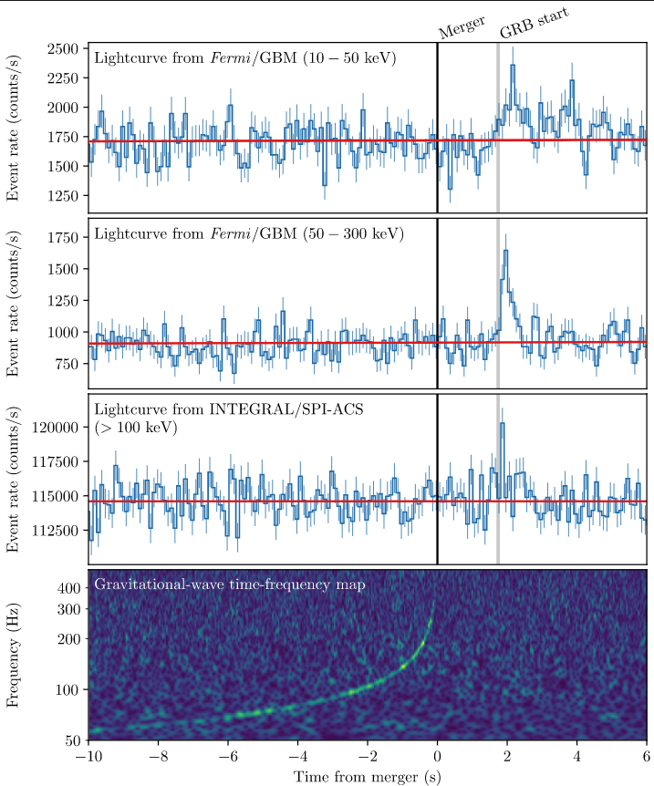
GW170817 NS-NS merger

Slide 14
GW170817 NS-NS merger
1.74s delay
Speed of gravity = Speed of light <10-15

Slide 15
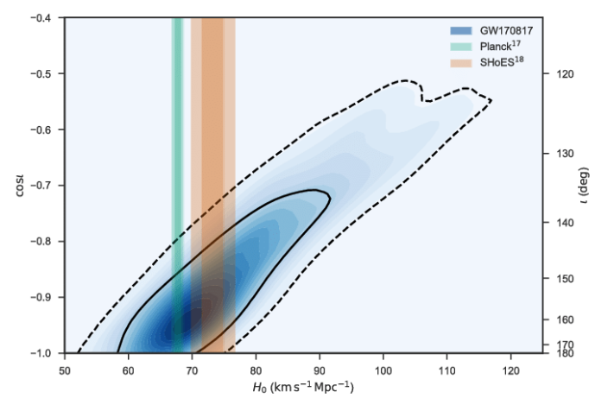
GW170817 NS-NS merger
1.74s delay
Speed of gravity = Speed of light <10-15
Red shift/ distance – Hubble constant

Slide 16
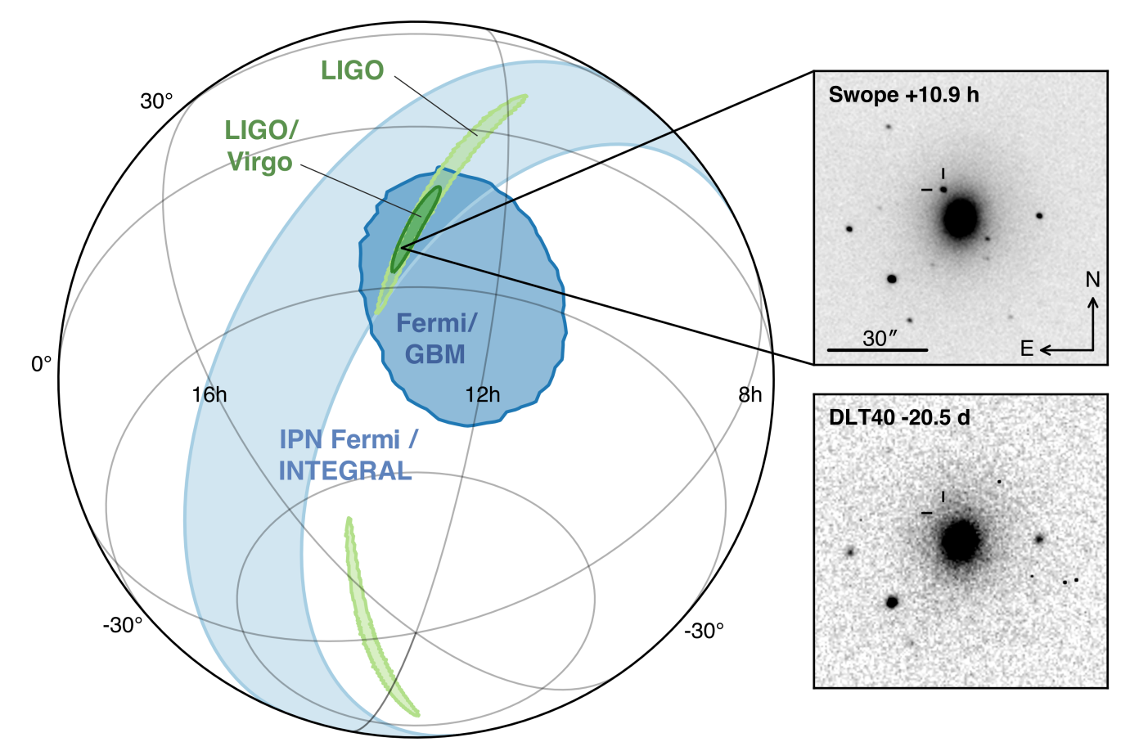
GW170817 NS-NS merger

Slide 17
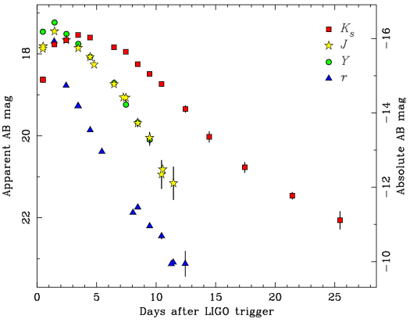
GW170817 NS-NS merger

Slide 18
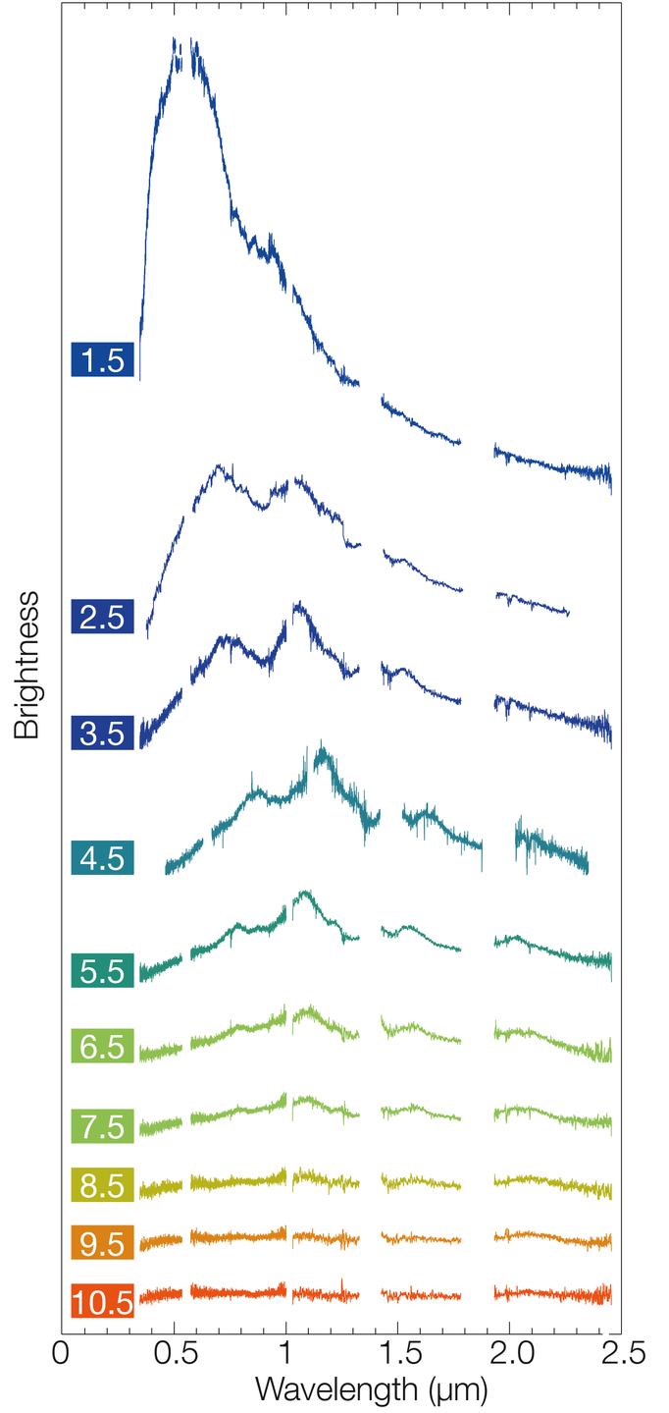
GW170817 NS-NS merger

Slide 19
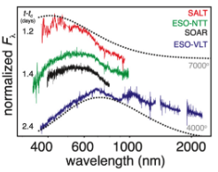
GW170817 NS-NS merger

Slide 20
GW170817 NS-NS merger

Slide 21
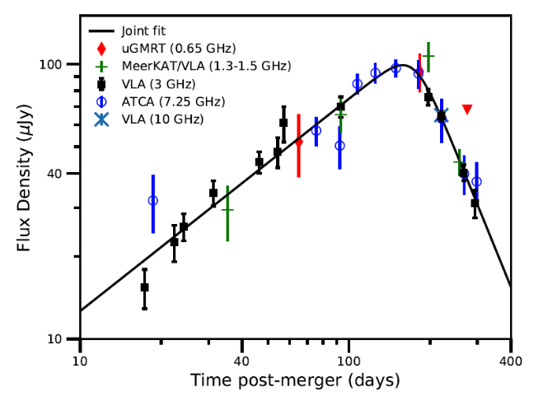
Mooley et al 2018

Slide 22
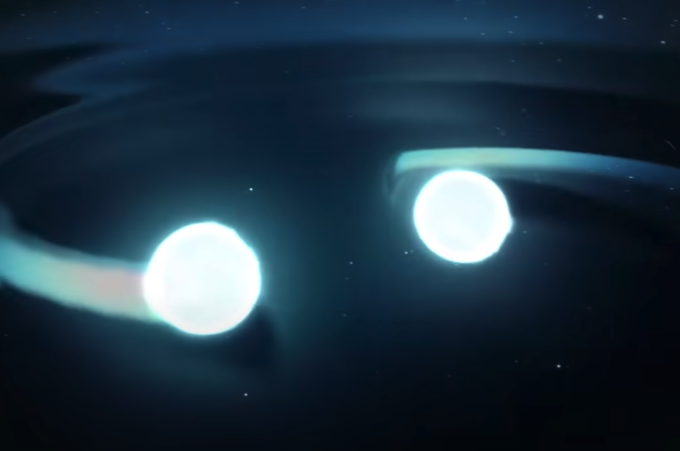
Gravitational waves

Slide 23
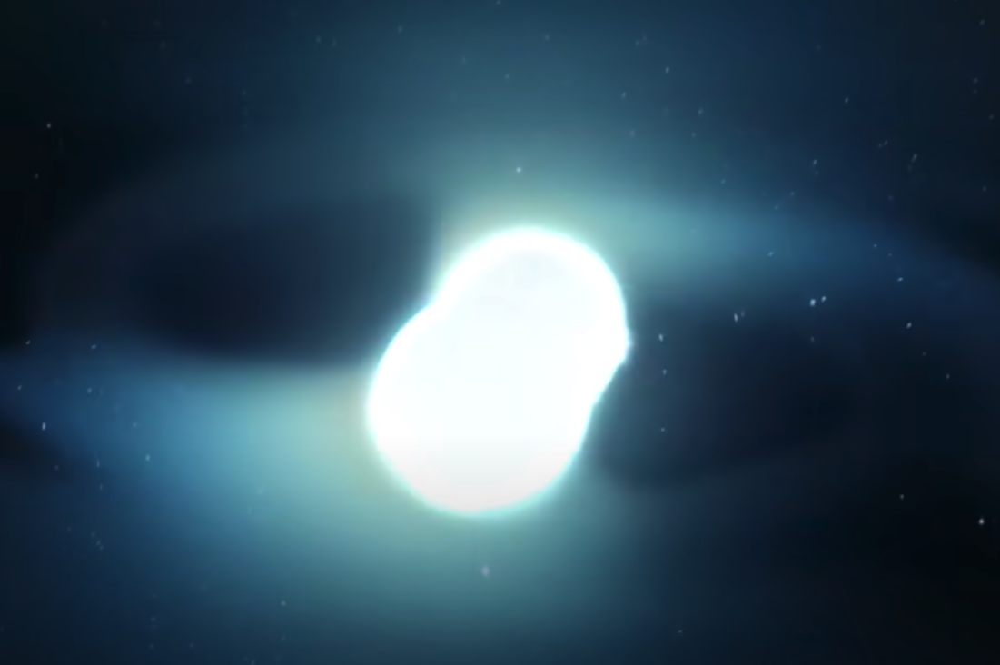
Collision

Slide 24
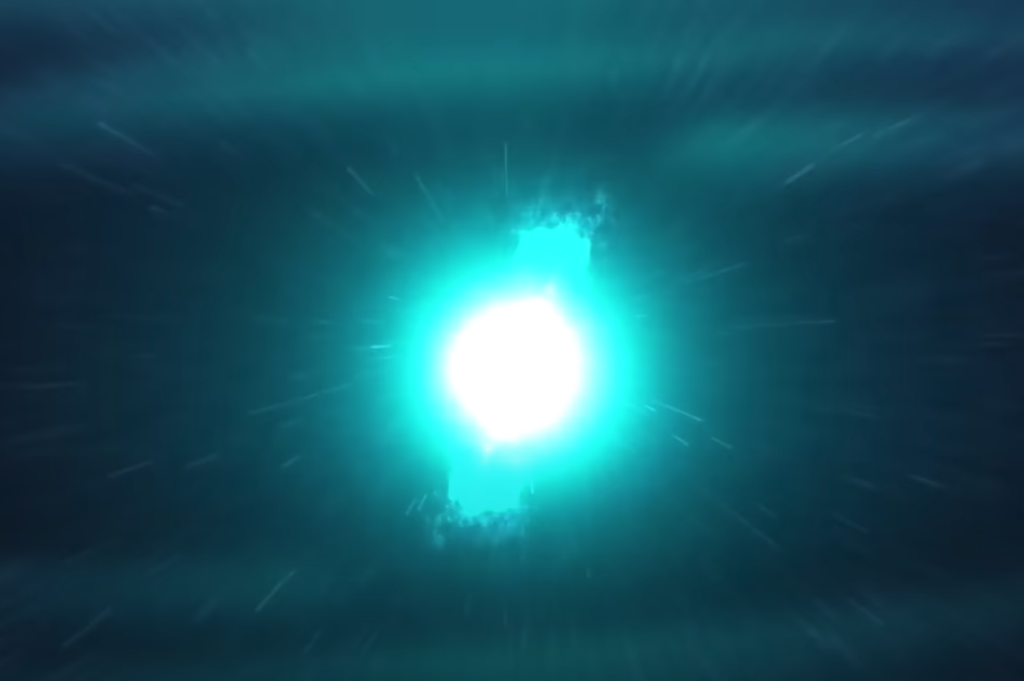
Collision

Slide 25
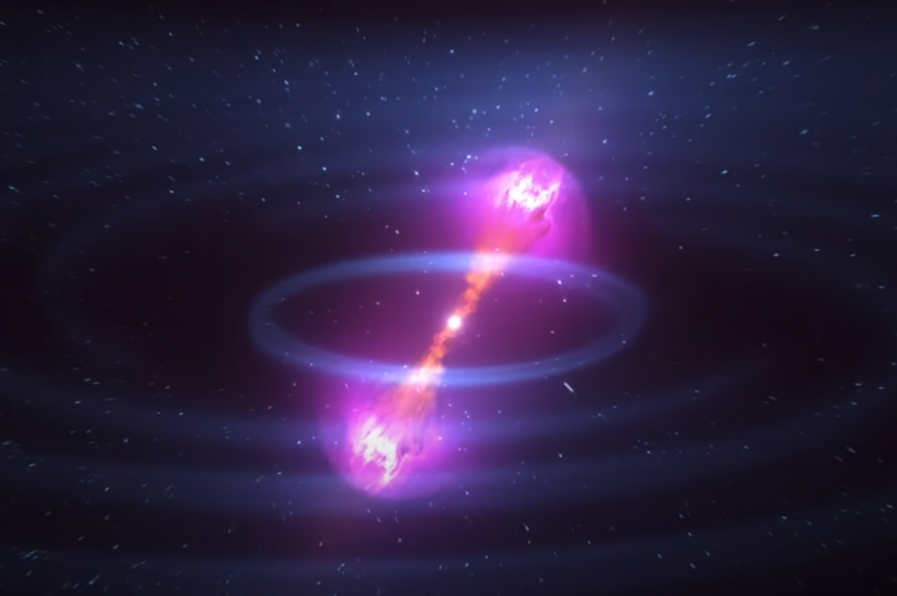
Near-light-speed jet – gamma rays

Slide 26
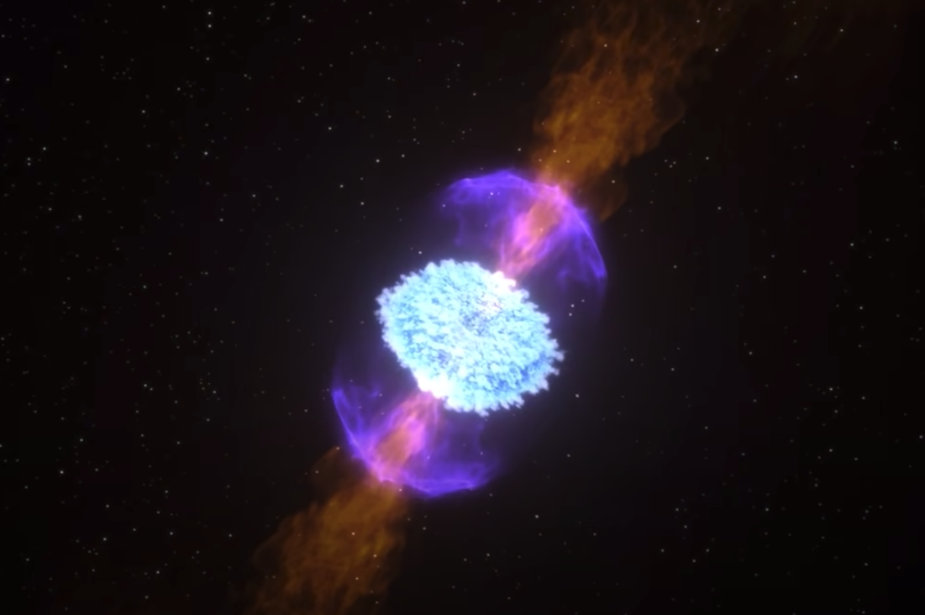
Expanding debris – heavy elements

Slide 27
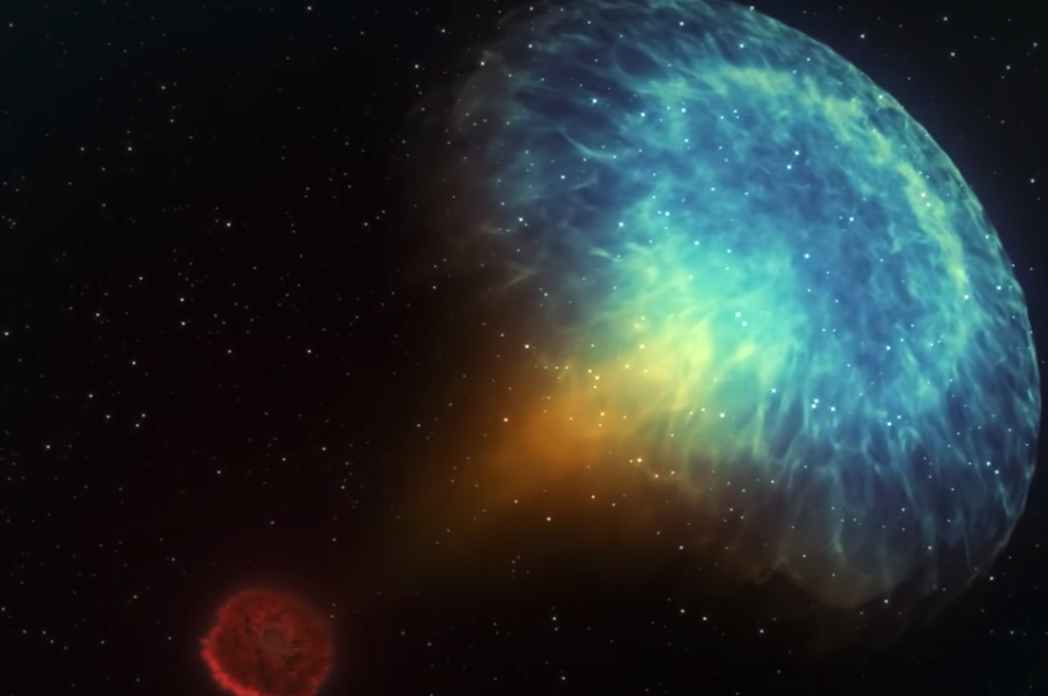
Radio emission colliding gas

Slide 28
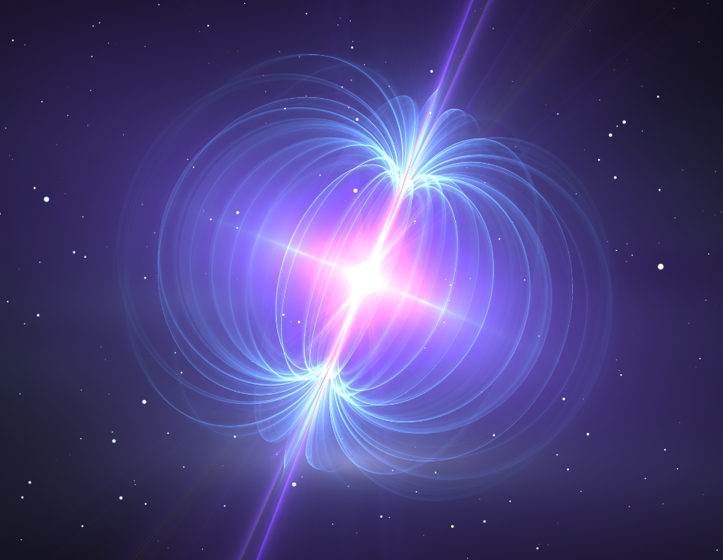
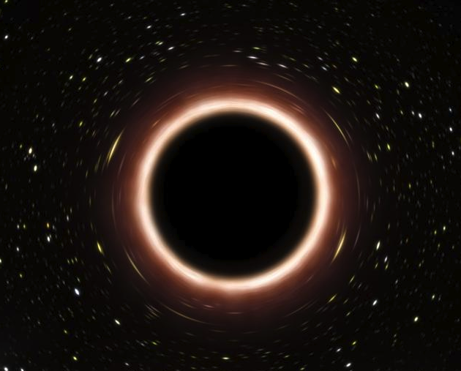
Black hole
Magnetar

