Slide 1

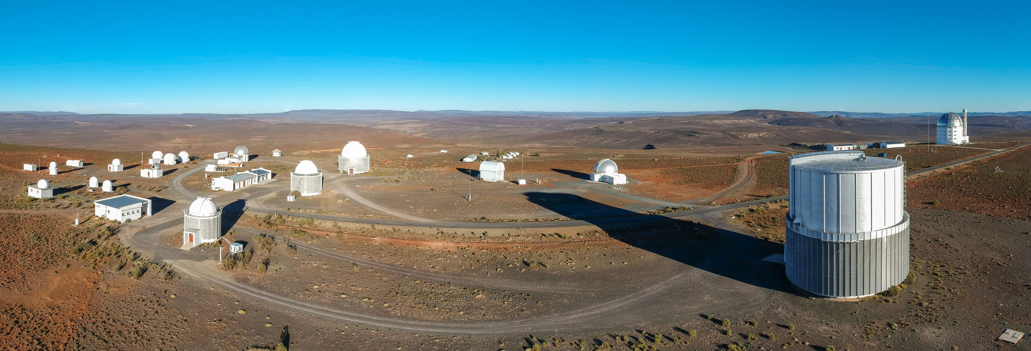



South African Astronomical Observatory
The Intelligent Observatory:
Advancing Astronomical Operations and Research
Stephen Potter (SAAO, UJ)
The IO Team

Slide 2
The Intelligent Observatory (IO)
Vision #1
Submit observation requests at any time✅
Science on any time scale ✅
Observe from Sutherland, Cape Town or anywhere ✅
Observe manually, queue or service ✅
Respond to alerts, computer generated requests ✅
Coordinated science across telescopes in the era of multi-messenger astronomy ✅

Slide 3
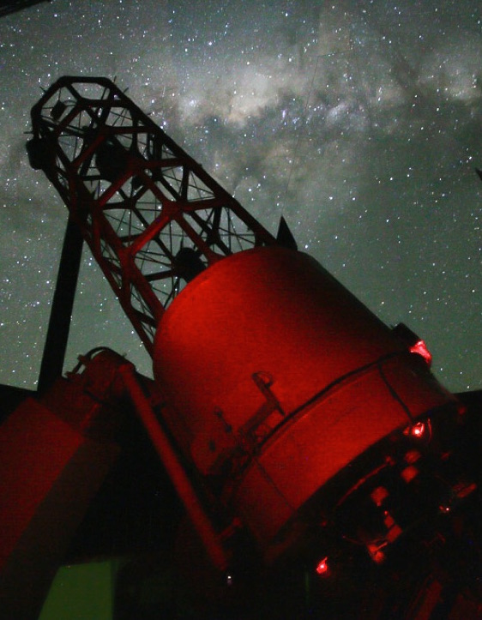
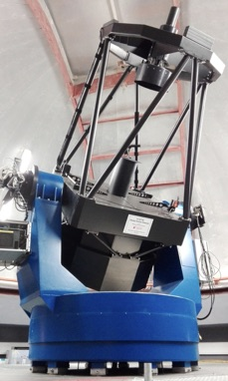
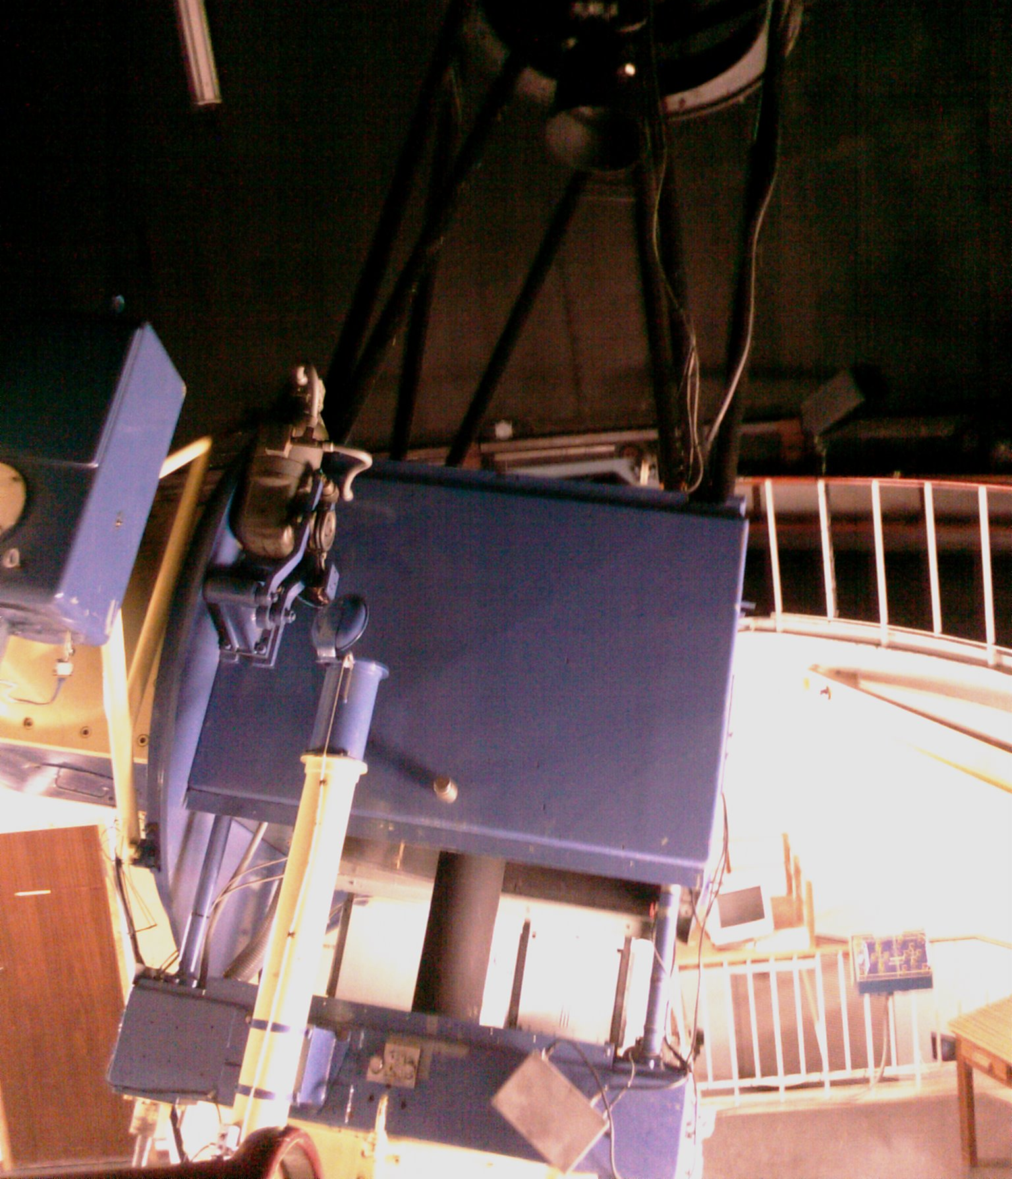
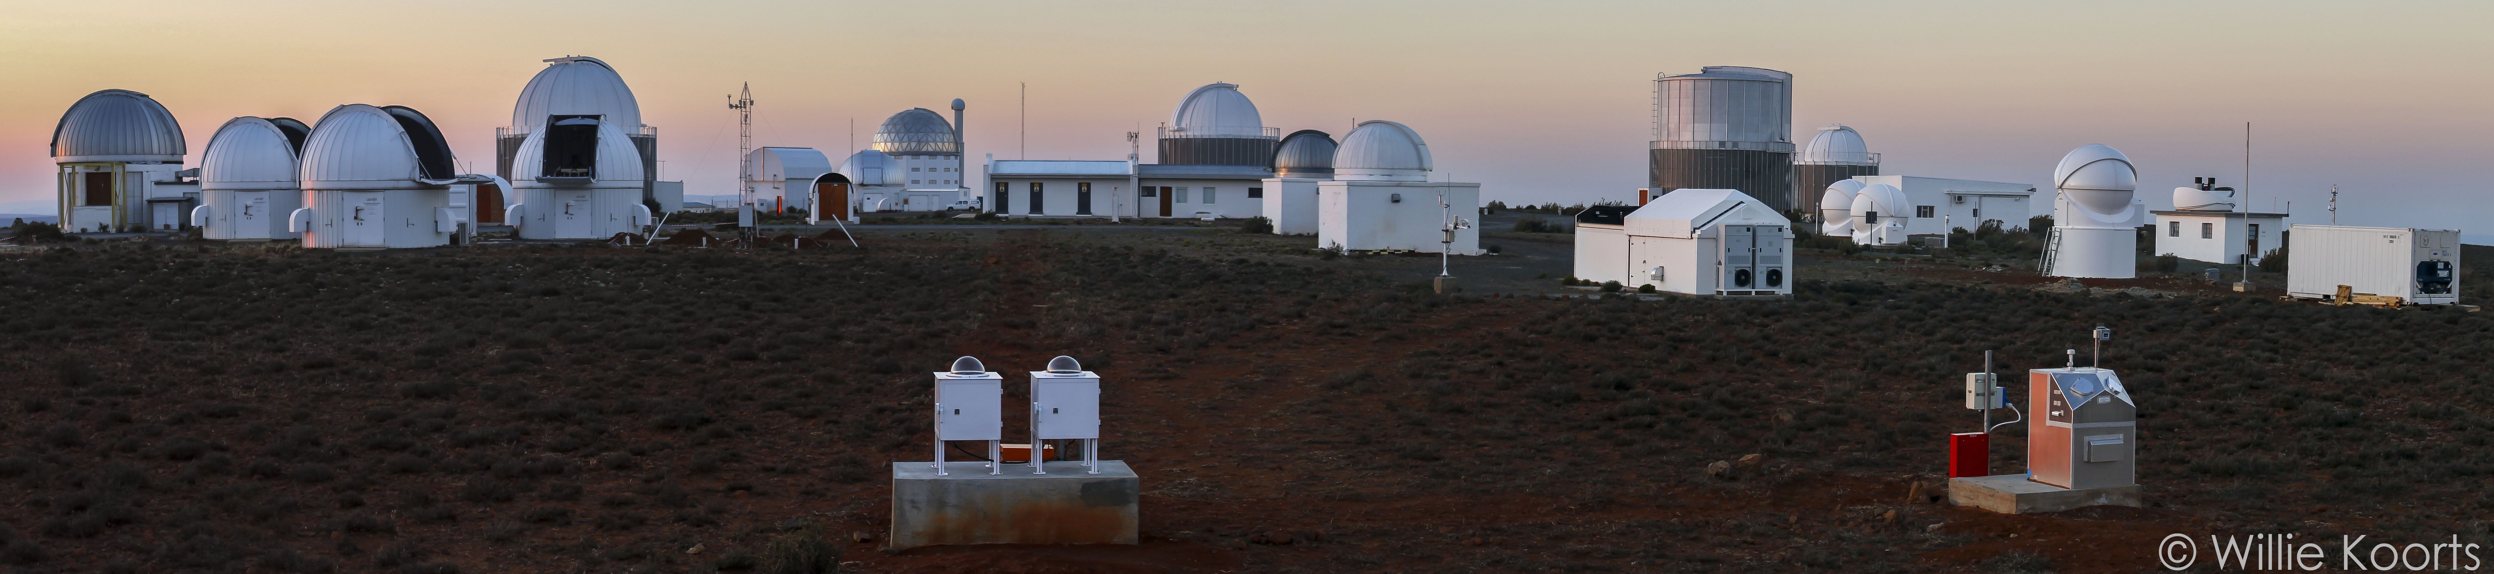

Telescopes 1.9m and 2 x 1.0m
Spectrographs
Polarimeters
Imagers
High-speed imagers

Slide 4
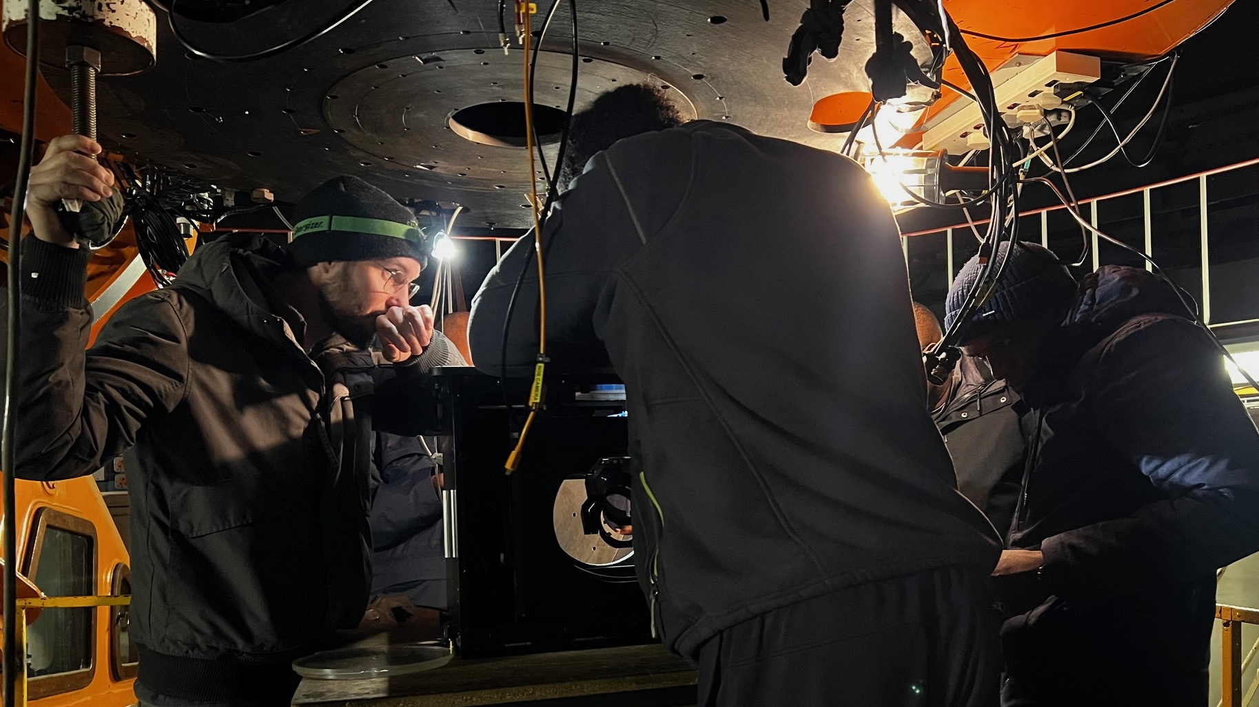
The 74inch Instrument Selector Port

Slide 5
Automation of 74inch+SHOCNWONDER
via the OCS
Testing/fine tuning:
Submit requests via OCS
74inch polls OCS for schedule
74inch executes OCS requests
Point to target RA, Dec
Perform WCS on live image
Fine pointing to magic pixel
Auto focus
Start guiding
Perform observations
LCU for weather override etc

Slide 6
The Intelligent Observatory (IO)
Vision #2
Advance SAAO operations into the 4IR
Document and Information Management
Telemetry Project
Advanced data products
Science idea –> data acquisition -> publication
Literature reviews
Proposal writing
Paper writing
TAC

Slide 7
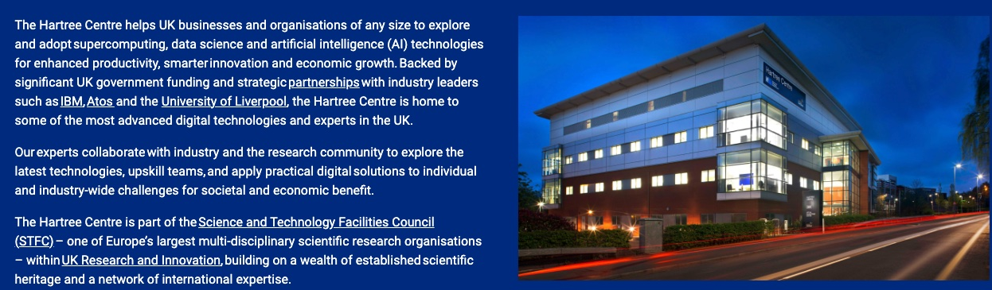

Slide 8
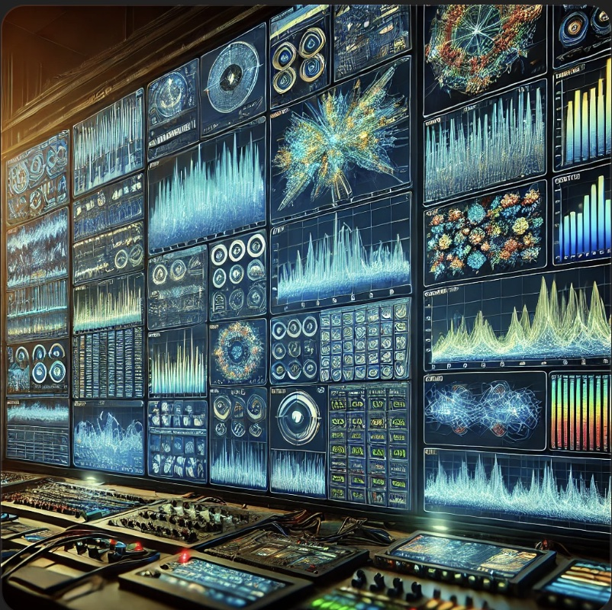

The Telemetry Project
SAAO RAG - Retrieval-Augmented Generation

Slide 9
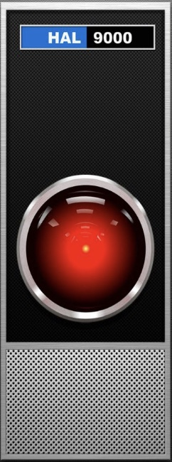
The Telemetry Project
A unified system to log and analyse telemetry from all instruments, telescopes and servers:
To perform health-checks, fault analysis
Predict necessary maintenance in advance
Produce advanced data products
Investigate equipment behaviour
Requires:
Logging of telemetry
Database design and implementation
AI tools

Slide 10
The Telemetry Project
Intelligent Observatory Telemetry System (IOTS)

Slide 11
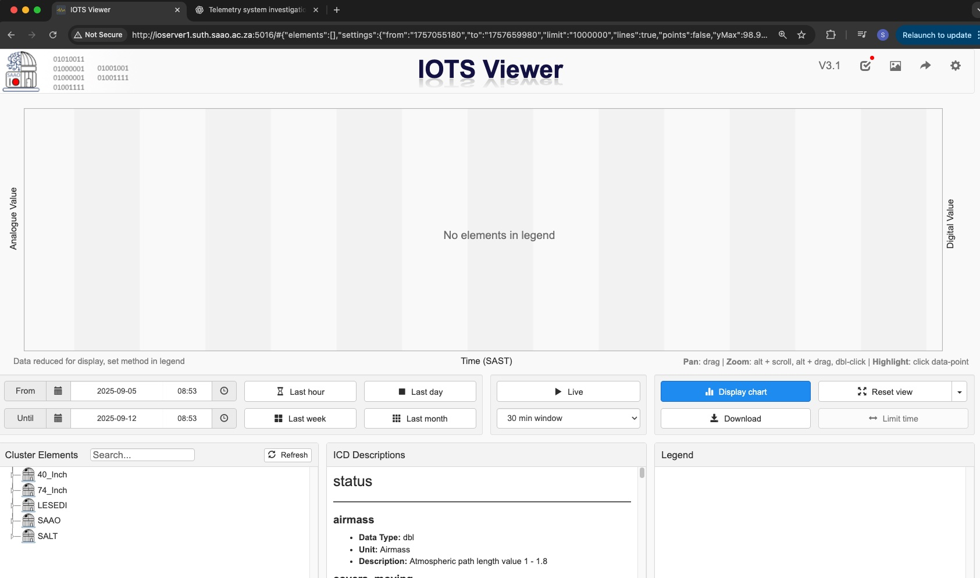
Intelligent Observatory Telemetry System (IOTS)

Slide 12
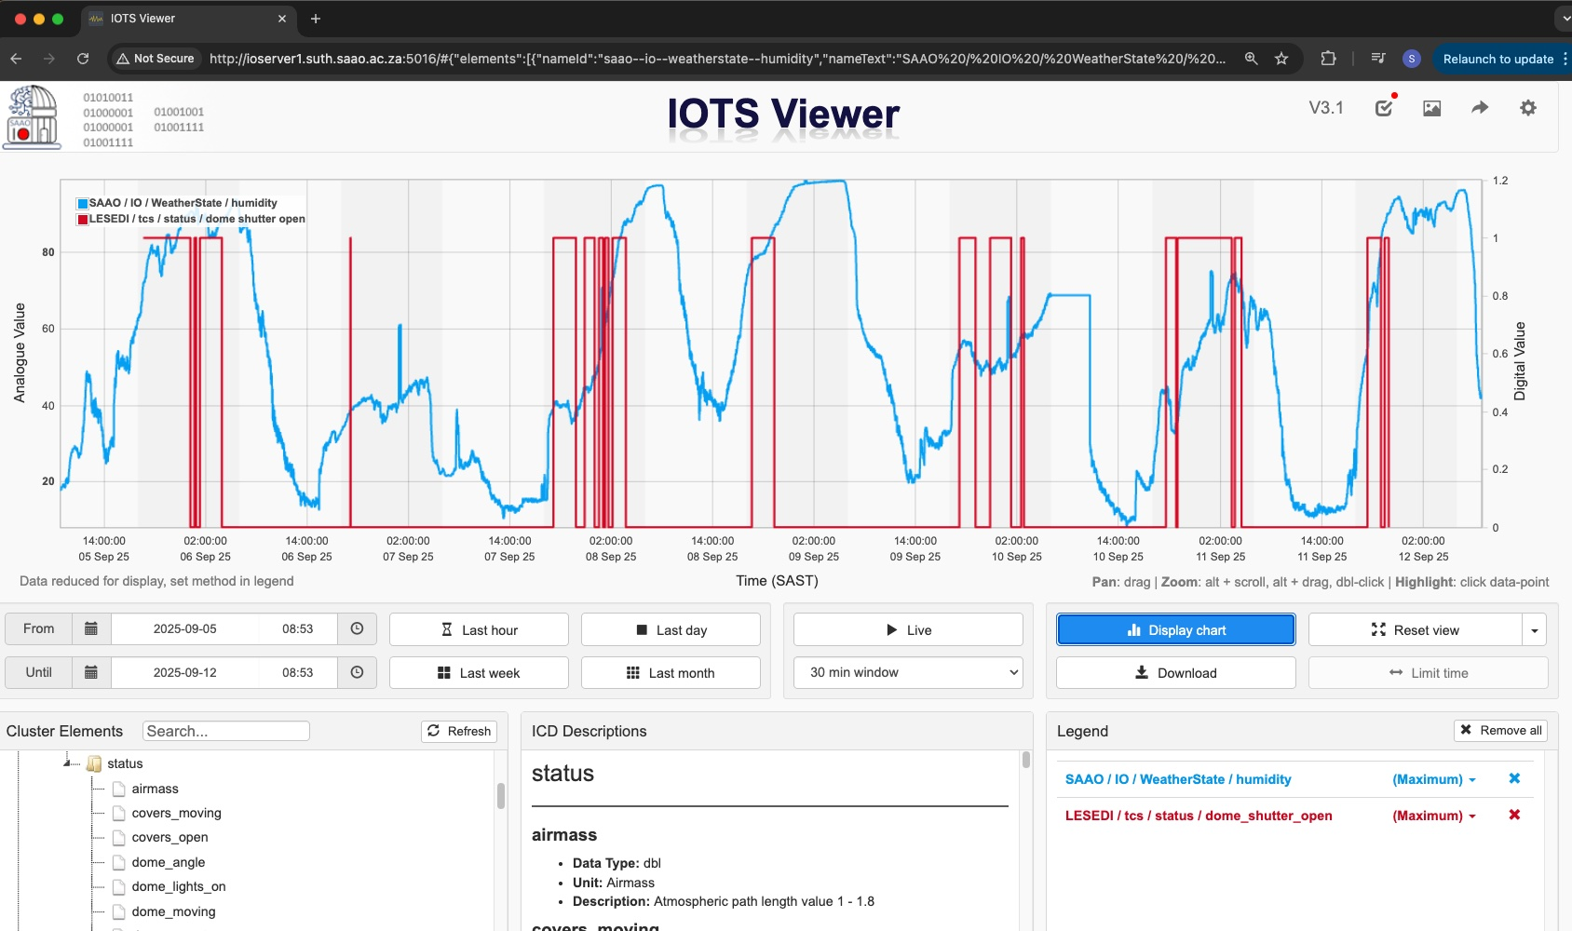
The Telemetry Project

Slide 13
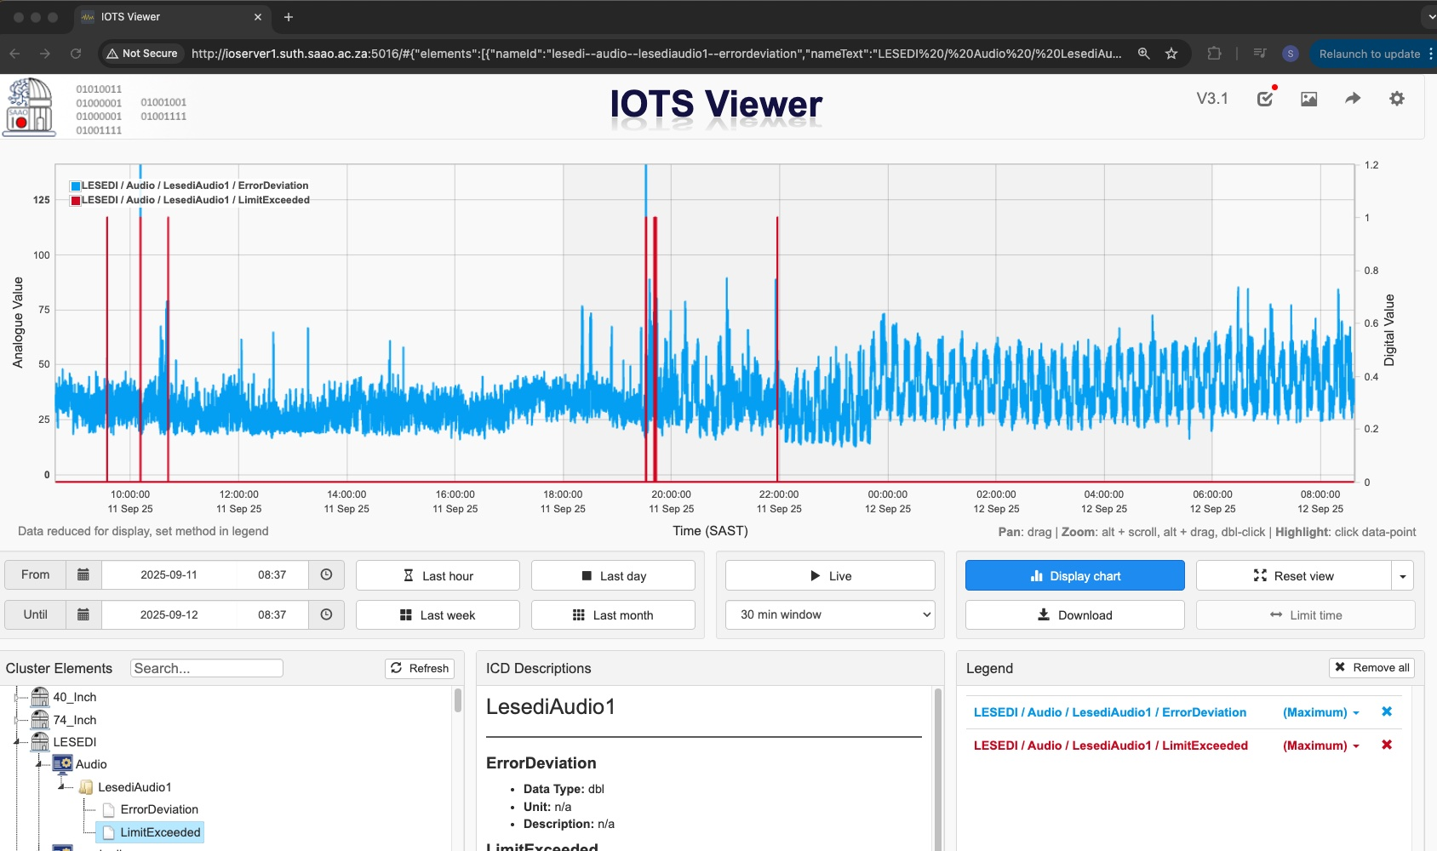
The Telemetry Project

Slide 14
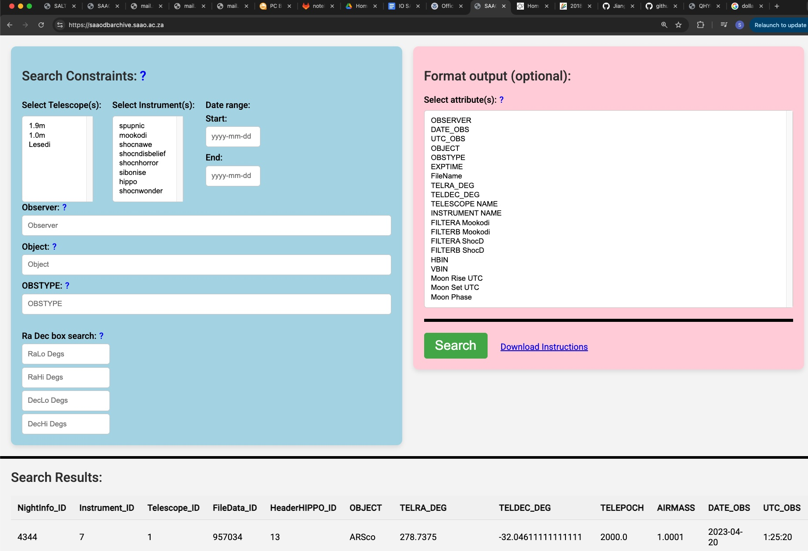
The Telemetry Project

Slide 15

Document Configuration Management
SALT docs, SAAO docs, IO docs, Topswiki, googledocs ….

Slide 16
Intelligent Document Configuration Management
New Tools
Large Language Models – local or cloud
RAG - Retrieval-Augmented Generation
New Opportunities
Making information capture and storage finally worth doing
Addressing IP and data security
Gathering and collating documents

Slide 17
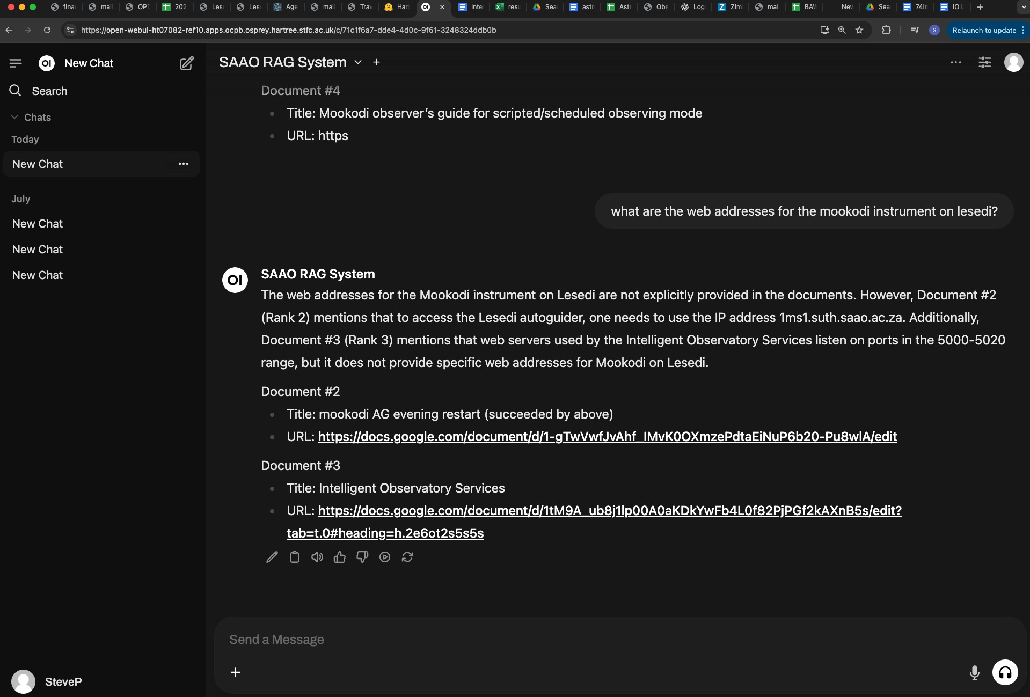
SAAO RAG - Retrieval-Augmented Generation

Slide 18
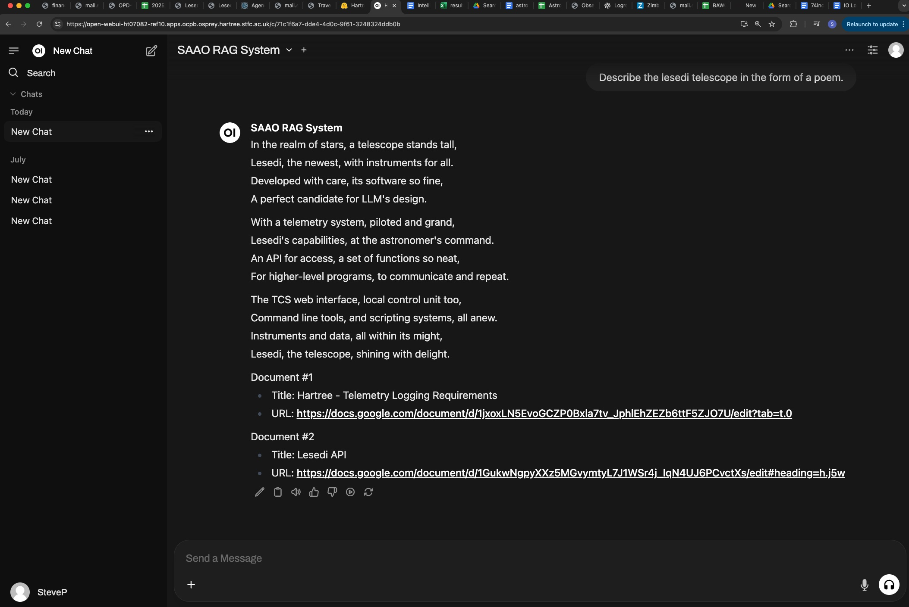
SAAO RAG - Retrieval-Augmented Generation

Slide 19
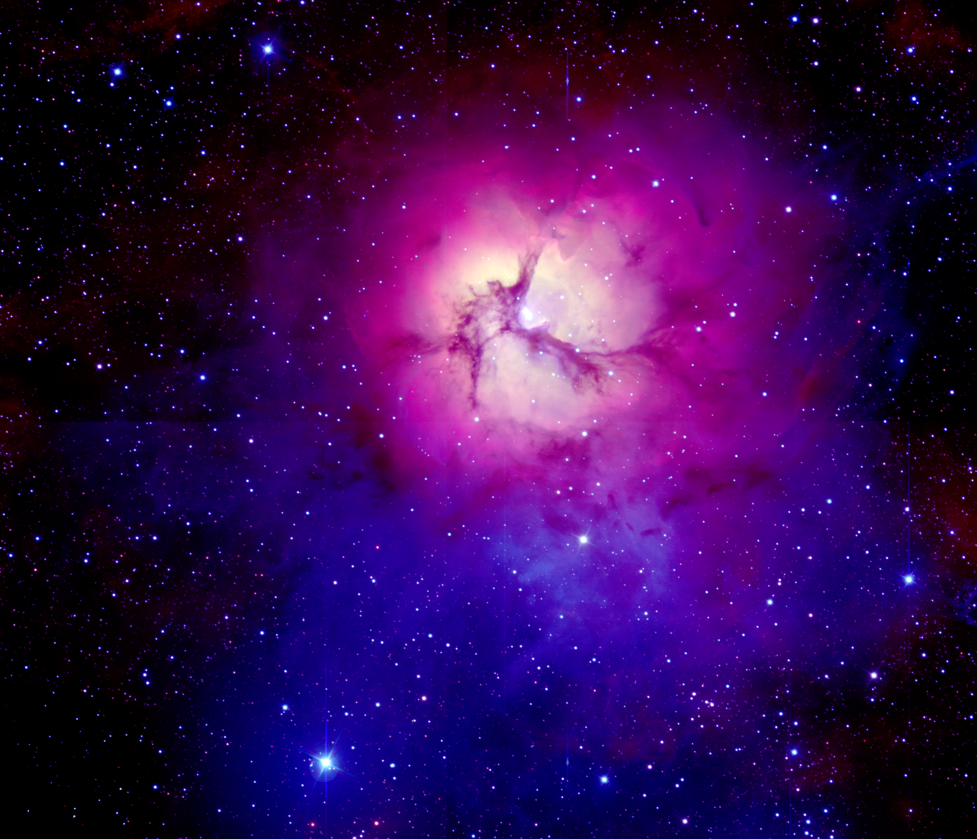
Lesedi Among the Stars
In the realm of stars, a telescope stands tall, Lesedi, the newest, with instruments for all. Developed with care, its software so fine, A perfect candidate for LLM's design.
With a telemetry system, piloted and grand, Lesedi's capabilities, at the astronomer's command. An API for access, a set of functions so neat, For higher-level programs, to communicate and repeat.
The TCS web interface, local control unit too, Command line tools, and scripting systems, all anew. Instruments and data, all within its might, Lesedi, the telescope, shining with delight.
SAAO RAG 12 Sept 2025

