Slide 1
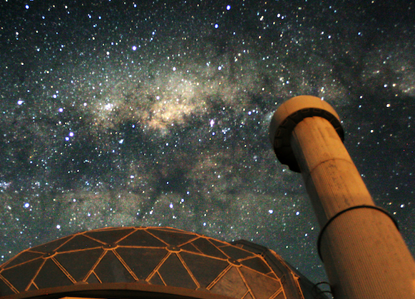
The extraordinary polarimetric nature of the white dwarf pulsar AR Sco
Stephen Potter
David Buckley
South African Astronomical Observatory

Slide 2
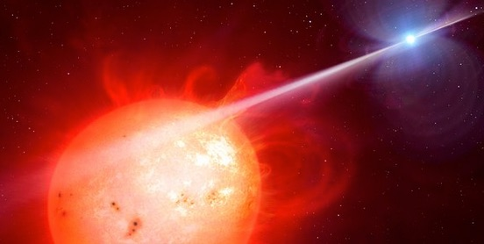
AR Sco Polarimetry
Buckley et al (2017) discovered optically pulsed polarized emission
GOALS:
Detailed polarimetry covering multiple orbits in 2016 and 2017
Present a Geometrical model

Slide 3
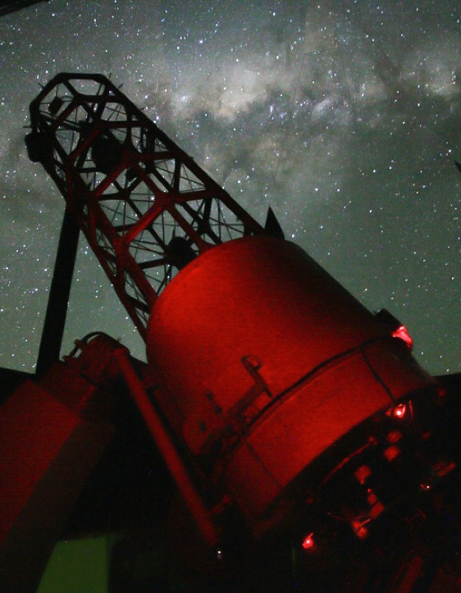
AR Sco Polarimetry
Buckley et al (2017) discovered optically pulsed polarized emission
GOALS:
Detailed polarimetry covering multiple orbits in 2016 and 2017
Present a Geometrical model

Slide 4
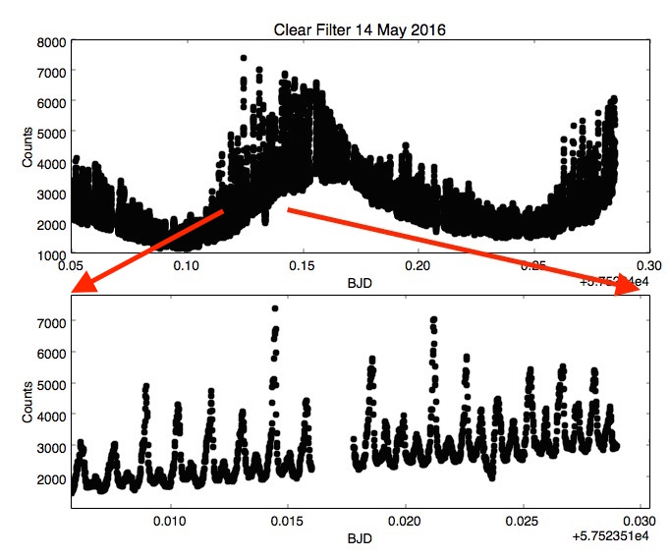

Slide 5
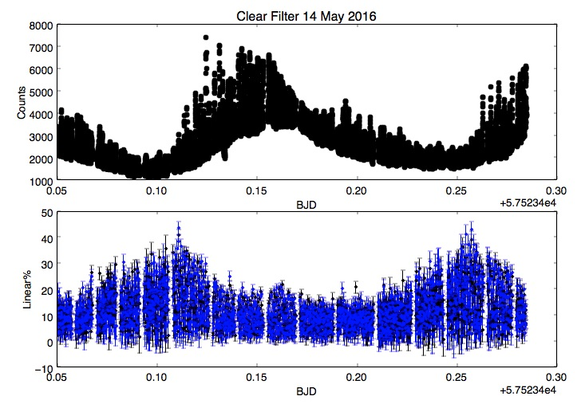

Slide 6
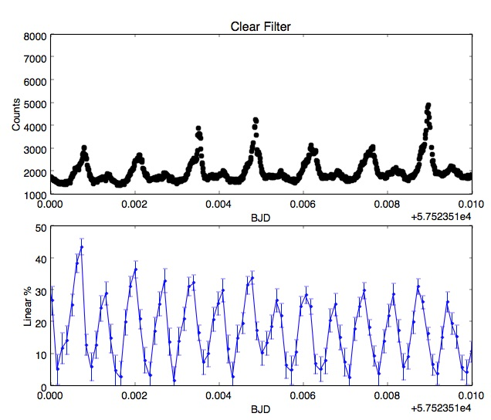

Slide 7
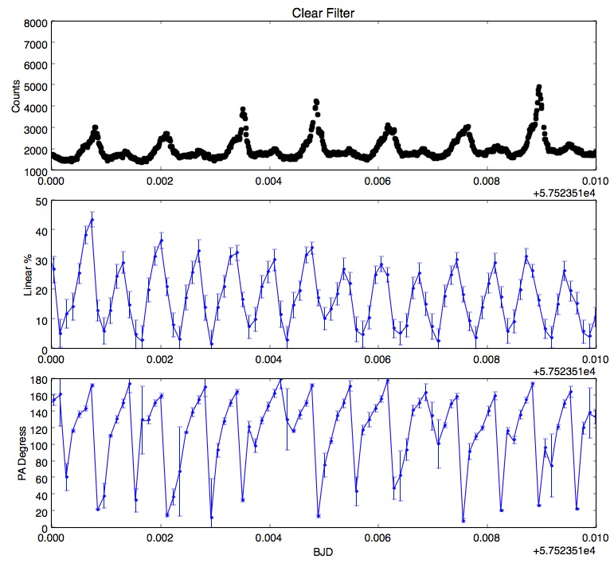

Slide 9
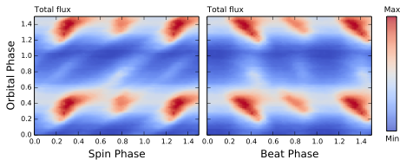

Slide 10
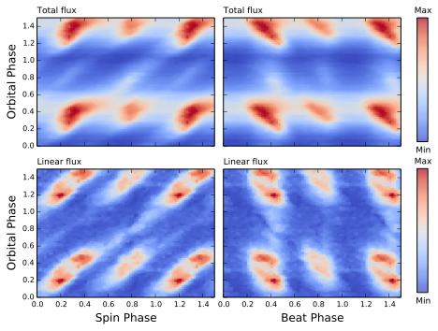

Slide 11
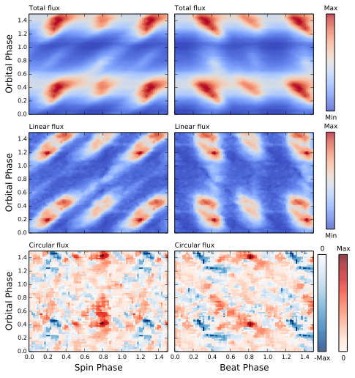

Slide 12
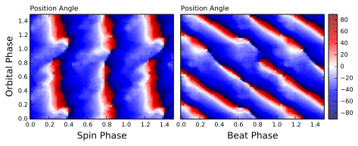
Position Angle
Spin Folded
Beat Folded

Slide 13
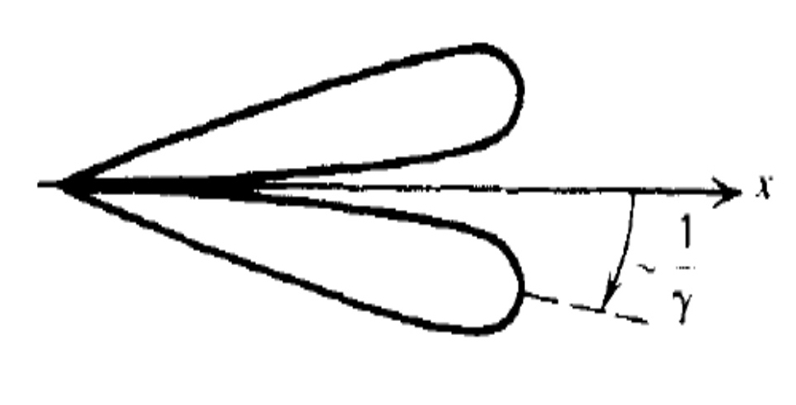
WD

Slide 14
WD
Intensity
0
WD spin phase
1

Slide 15
WD
Intensity
0
WD spin phase
1

Slide 16
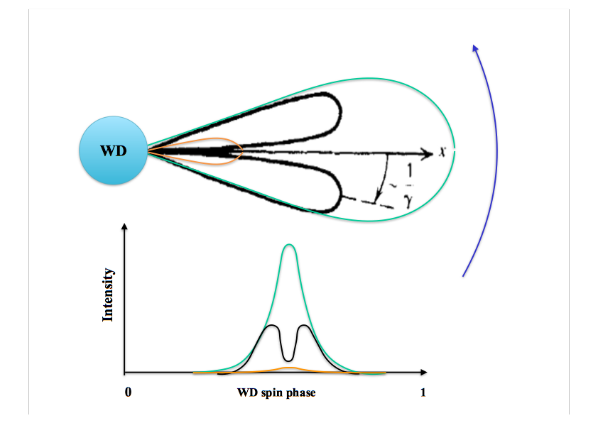

Slide 17
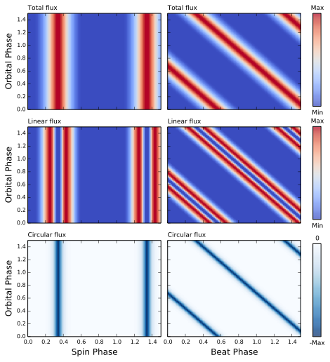
Model

Slide 18
Model
Observations

Slide 19
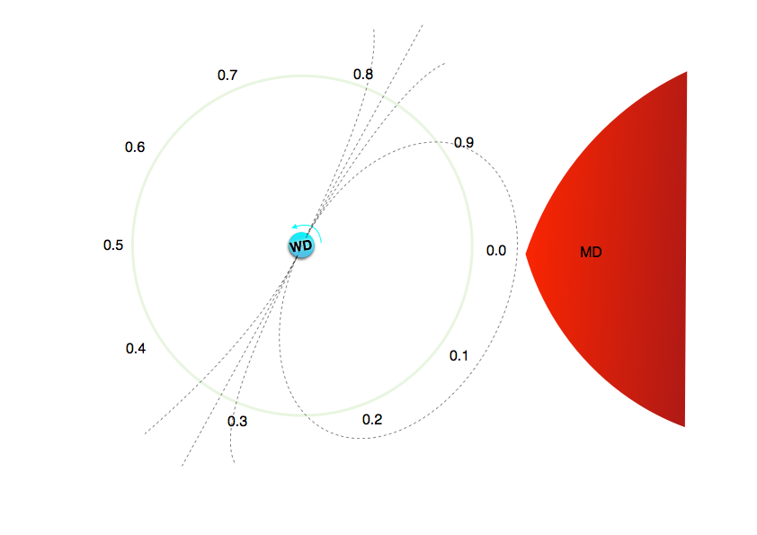

Slide 20
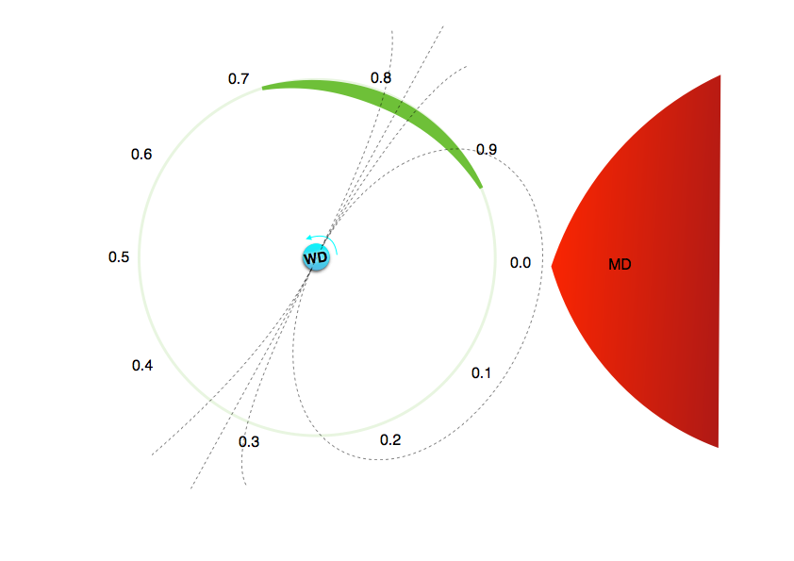

Slide 21
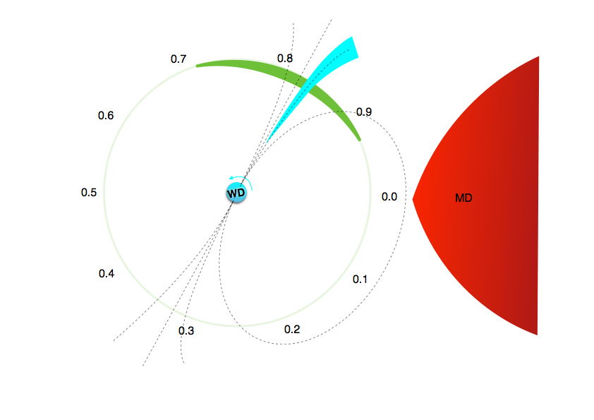

Slide 22
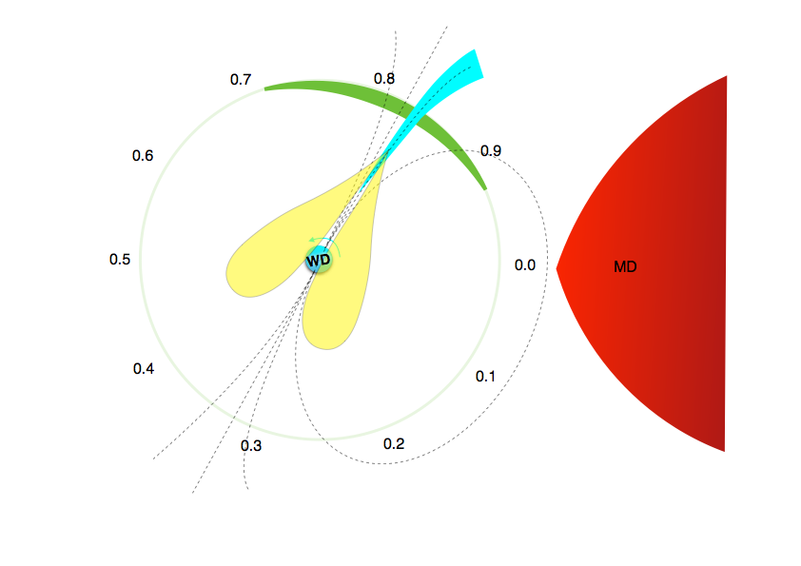

Slide 23
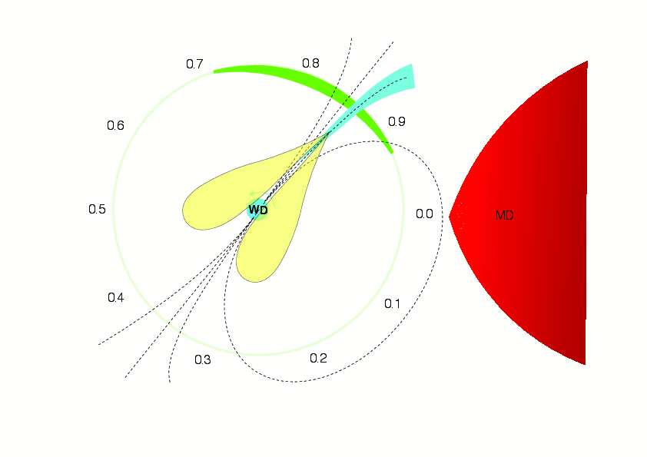

Slide 24
Model

Slide 25
Model

Slide 26
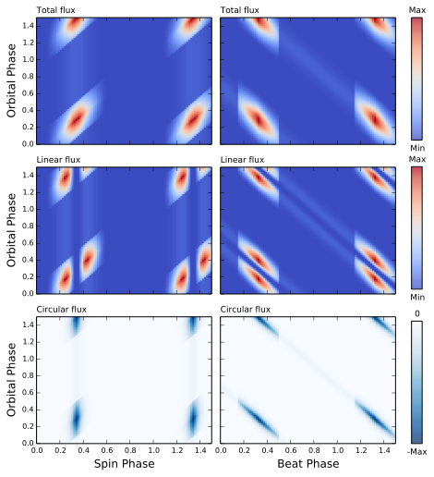
Model

Slide 27
Model
Observations

Slide 29
Model
Observations

Slide 30
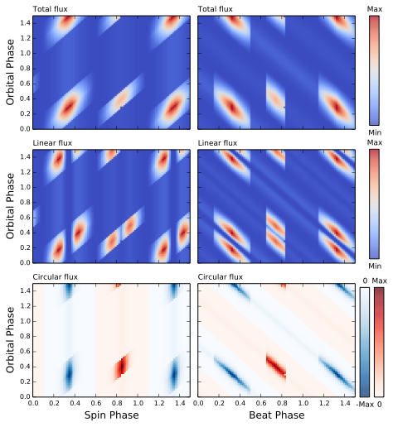
Model
Observations

Slide 31
Thank you

