Slide 1
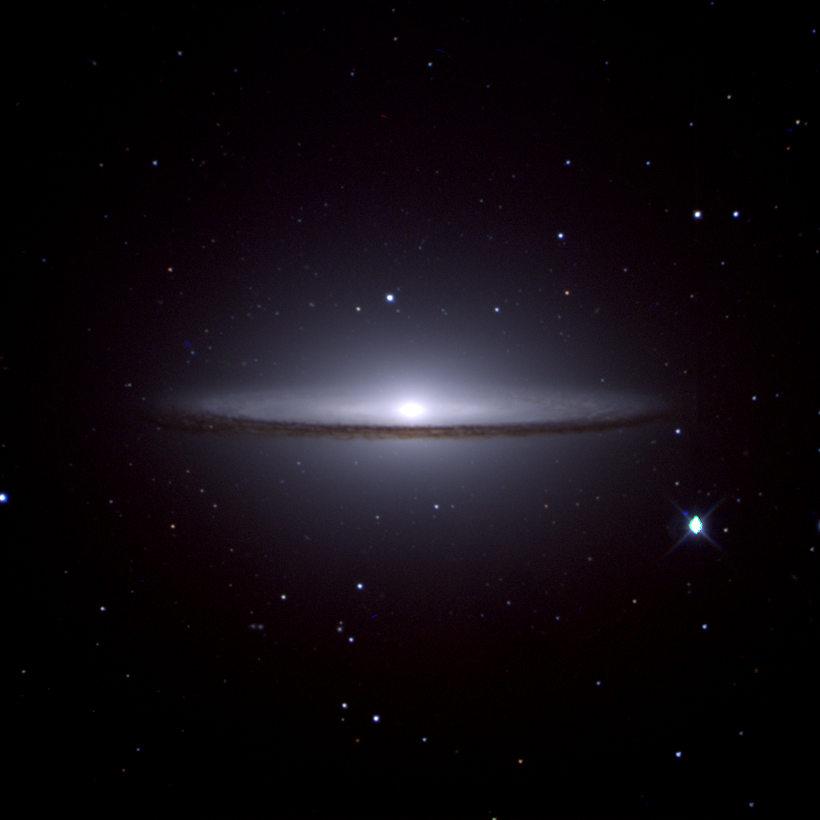

  Advancements and Opportunities
  at SAAO and SALT
  Stephen Potter
  South African Astronomical Observatory
  University of Johannesburg

Slide 2
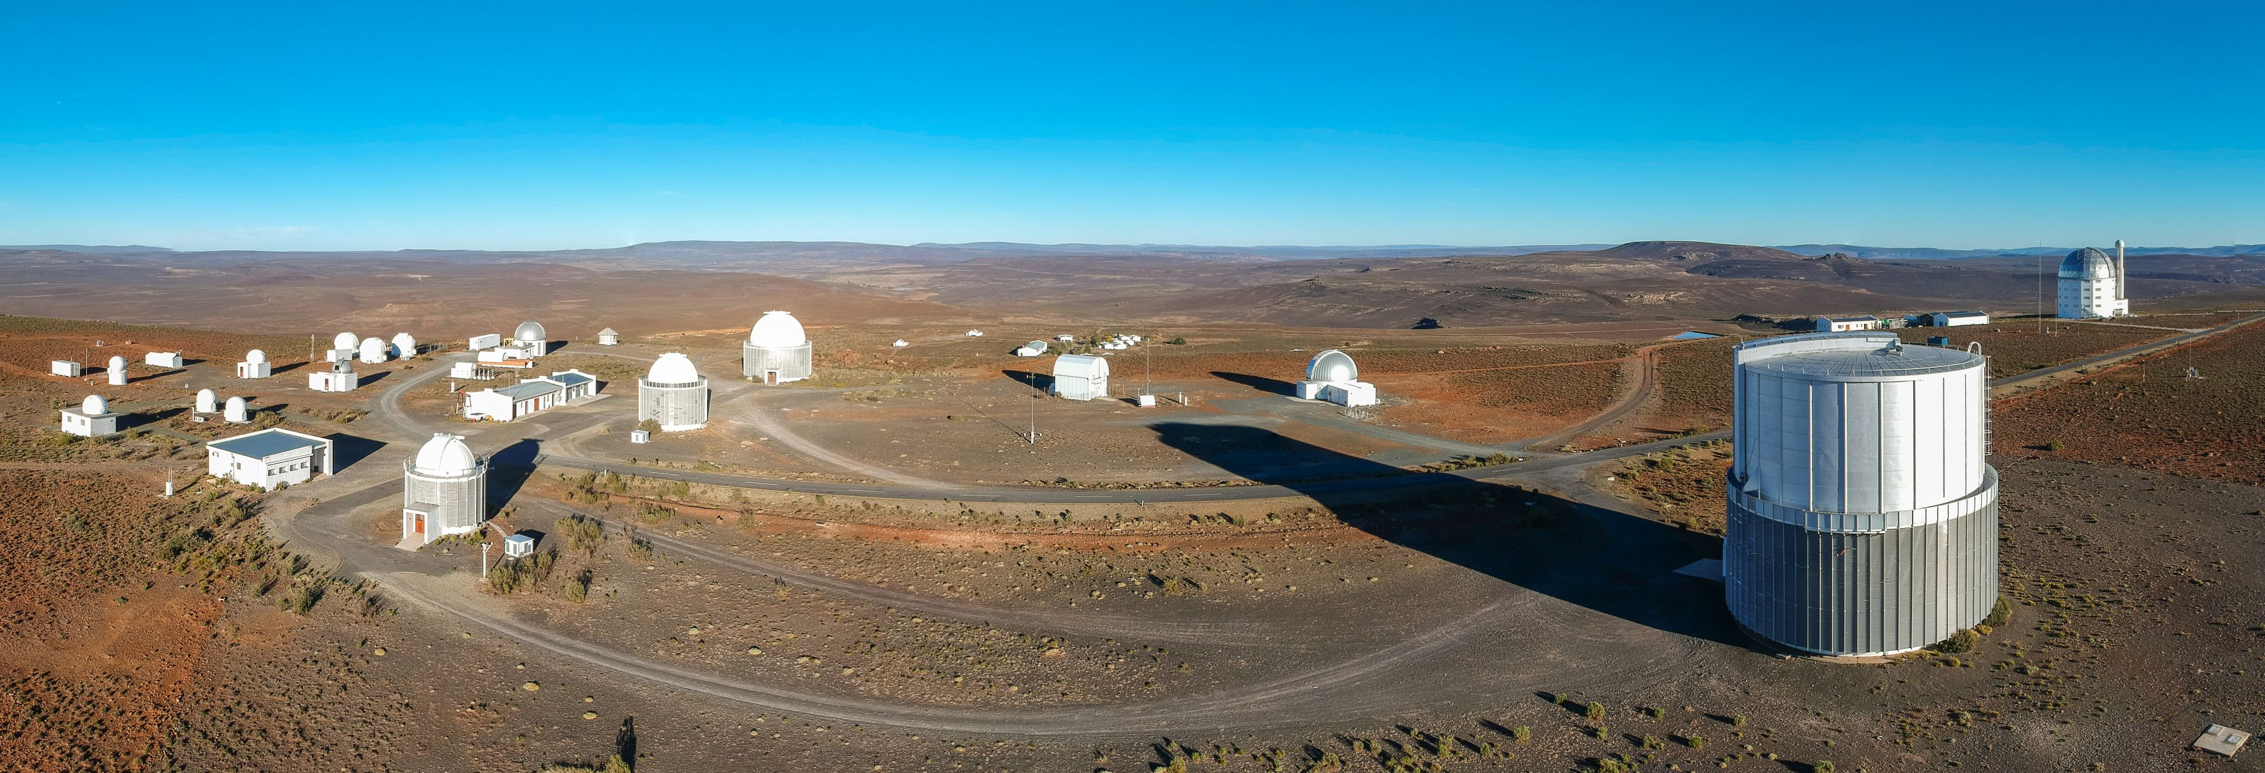

Slide 3
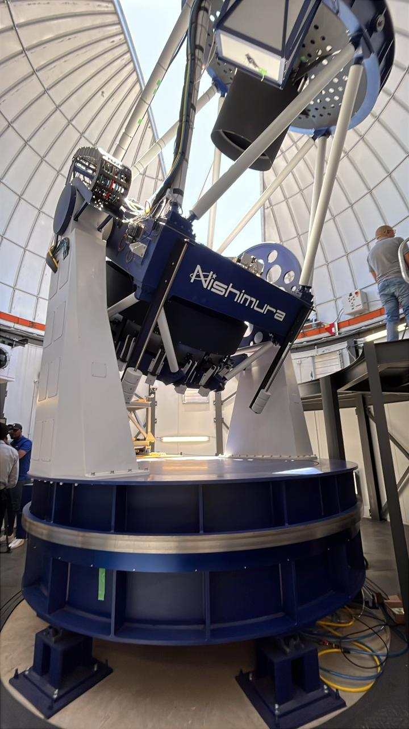
PRIME telescope
diameter = 1.8-m
prime focus detector = mosaic of 4 x H4RG-10 HgCdTe arrays with 10 micron pixels (flight spares from the WFIRST-Nancy Grace Roman Space Telescope mission)
1.3x1.3 degree FOV

Slide 4
The Intelligent Observatory (IO)
Vision #1
                Submit observation requests at any time✅
                Science on any time scale ✅
                Observe from Sutherland, Cape Town or anywhere ✅
                Observe manually, queue or service ✅
                Respond to alerts, computer generated requests ✅
                Automate from science idea –> data acquisition -> publication⏳
                Enhance our national and international partnerships ✅
Coordinated science across telescopes in the era of multi-messenger astronomy ✅
Advance SAAO into the 4IR ⏳

Slide 5
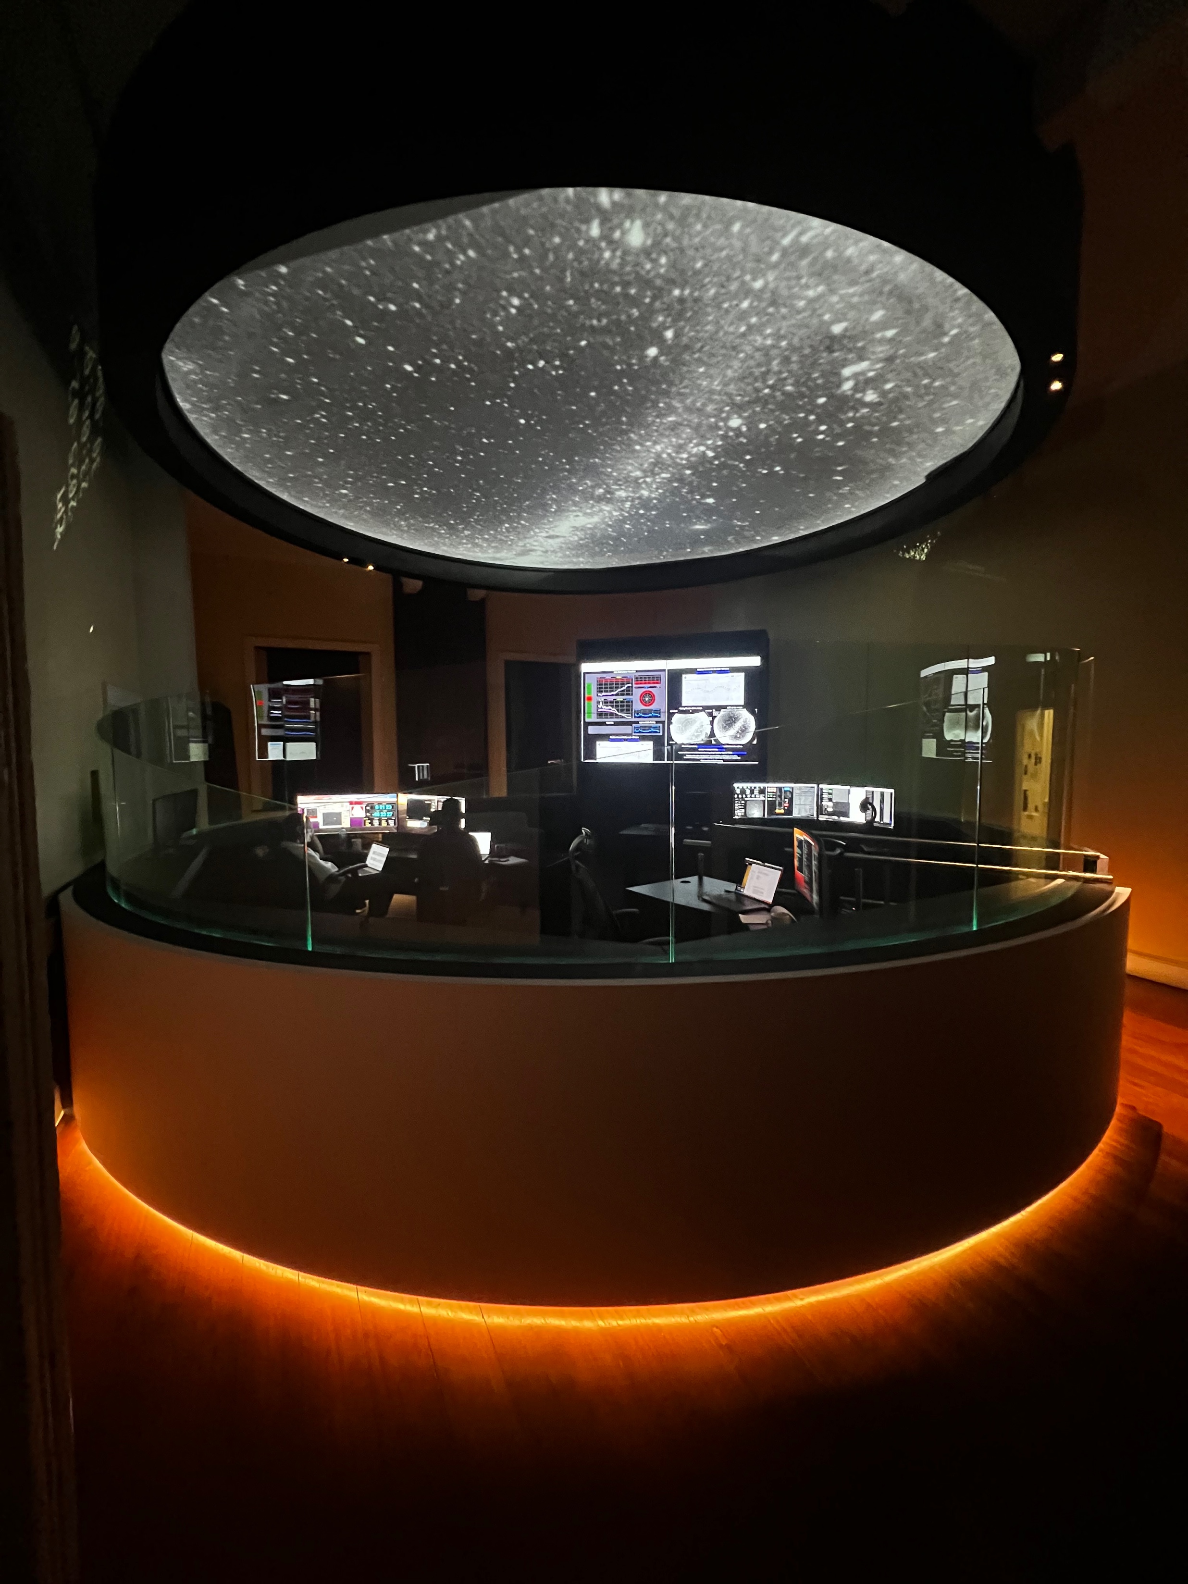
Remote Control Room in Cape Town
Designed as our flagship facility for remote operations
Immersive experience.
For our researchers, students and visitors

Slide 6
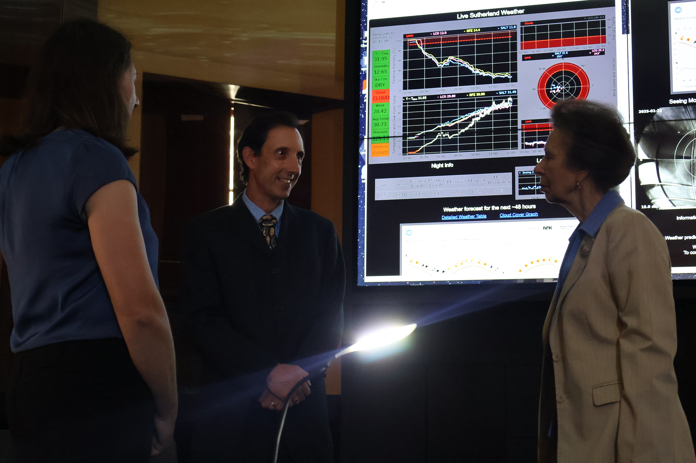

Slide 7


                New partnership with Hartree Center UK
New partnership: NRF – UK Science Technology Research Council
Hartree operates under the Science and Technology Facilities Council (STFC), which is part of UK Research and Innovation (UKRI)
established in 2012, Hartree Center is a UK-based research facility specializing in:
            high-performance computing (HPC),
      data analytics,
      and artificial intelligence (AI).

Slide 8
The Intelligent Observatory (IO)
Vision #2
                Analysing Observing Logs for Mookodi
                Analysis of ATLAS all-sky DAY images for scheduling flats with Mookodi
                Analysis of ATLAS All-Sky Night Images for Determining Cloud Coverage
                Automation of 74inch + SHOCNWONDER via the OCS
                SAAO data archive
                Document Configuration Management
                RAG Projects
                Telemetry Project
                Alerts Project

Slide 9
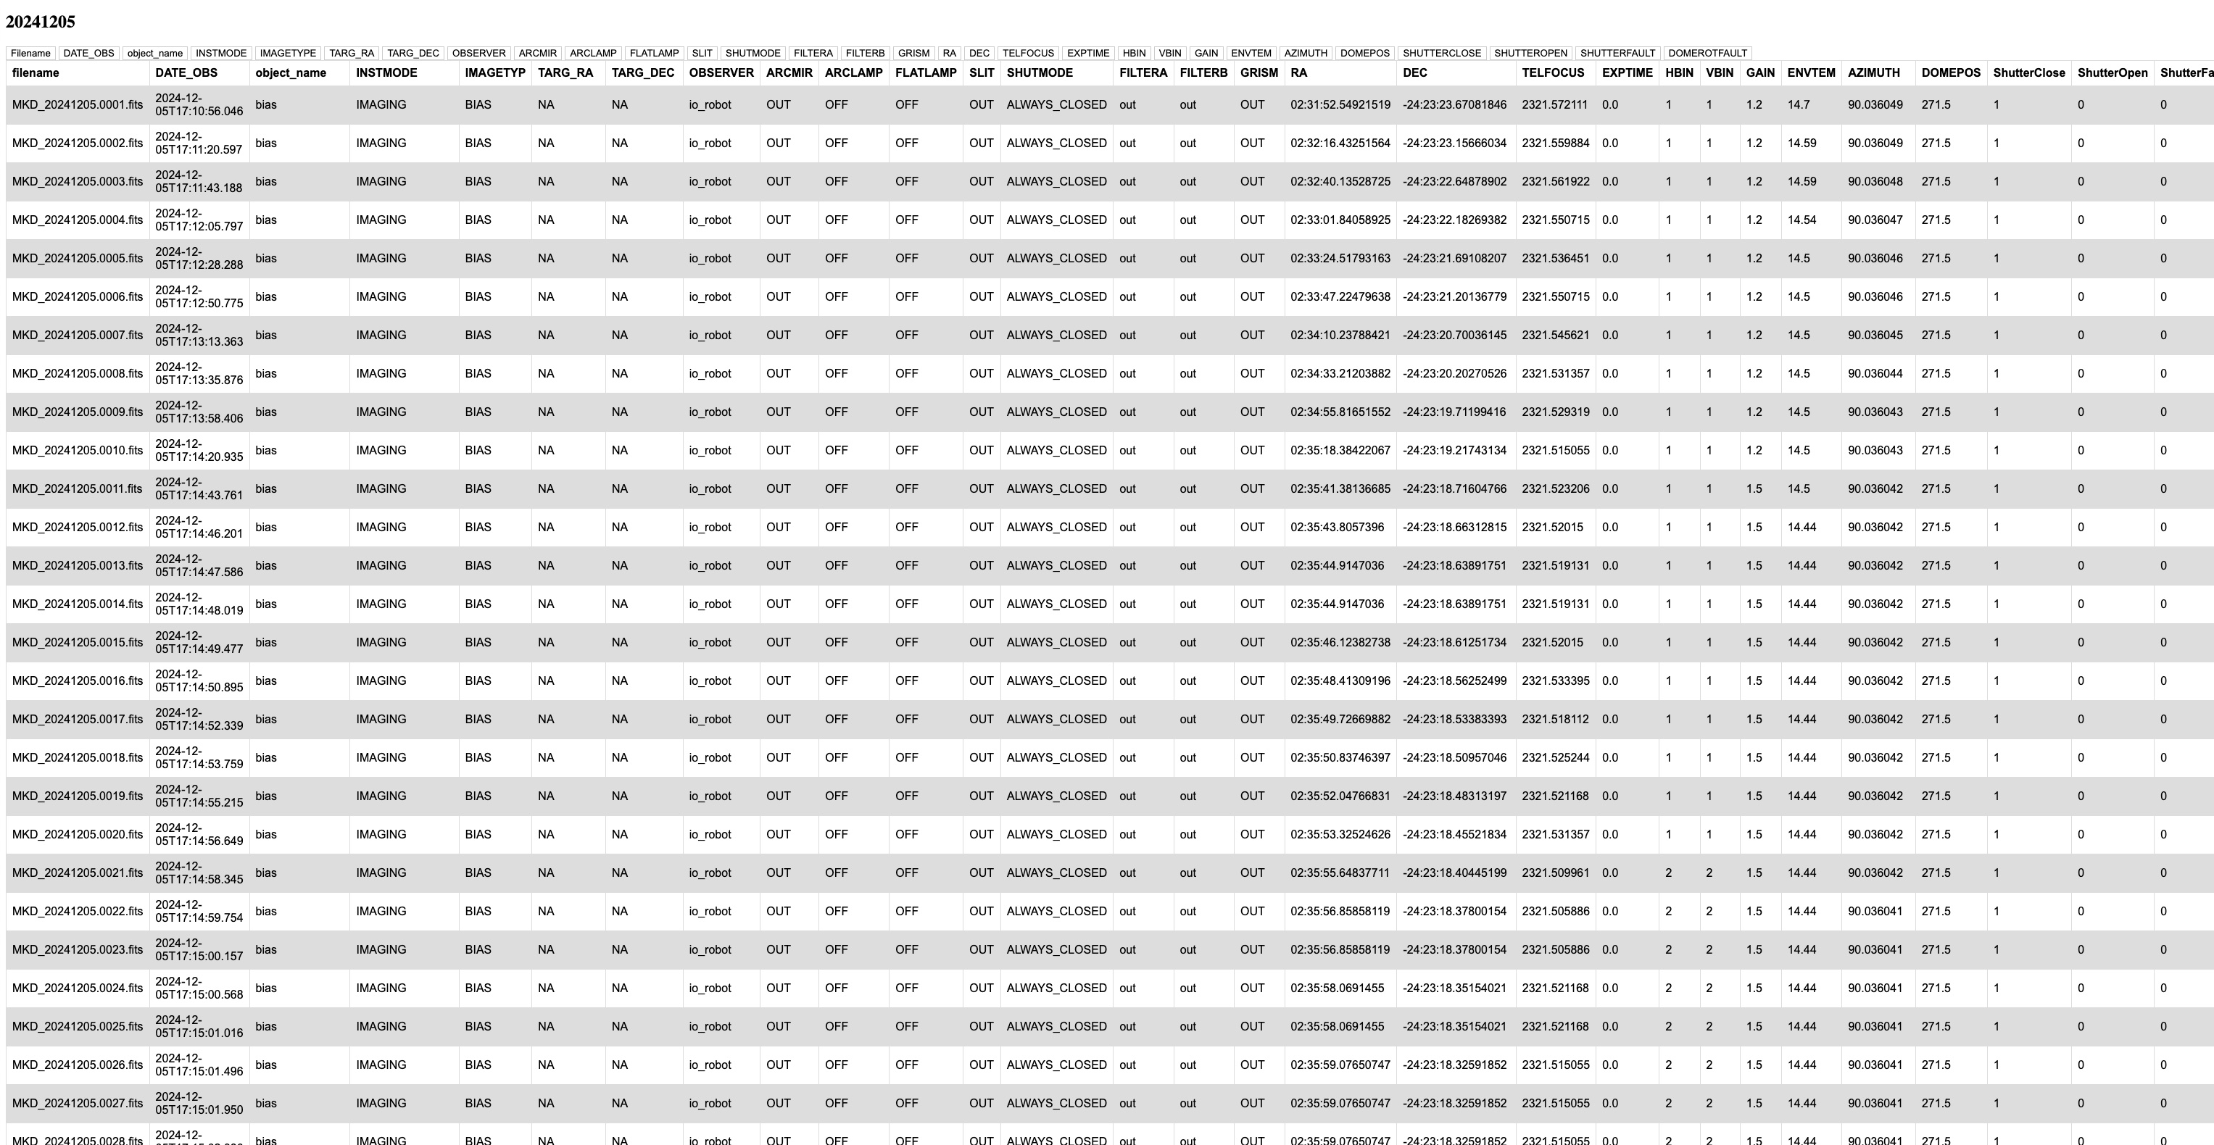
                Analysing Observing Logs for Mookodi/Lesedi

Slide 10

                Analysing Observing Logs for Mookodi/Lesedi

Slide 11
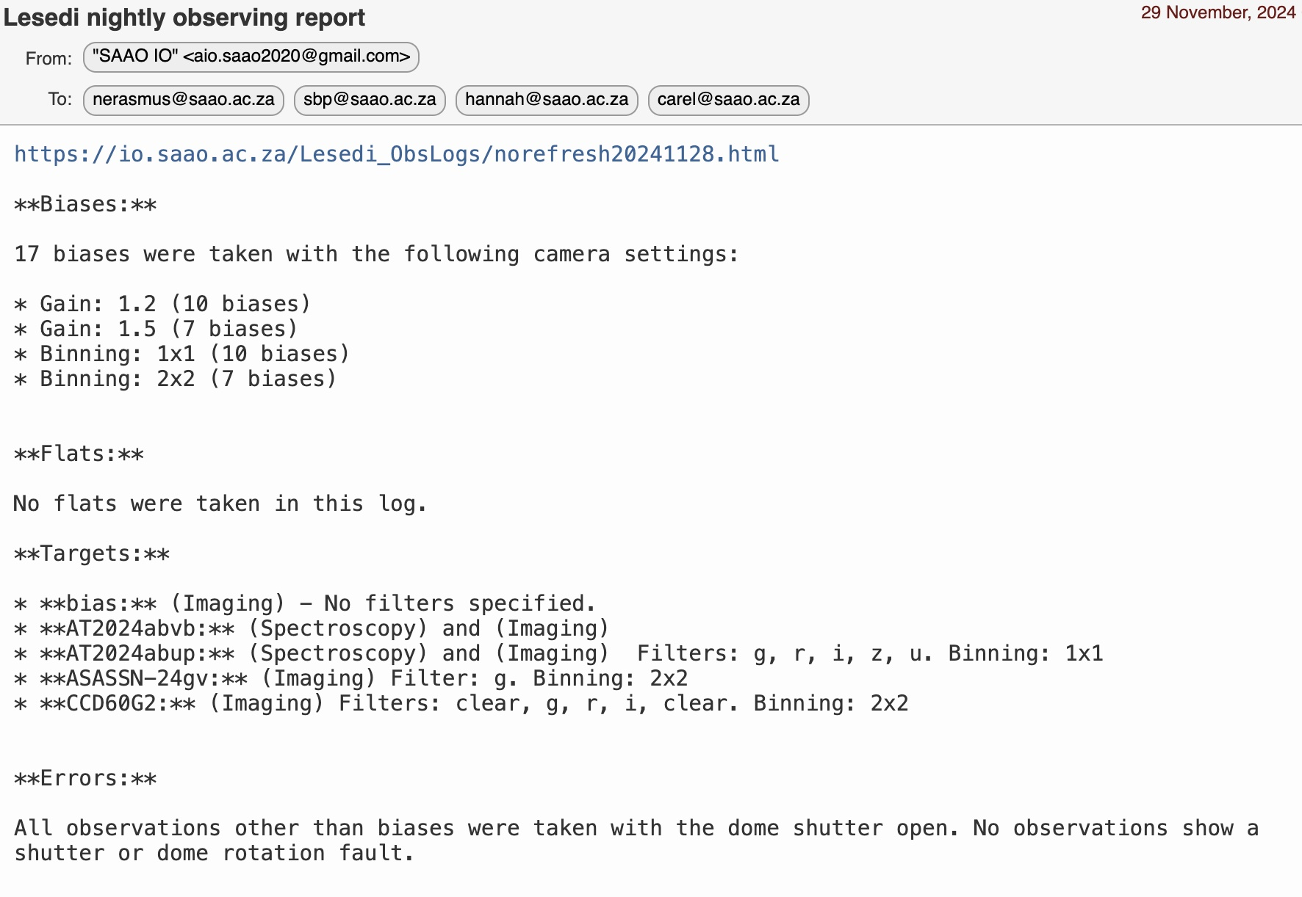
                Analysing Observing Logs for Mookodi/Lesedi

Slide 12
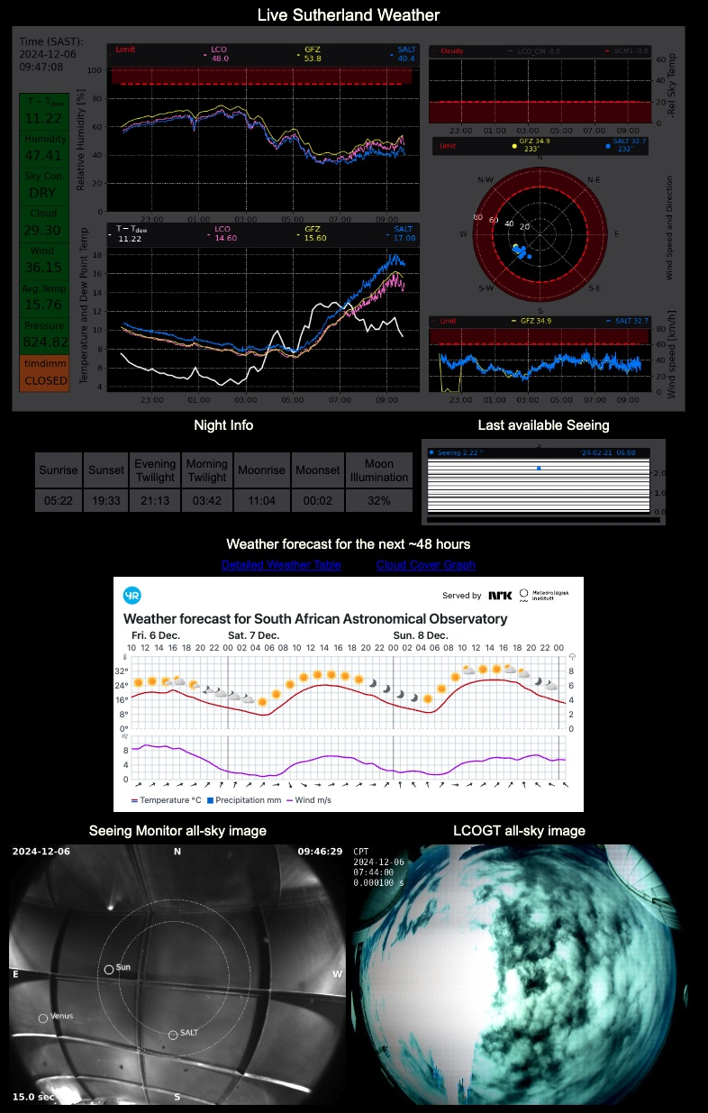
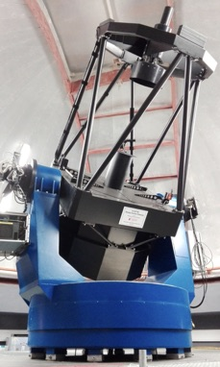


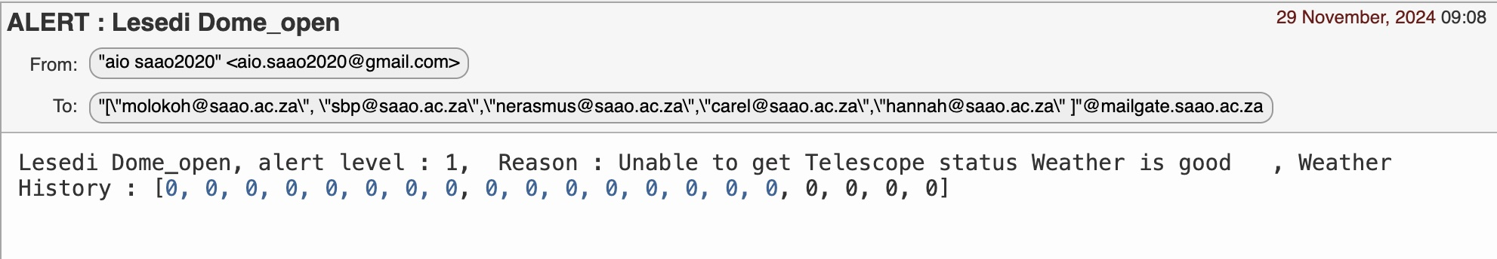
                The Alerts Project
A unified system to alert:

Slide 13
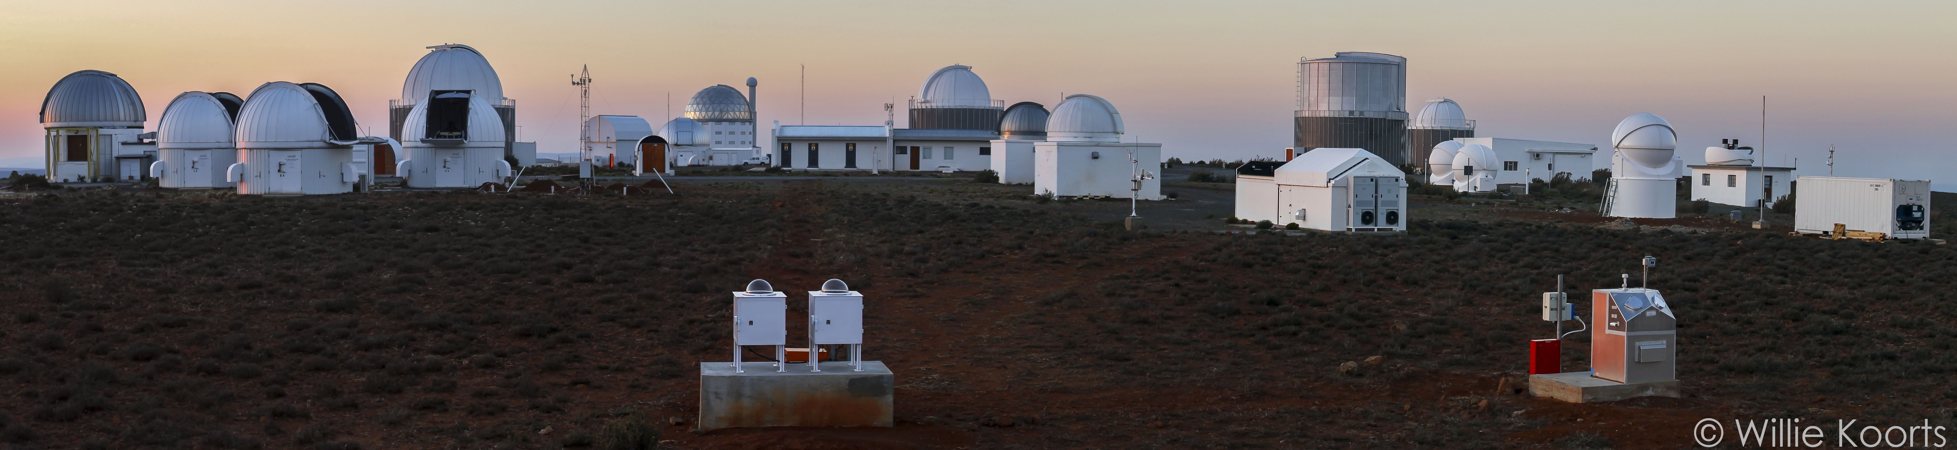

                The Telemetry Project
A unified system to log and analyse telemetry from all instruments and telescopes:
To perform health-checks
Predict necessary maintenance in advance
Produce advanced data products
Requires:
Logging of telemetry
Database design and implementation
AI tools

Slide 14
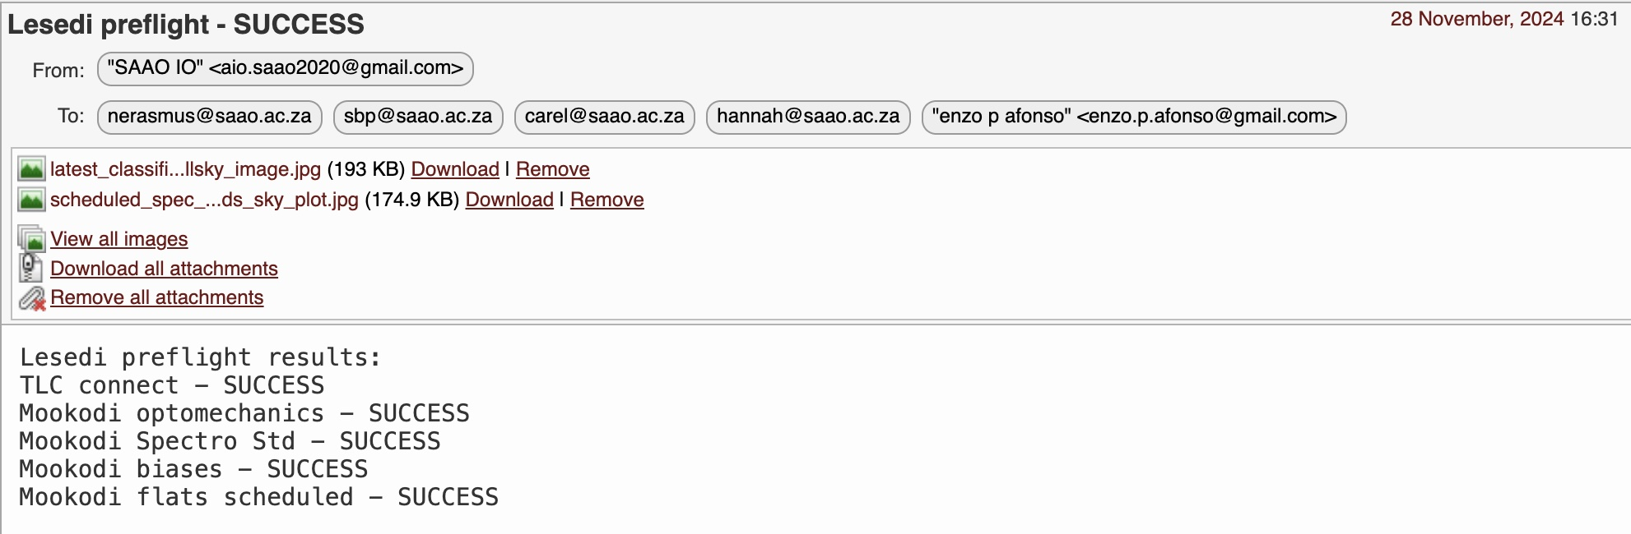
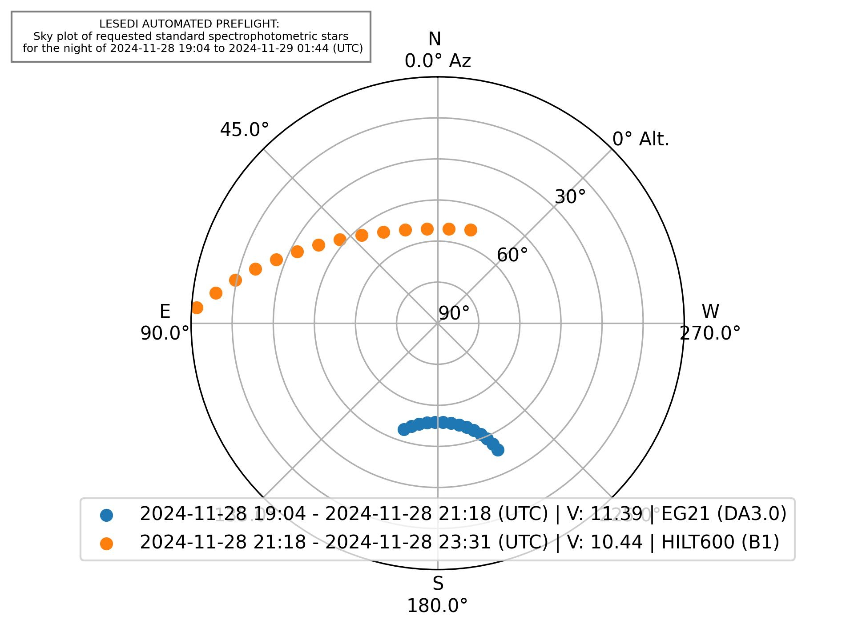
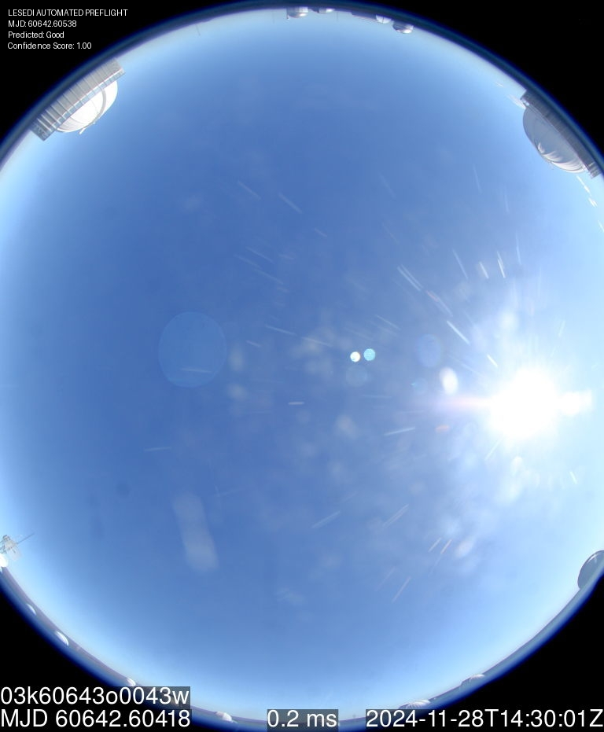
                Lesedi Pre-Flight

Slide 15
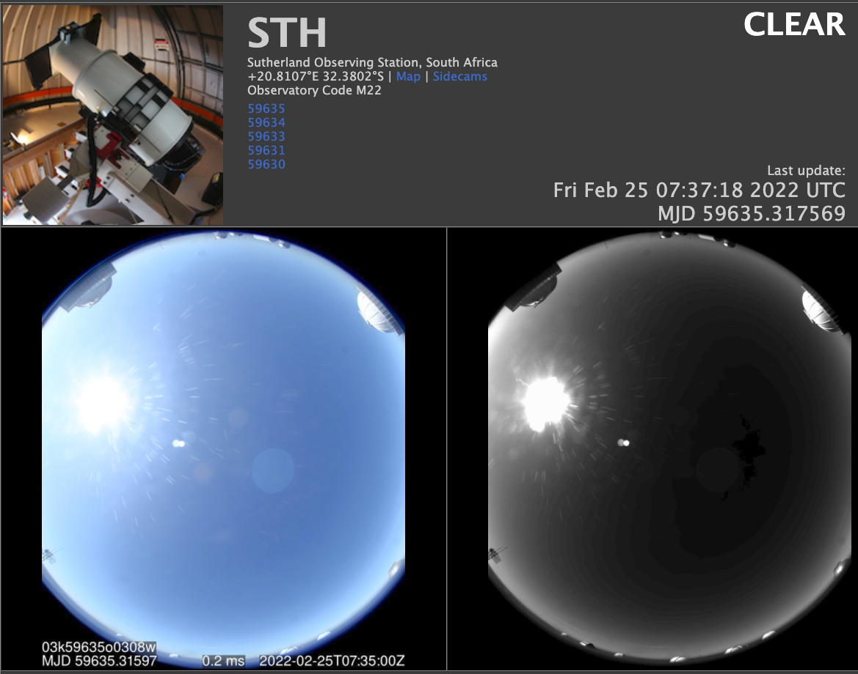
                Analysis of ATLAS all-sky DAY images
                for scheduling flats with Mookodi

Slide 16
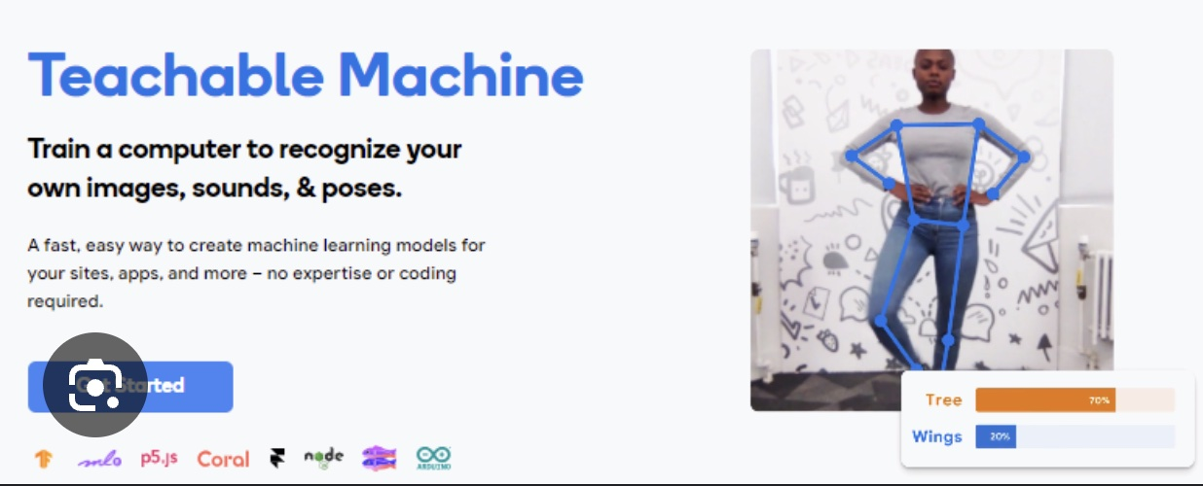

                Analysis of ATLAS all-sky DAY images
                for scheduling flats with Mookodi
The model is trained on data collected over several months and sorted by cloud cover percentages (GOOD: 0-20%, MARGINAL: 20-40%, BAD: 40-100%).
The model was trained via Google’s Teachable Machines, then implemented in Python using Keras (an open-source deep learning library written in Python).
Image is also verified using computer vision of timestamps embedded within the image).

Slide 17
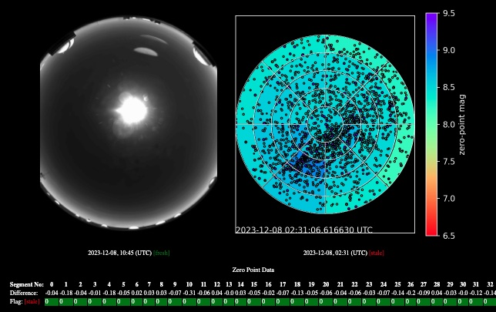
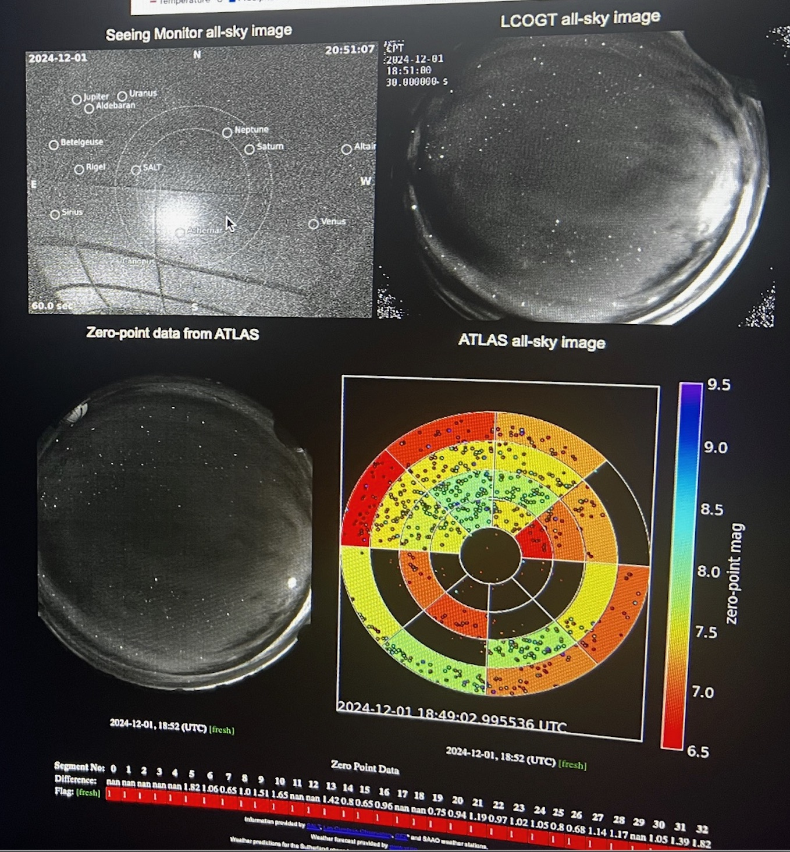
                Analysis of ATLAS all-sky NIGHT images
                for determining cloud coverage

Slide 18
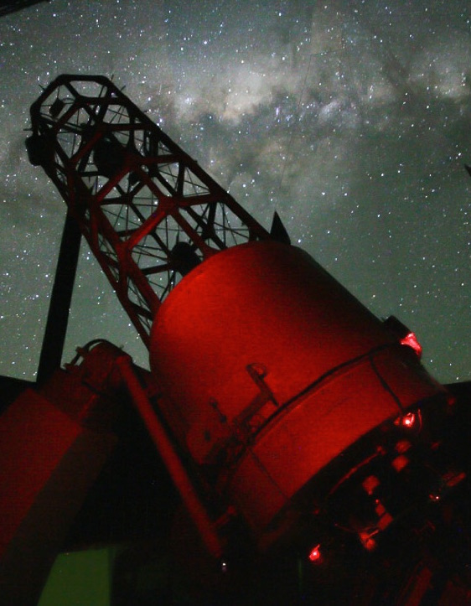
                Automation of 74inch+SHOCNWONDER
                via the OCS
Testing/fine tuning:
Submit requests via OCS
74inch polls OCS for schedule
74inch executes OCS requests
Point to target RA, Dec
Perform WCS on live image
Fine pointing to magic pixel
Auto focus
Start guiding
Perform observations
Todo:
LCU for weather override etc

Slide 19
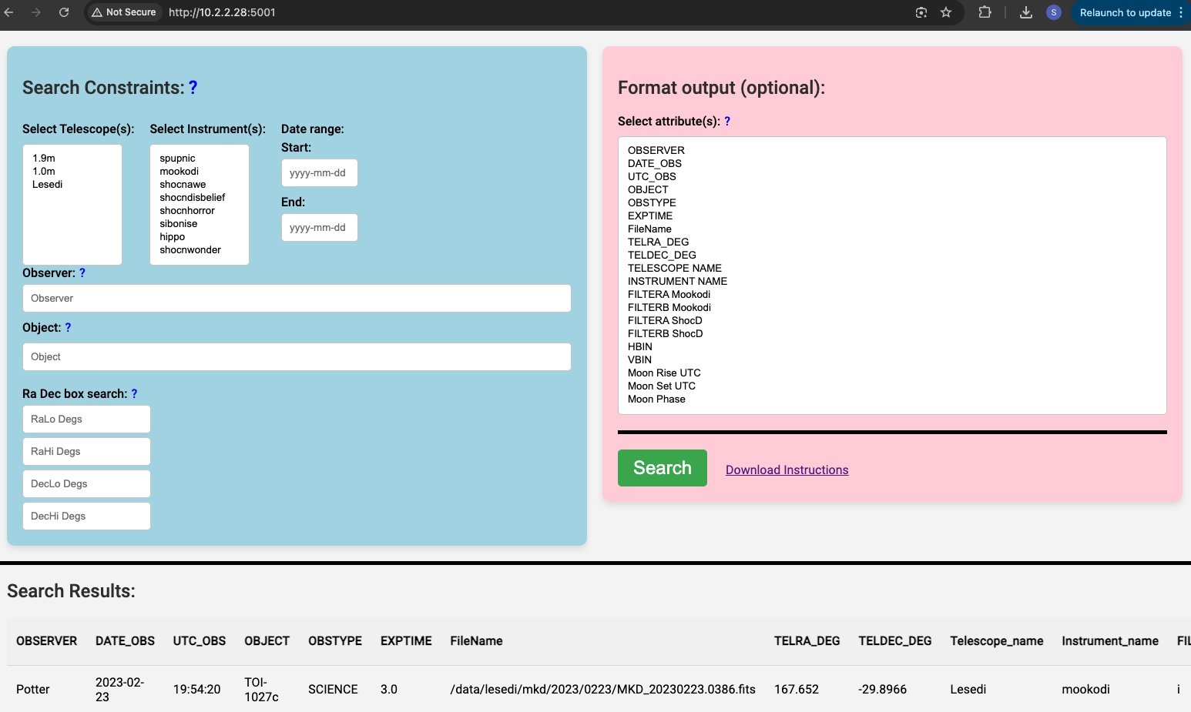
                SAAO data archive

Slide 20

                Document Configuration Management
                SALT docs, SAAO docs, IO docs, Topswiki, googledocs ….

Slide 21
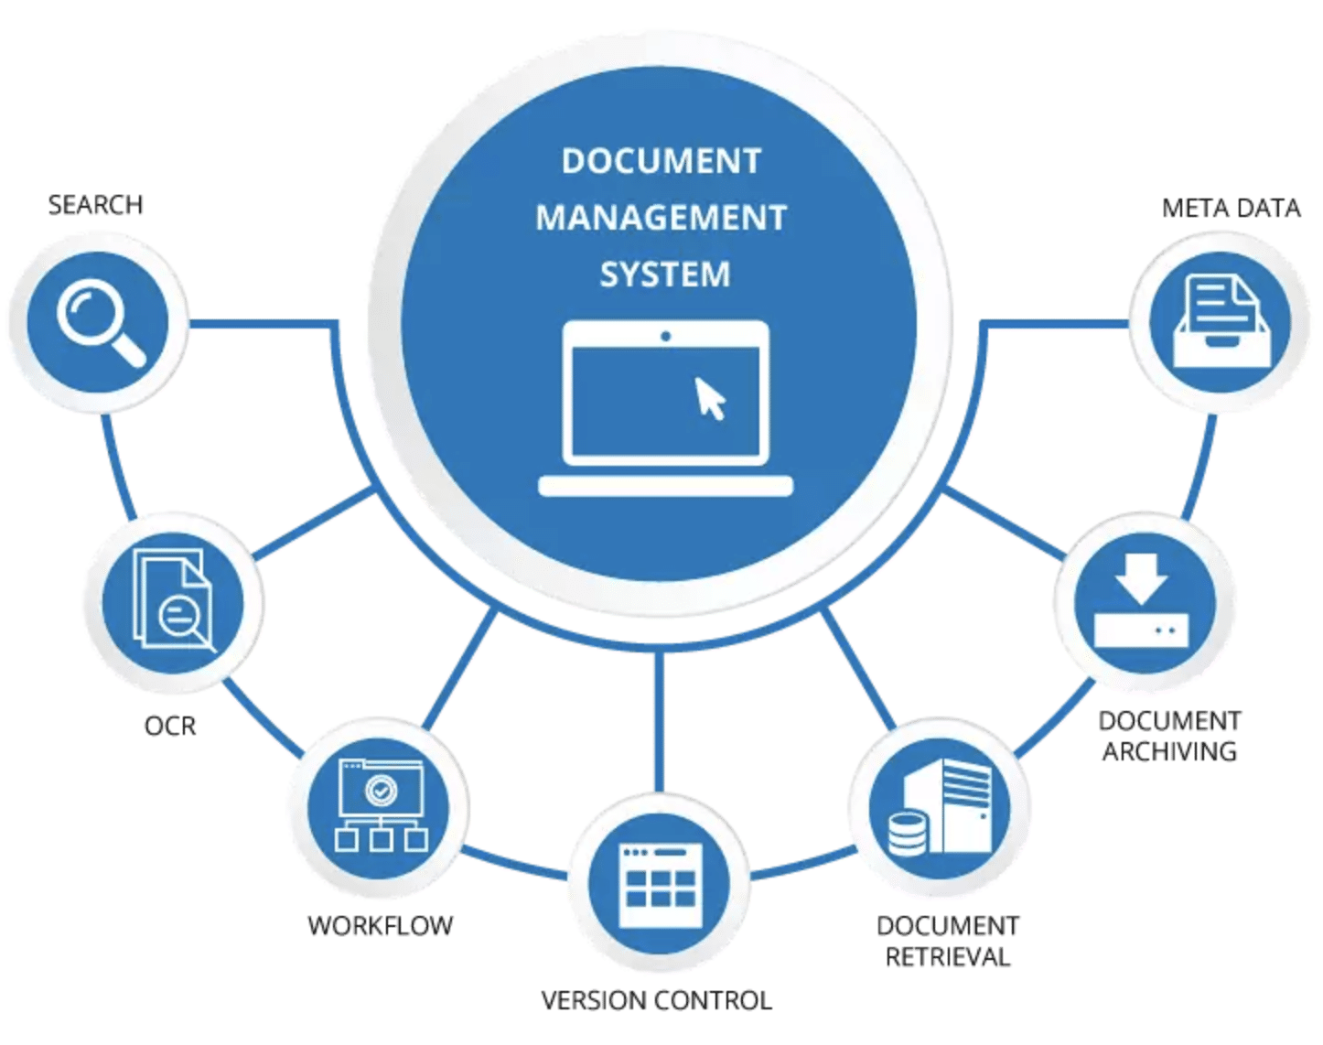


Slide 22
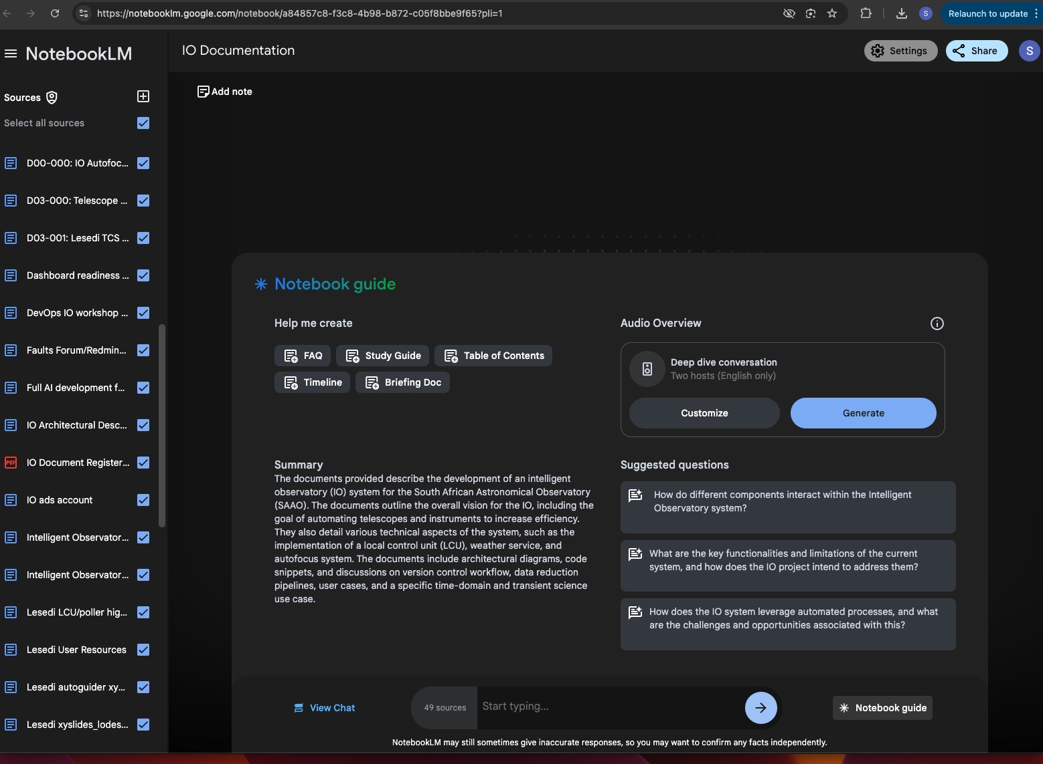

Slide 23
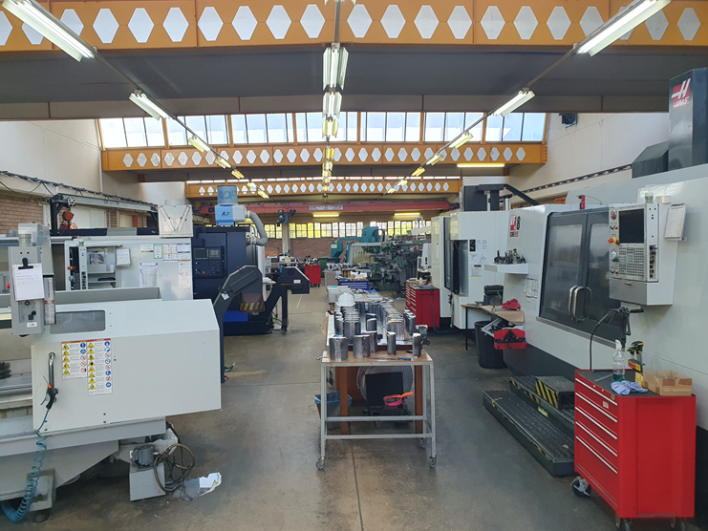
Precision Manufacturing
Fabrication:
Three 5-axis CNC precision milling 2um precision
Two CNC lathes precision turning 2um precision
EDM (Electrical discharge machining), plunge and wire, sub micron precision
Measurement (all sub micron):
Coordinate Measuring Machine ( 1.5m bed)
Videograph (shadow graph measurement)
Optical and fibre Lab
50um and larger fibre splicing, polishing and bonding for IFU's
Optical Characterisation and calibration of fibre bundles

Slide 24
  Advancements and Opportunities
  at SAAO and SALT
  Stephen Potter
  South African Astronomical Observatory
  University of Johannesburg

Slide 25

Science
Automation
Telemetry
AI

