Slide 1
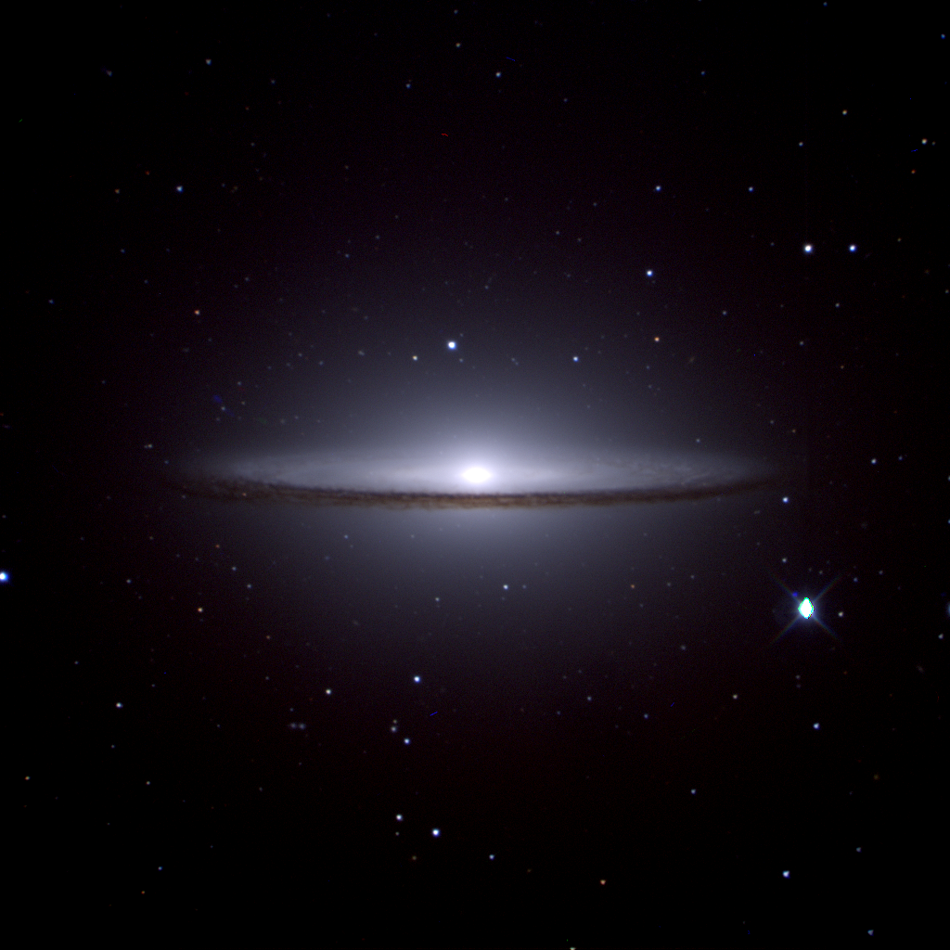
South African Astronomical Observatory
The IO programme
Sprint #21 Review
Moloko Hlakola, Hannah Worters, Carel van Gend, Nicolas Erasmus, Roufurd Julie, Sunil Chandra, Stephen Potter

Slide 2
Sprint Updates
Non-sidereal spectroscopy
Biases and flats
OCS time accounting
Dashboard
Weather service
74inch instrument selector port

Slide 3
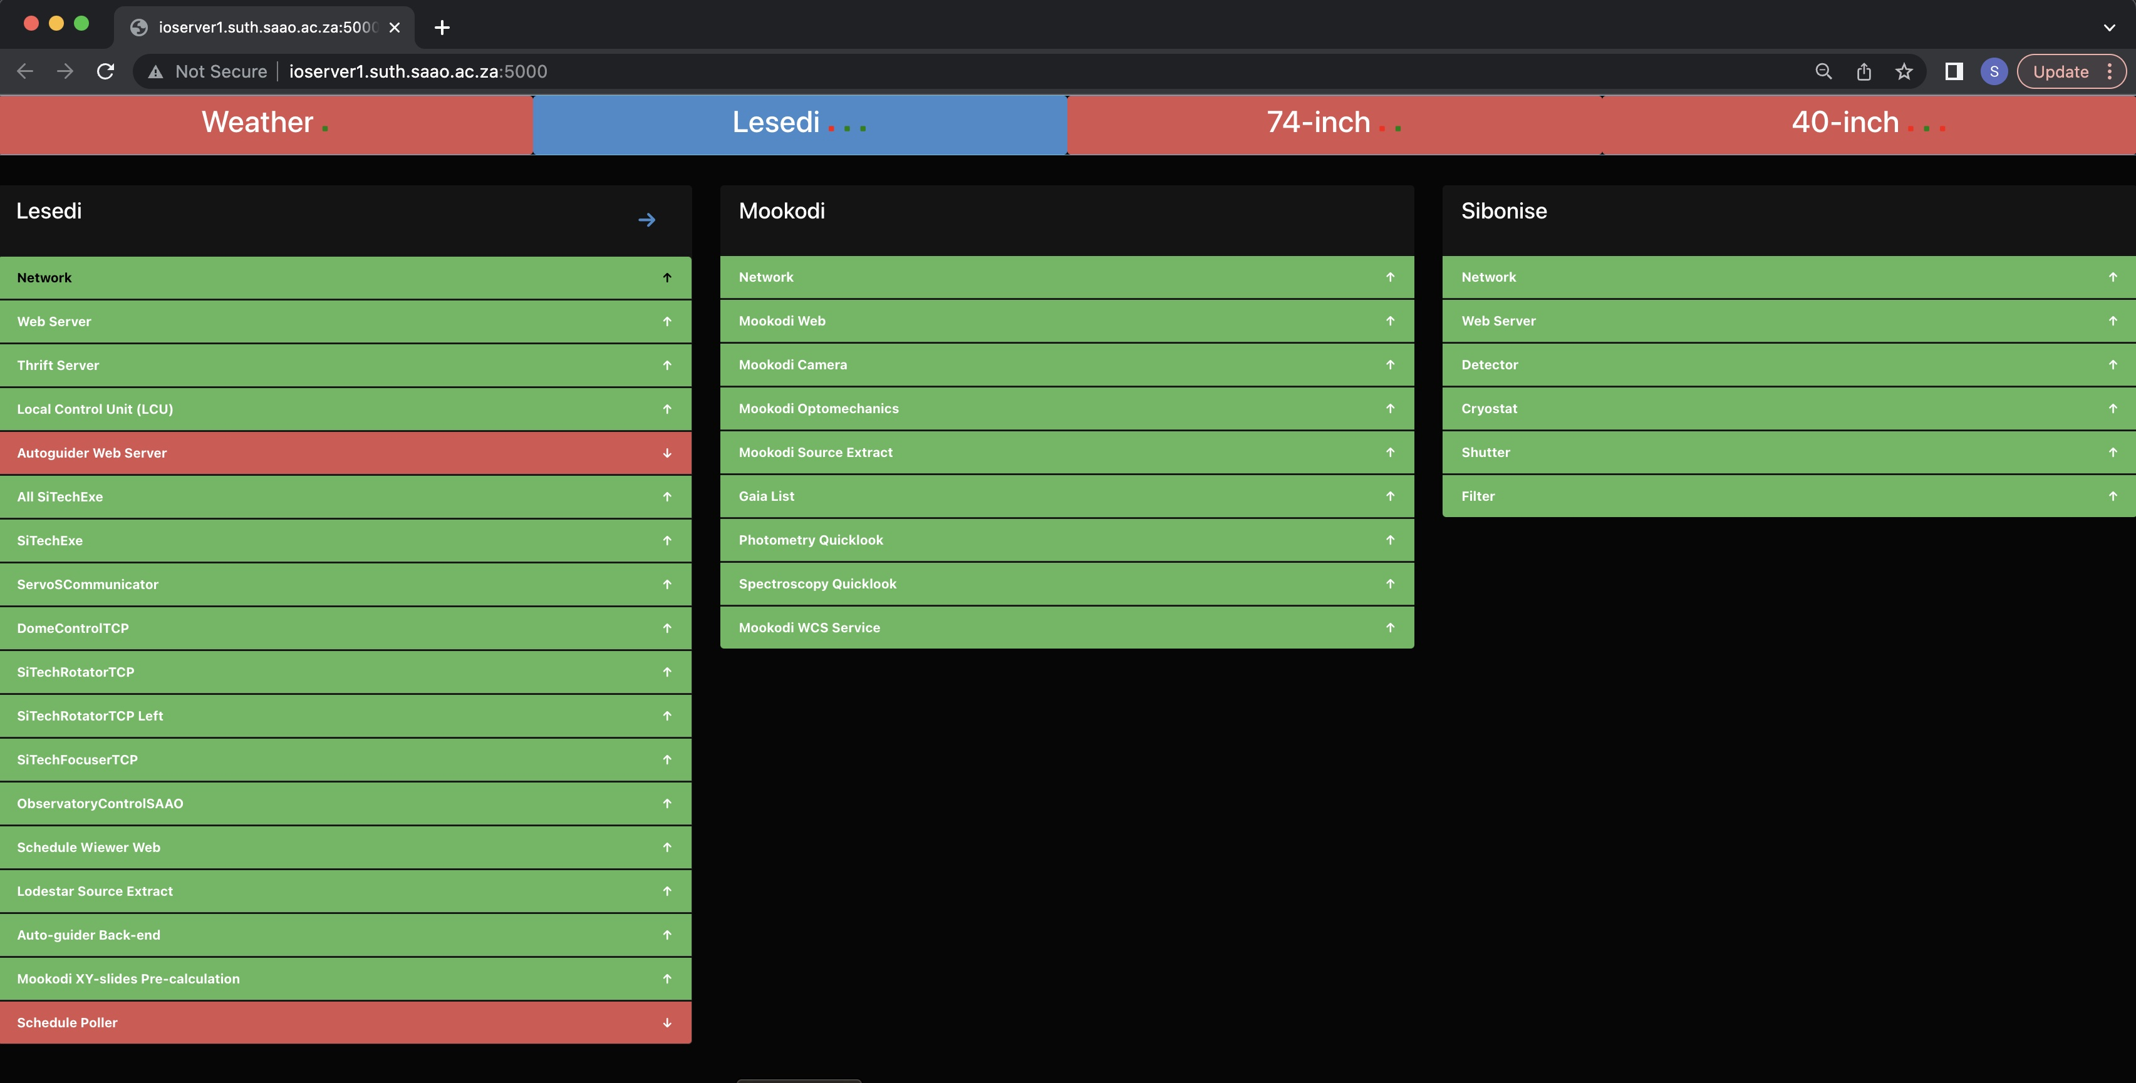
Dashboard

Slide 4
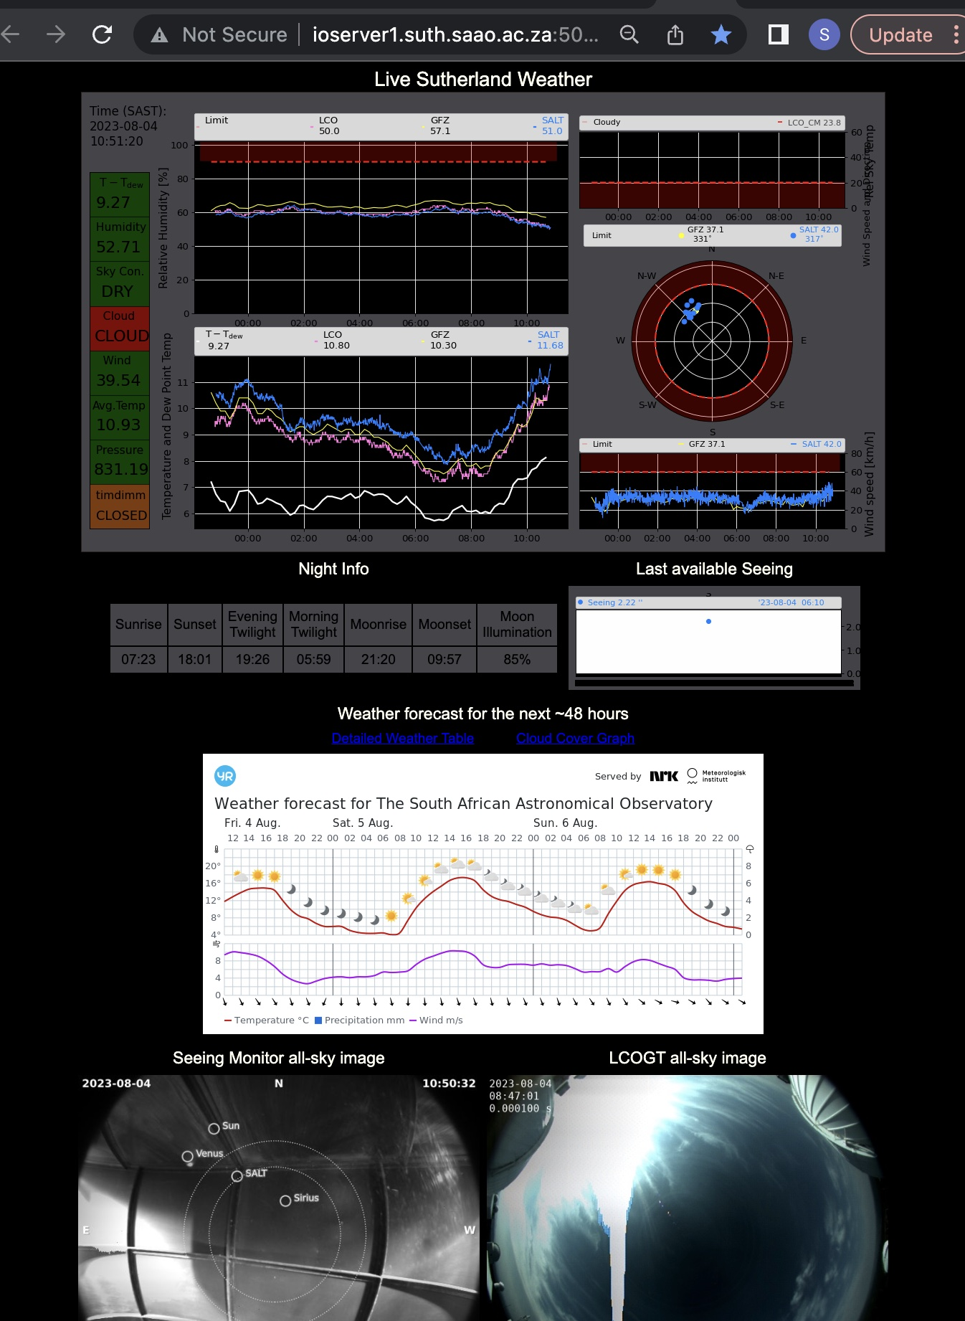
Weather Service

Slide 5
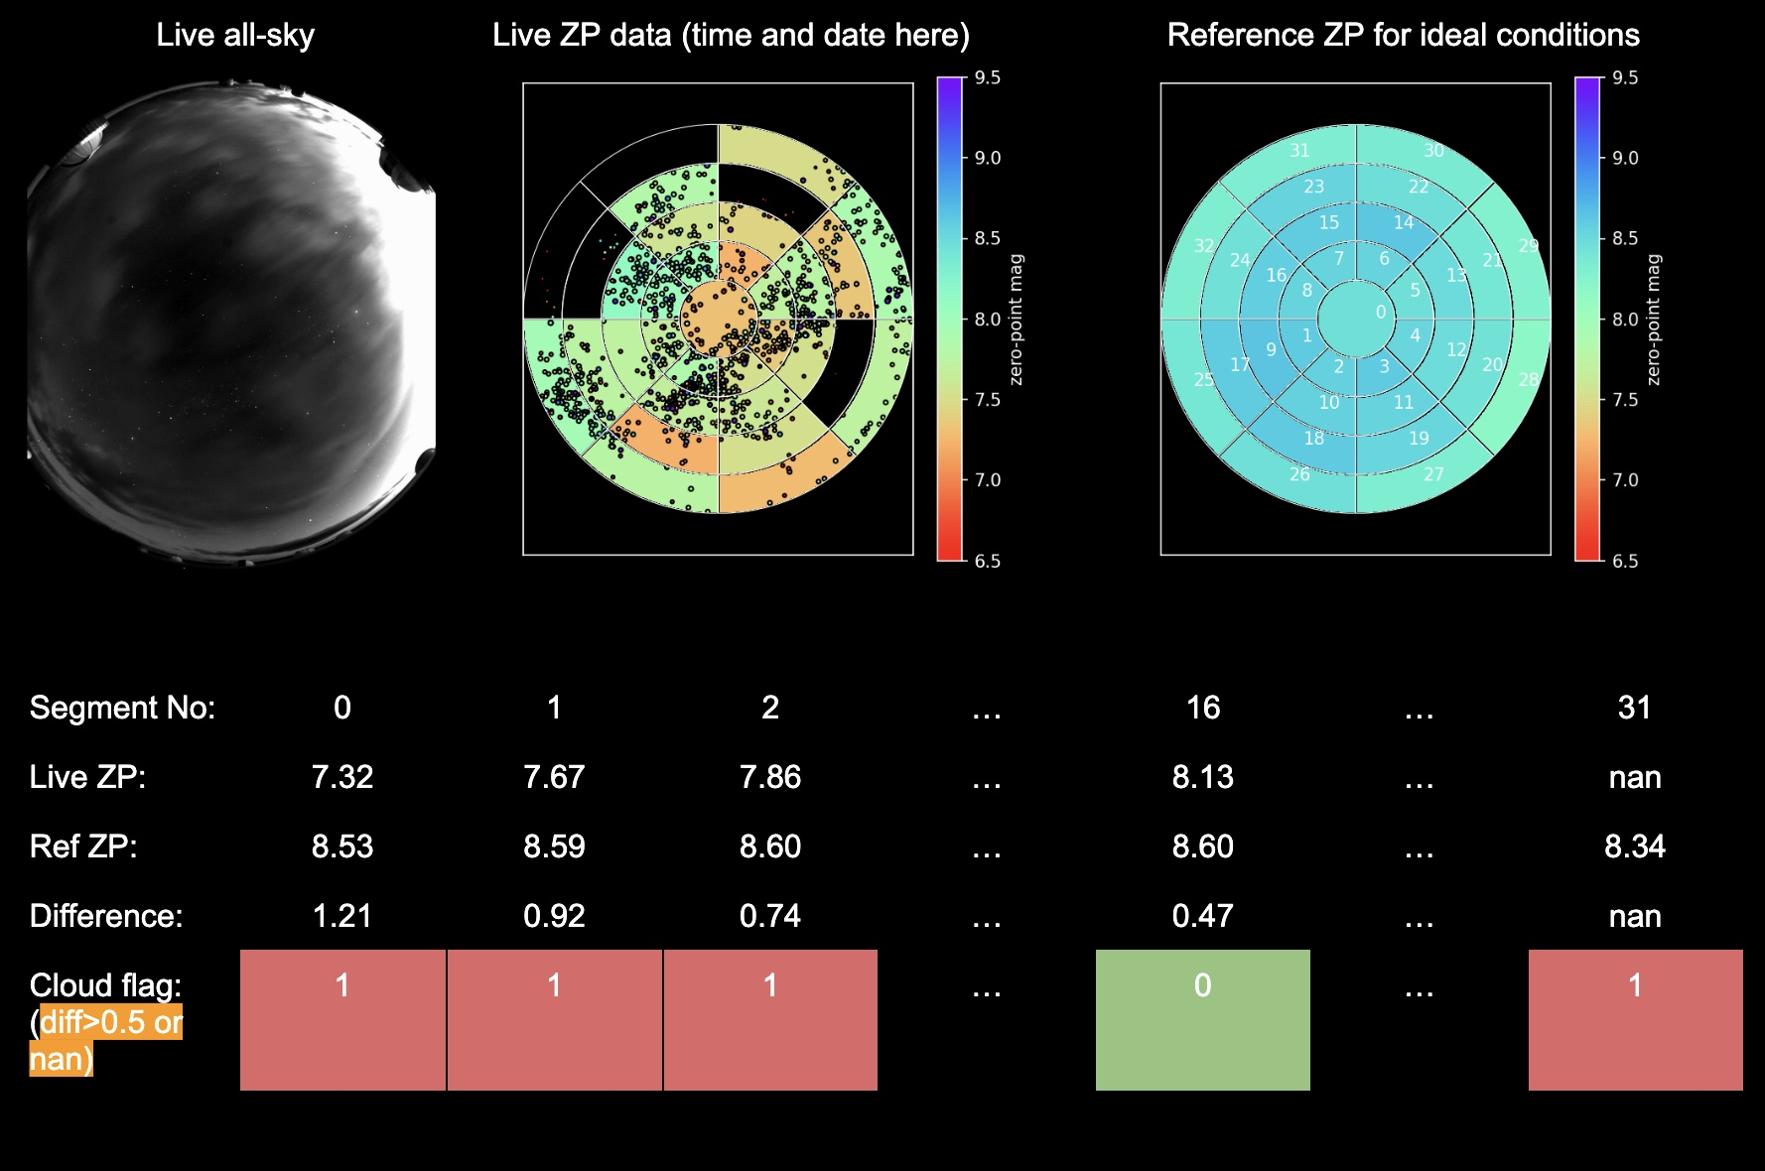
Weather Service

Slide 6
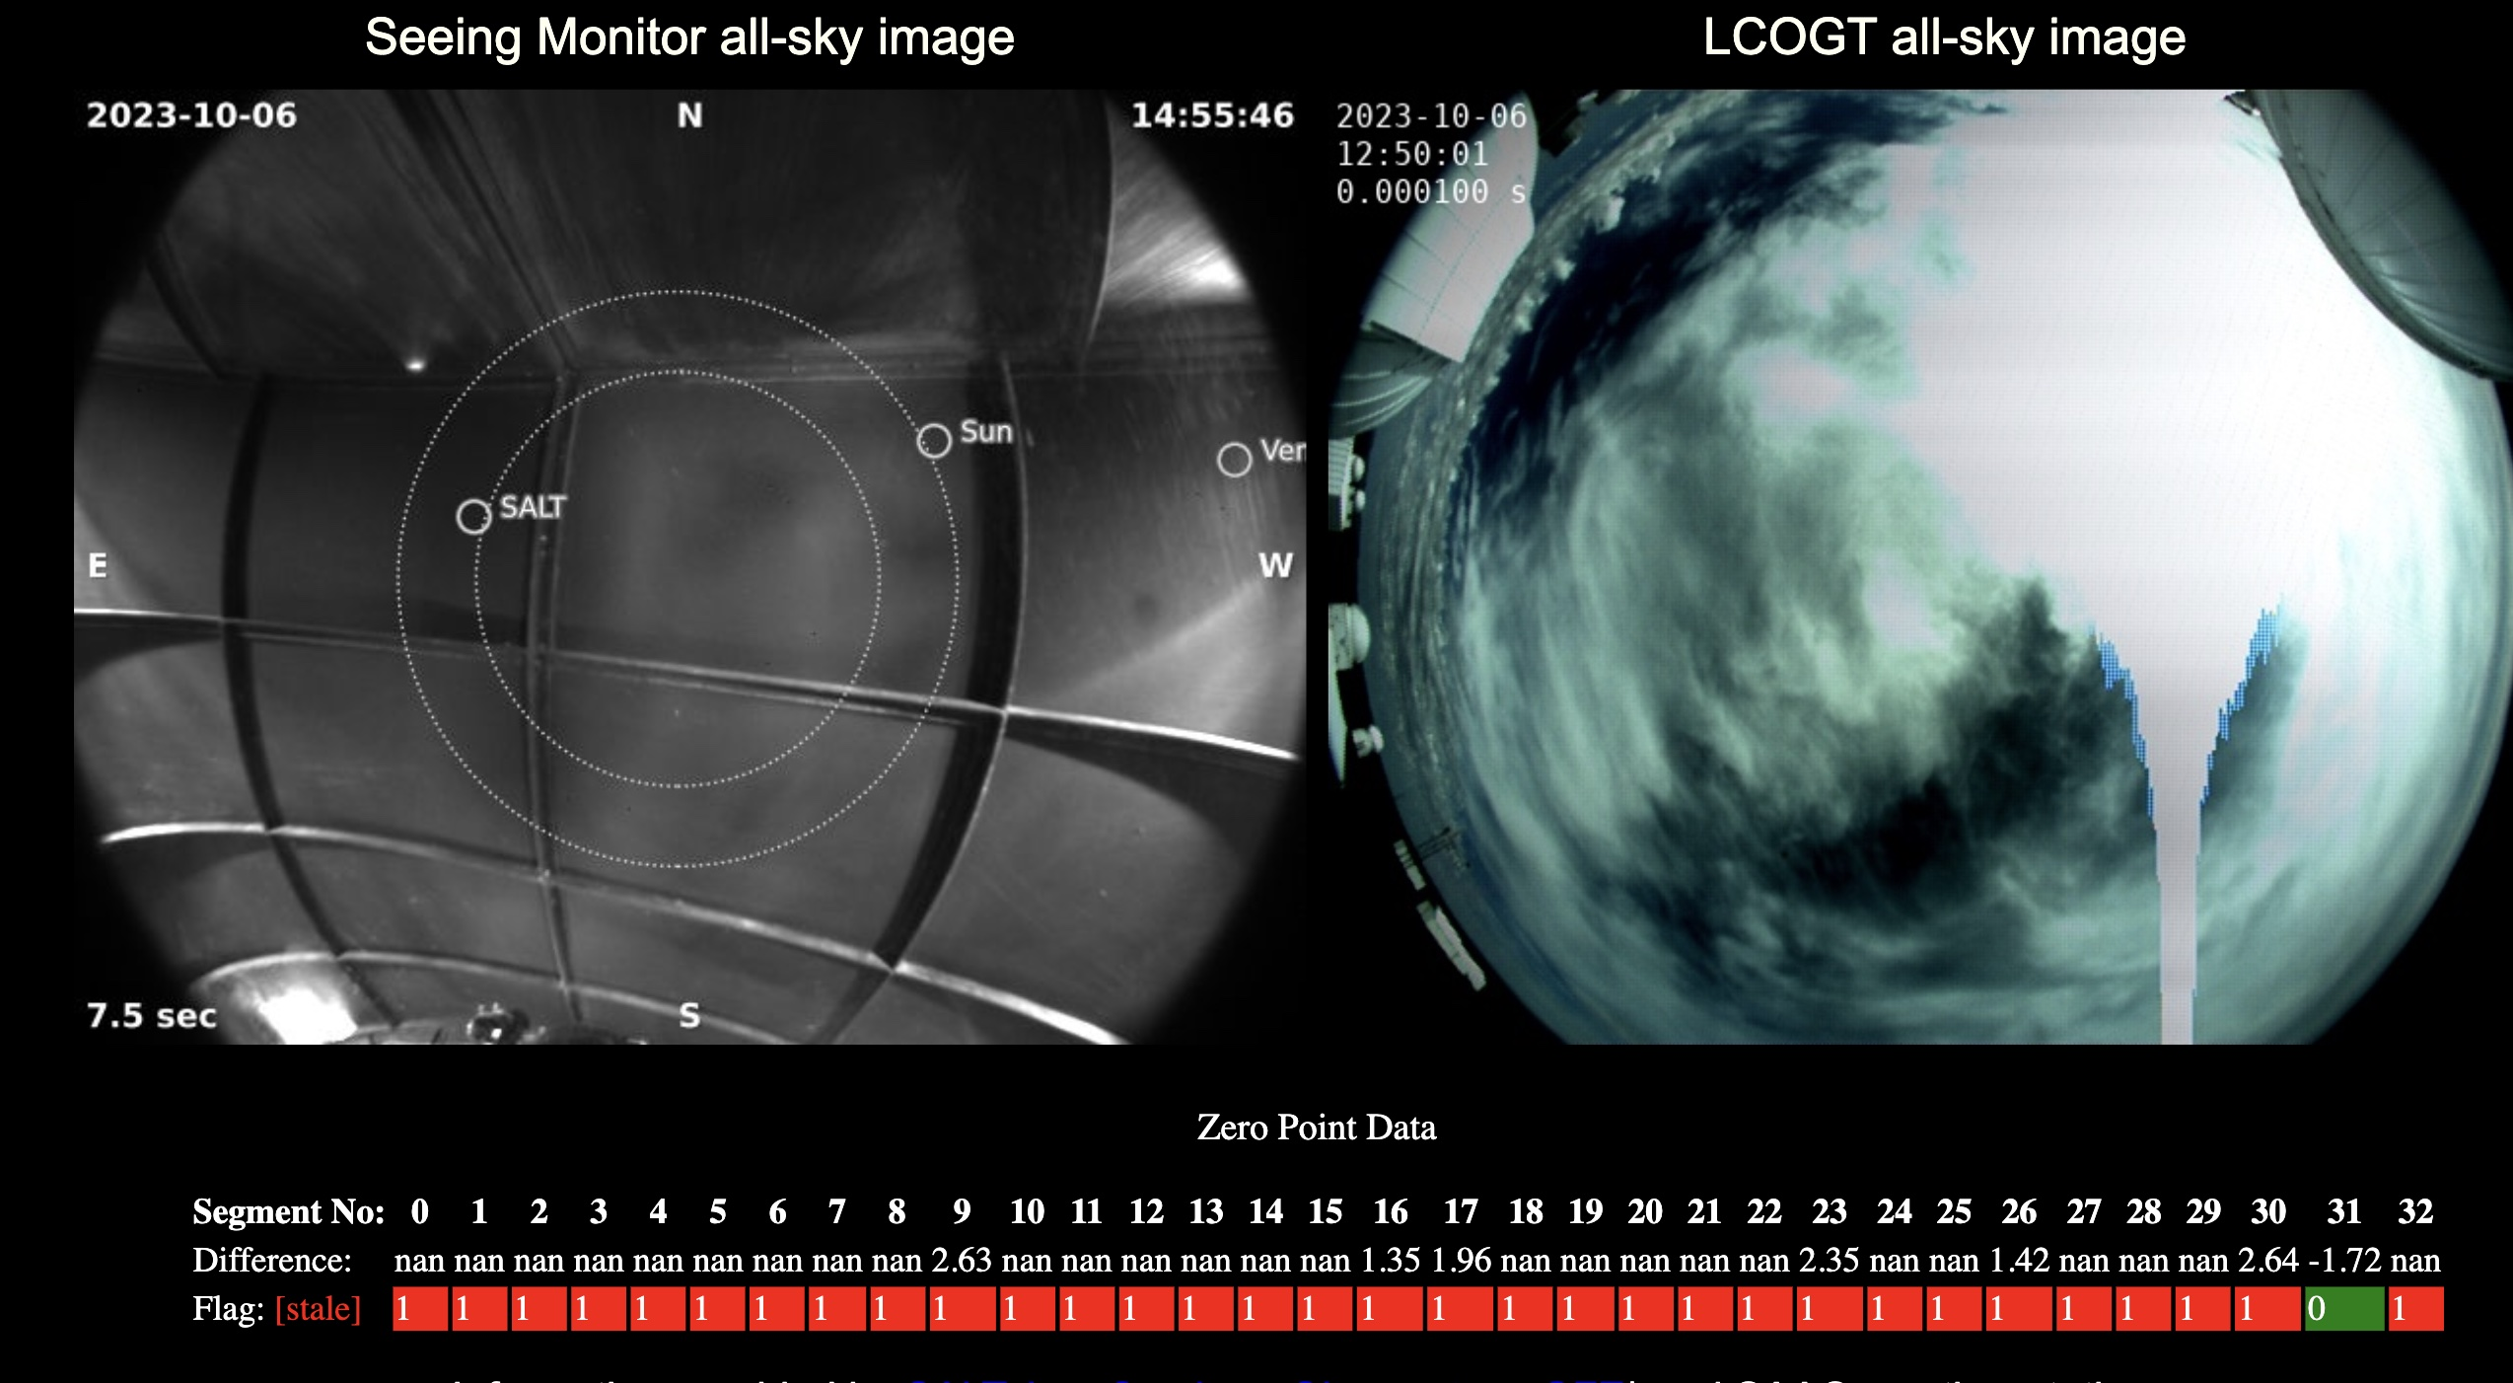

Slide 7
Sprint Updates
Non-sidereal spectroscopy
Biases and flats
OCS time accounting
Dashboard
Weather service
74inch instrument selector port

Slide 8
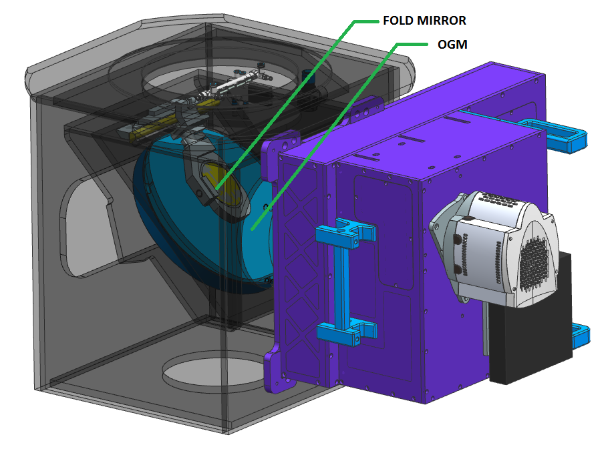
74inch instrument selector port

Slide 9
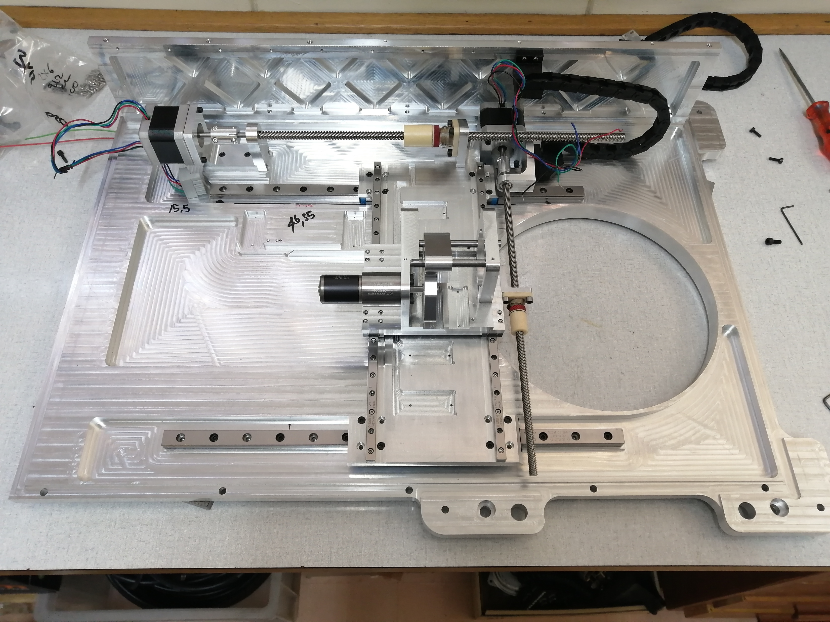

Slide 11
Upgrade highlights
- The new XYslides has a significantly larger sky access than the old system. Old system was limited to 10x10 arc mins. New one seems to be 15x15 arc mins
- The guide camera image quality is superior to the old one. Stars more round/symmetric for the whole XY slide search area
- The new lodestar guide camera has better sensitivity than the Ultrastar camera
- New XYslides move much faster than the old slides
- New guider focus mechanism is much more repeatable and much faster than the old system
- New guiding algorithm (python source extractor) appears to be better at guide star detection than the older algorithm
- XYslide coordinates are now mapped to DSS image coordinates .. so clicky clicky on guide star will automatically send XY coords to TCS
- So far no signs of relative flexure between slit and red box on guide camera ... more extreme slewing tests needed to test further

Slide 12
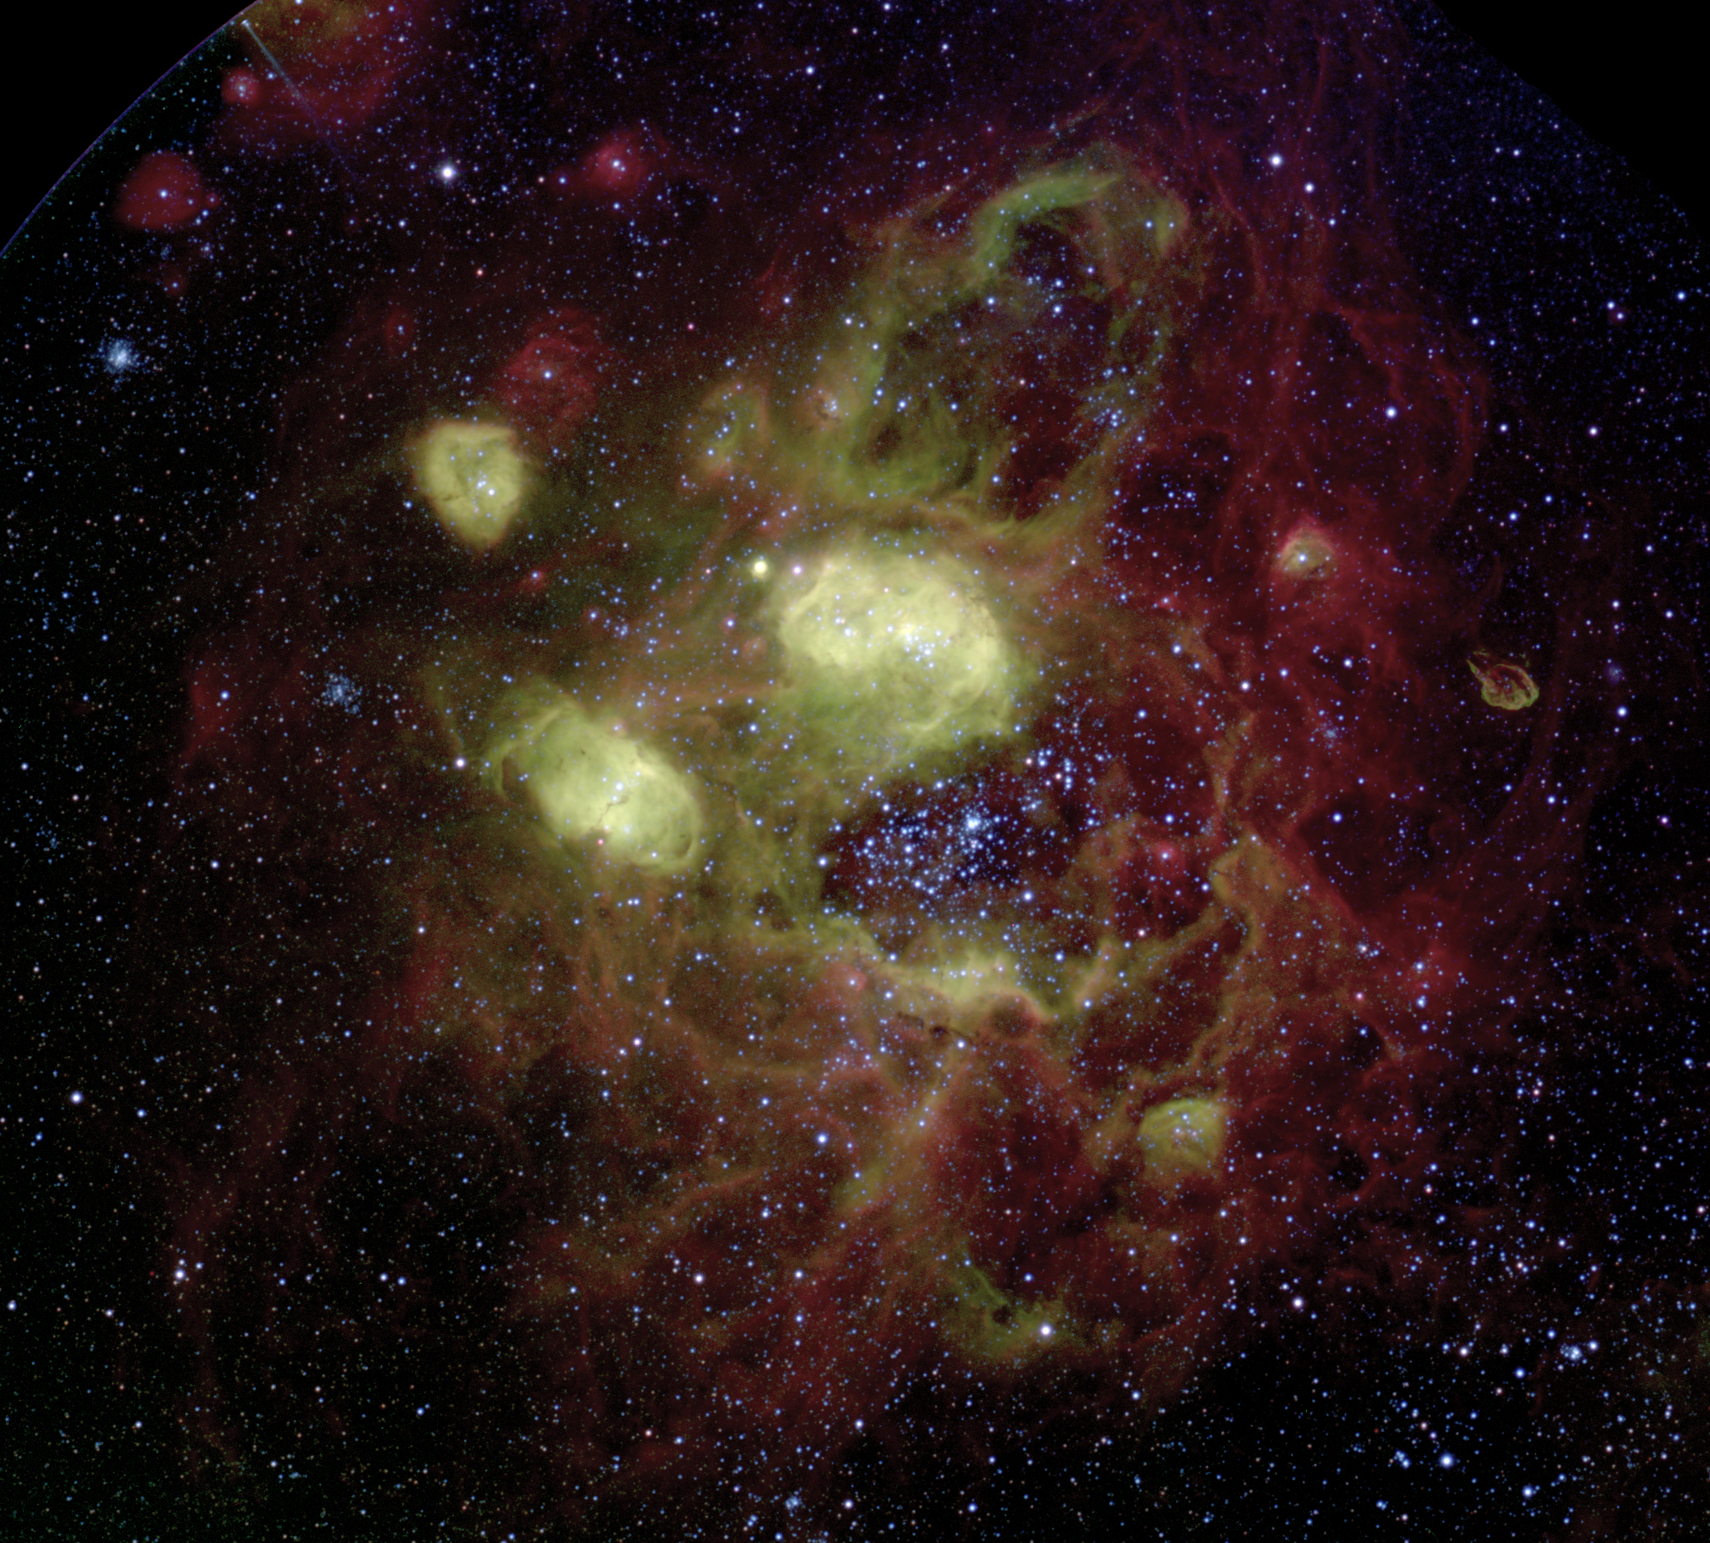
Conferences
HEASA2023
Gaia2023 alerts + ORP
ICALEPCS2023
BRICSAWG2023
AstroRob2023

